Slide 2
Agenda
Introduce Continuous Performance Management and SnapEval (5 min)
Logging into your SnapEval account (15 min)
SnapEval web portal
SnapEval mobile app
Using the SnapEval web portal (15 min)
Capturing & Sharing feedback
Receiving feedback
Dashboards
Using the SnapEval mobile app (5 min)
Voice-to-text dictation (Demo)
Introduce Performance Summaries (5 min)
Q&A and Homework Assignment (10 min)

Slide 3
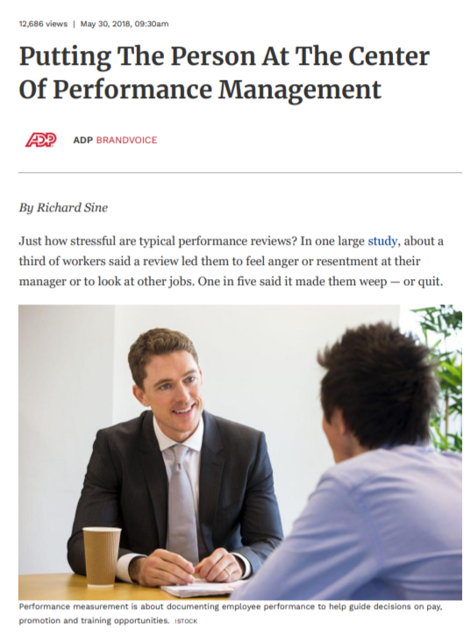
Performance Management is Undergoing Transformation
Annual reviews are usually dreaded by workers and bosses alike.
A growing number of companies are replacing or complementing annual performance reviews with more frequent coaching and measurement (‘Continuous Performance Management’).
‘Light-touch, nimble tools’ are emerging for Continuous Performance Management.
Key points from Forbes article interviewing
Jay Caldwell, Vice President of Talent Solutions,
Global Talent and Development, ADP, LLC.
https://www.forbes.com/sites/adp/2018/05/30/putting-the-person-at-the-center-of-performance-management/

Slide 4
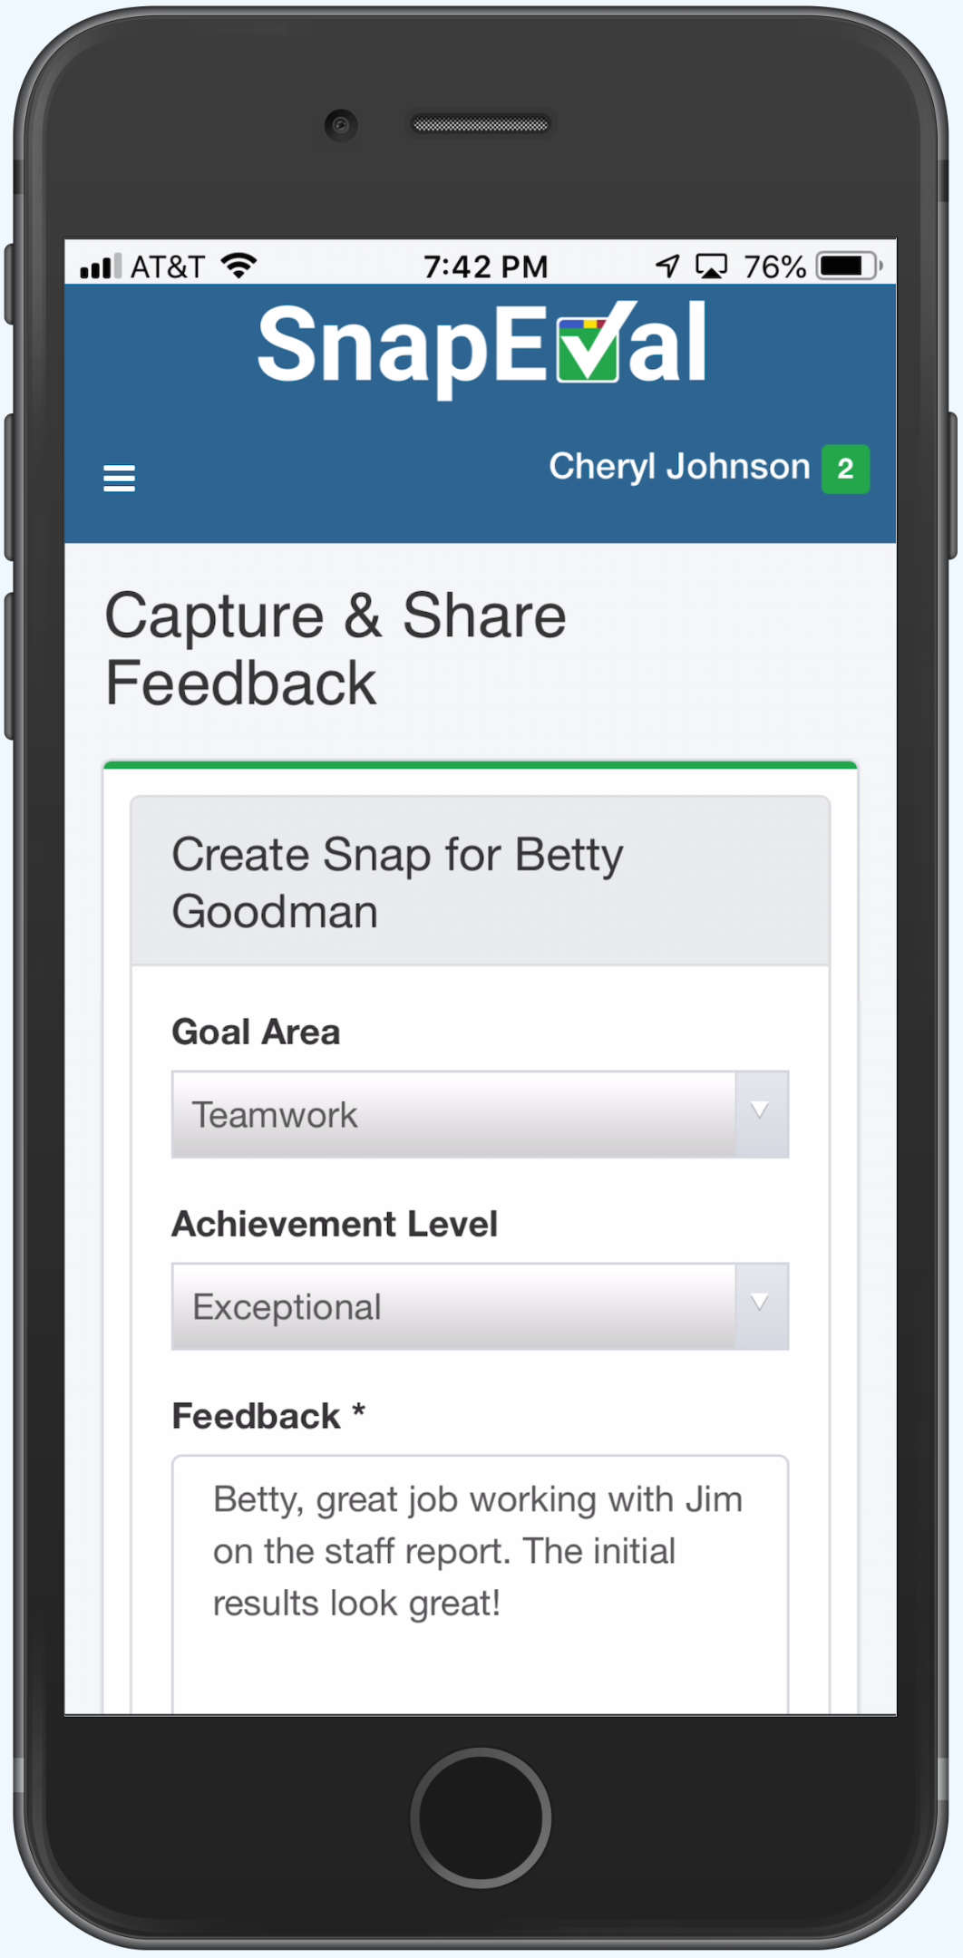
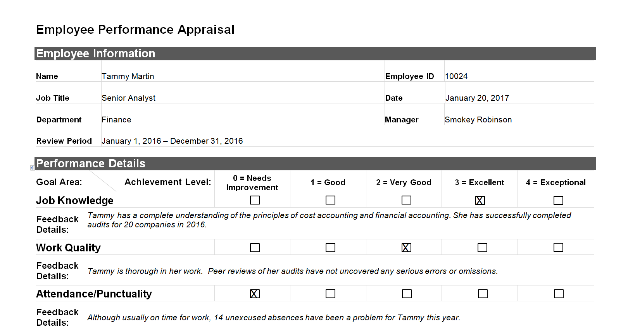
Traditional Performance Appraisal
Capturing Feedback (a ‘Snap’)
SnapEval

Slide 5
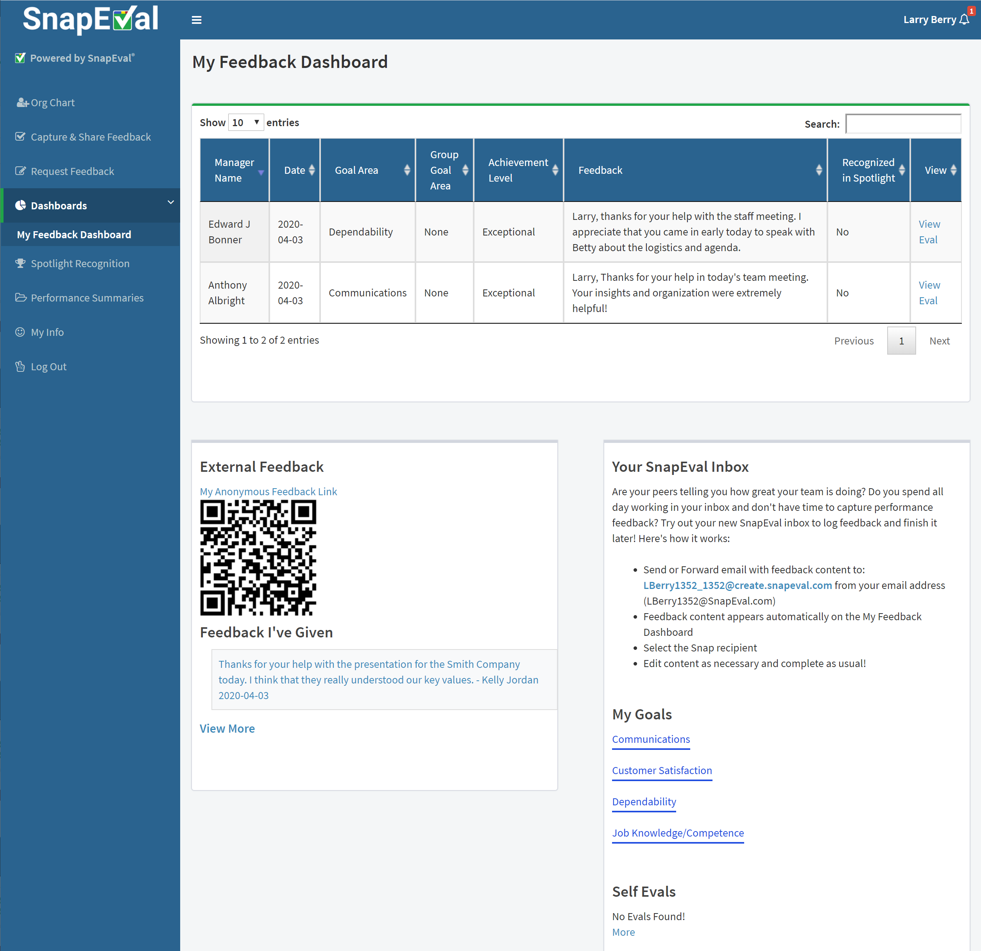
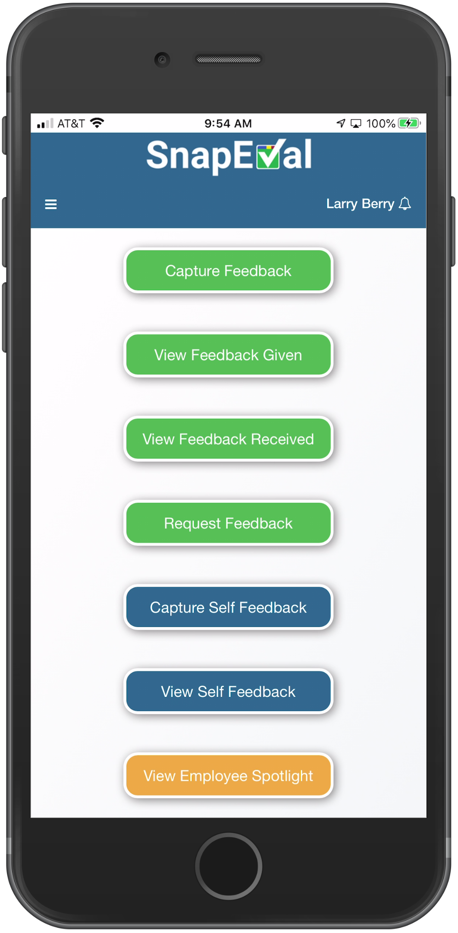
Logging into your SnapEval account

Slide 6
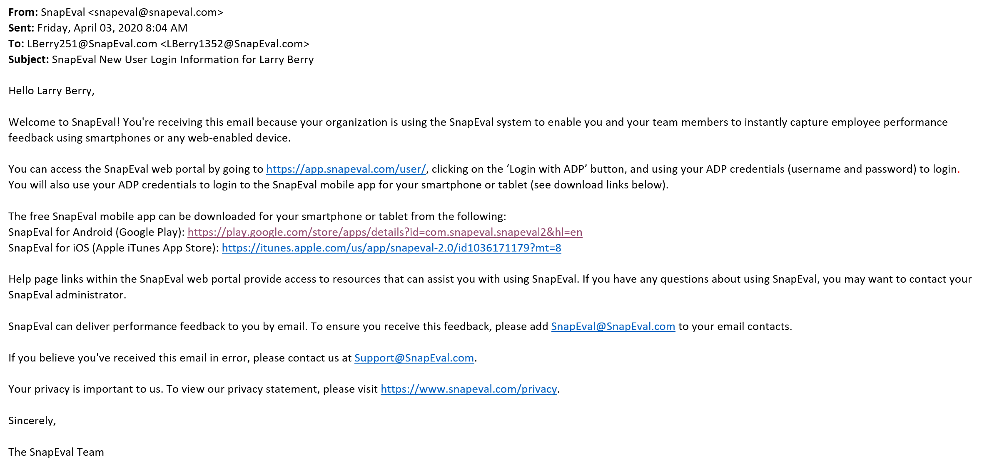
SnapEval Welcome Email
You automatically receive this Welcome Email when you’re assigned to SnapEval
Click on this link to login

Slide 7
Logging into the SnapEval Web Portal
1. Browse to SnapEval.com
2. Click Login button

Slide 8
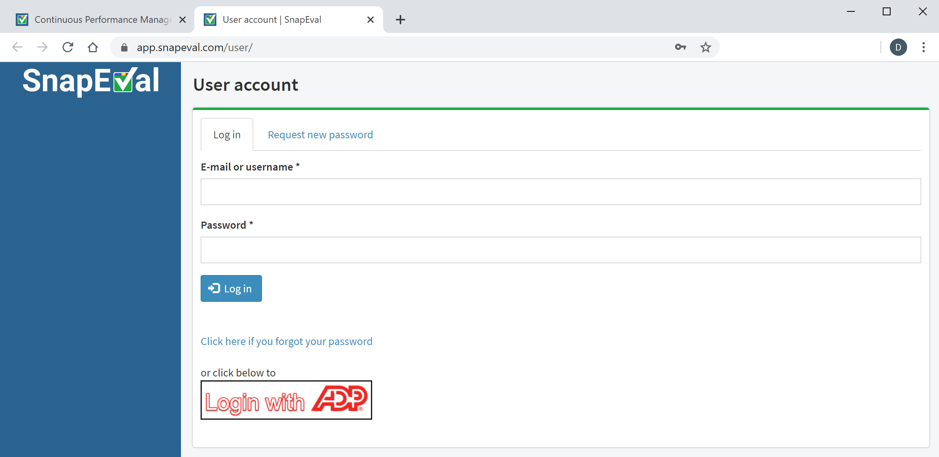
Logging into the SnapEval Web Portal
3. Click the ‘Login with ADP’ button

Slide 9
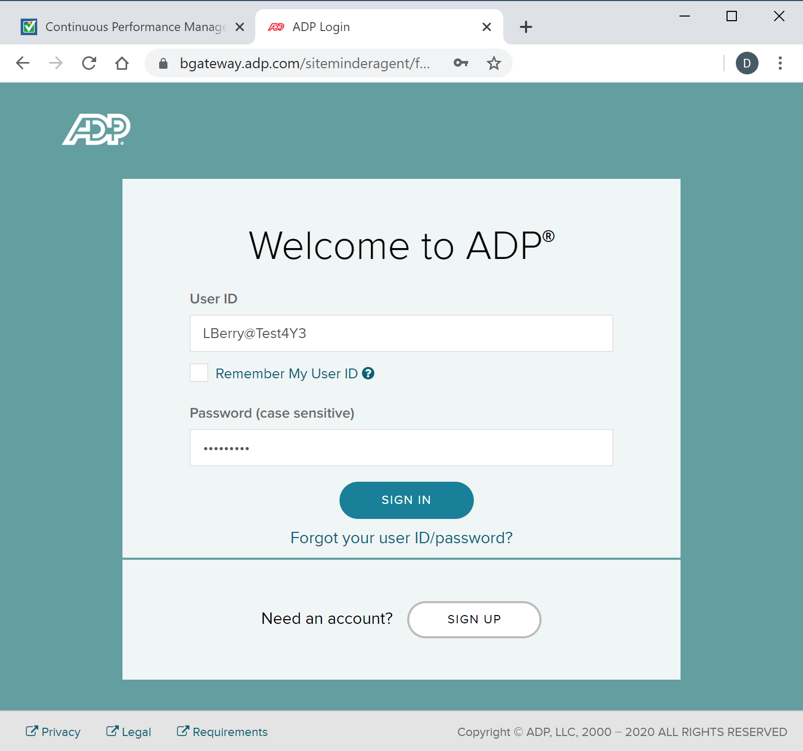
Logging into the SnapEval Web Portal
4. Enter your ADP UserID
5. Enter your ADP password
6. Click the ‘Sign In’ button
Click here to reset your ADP password if you’ve forgotten it.

Slide 10
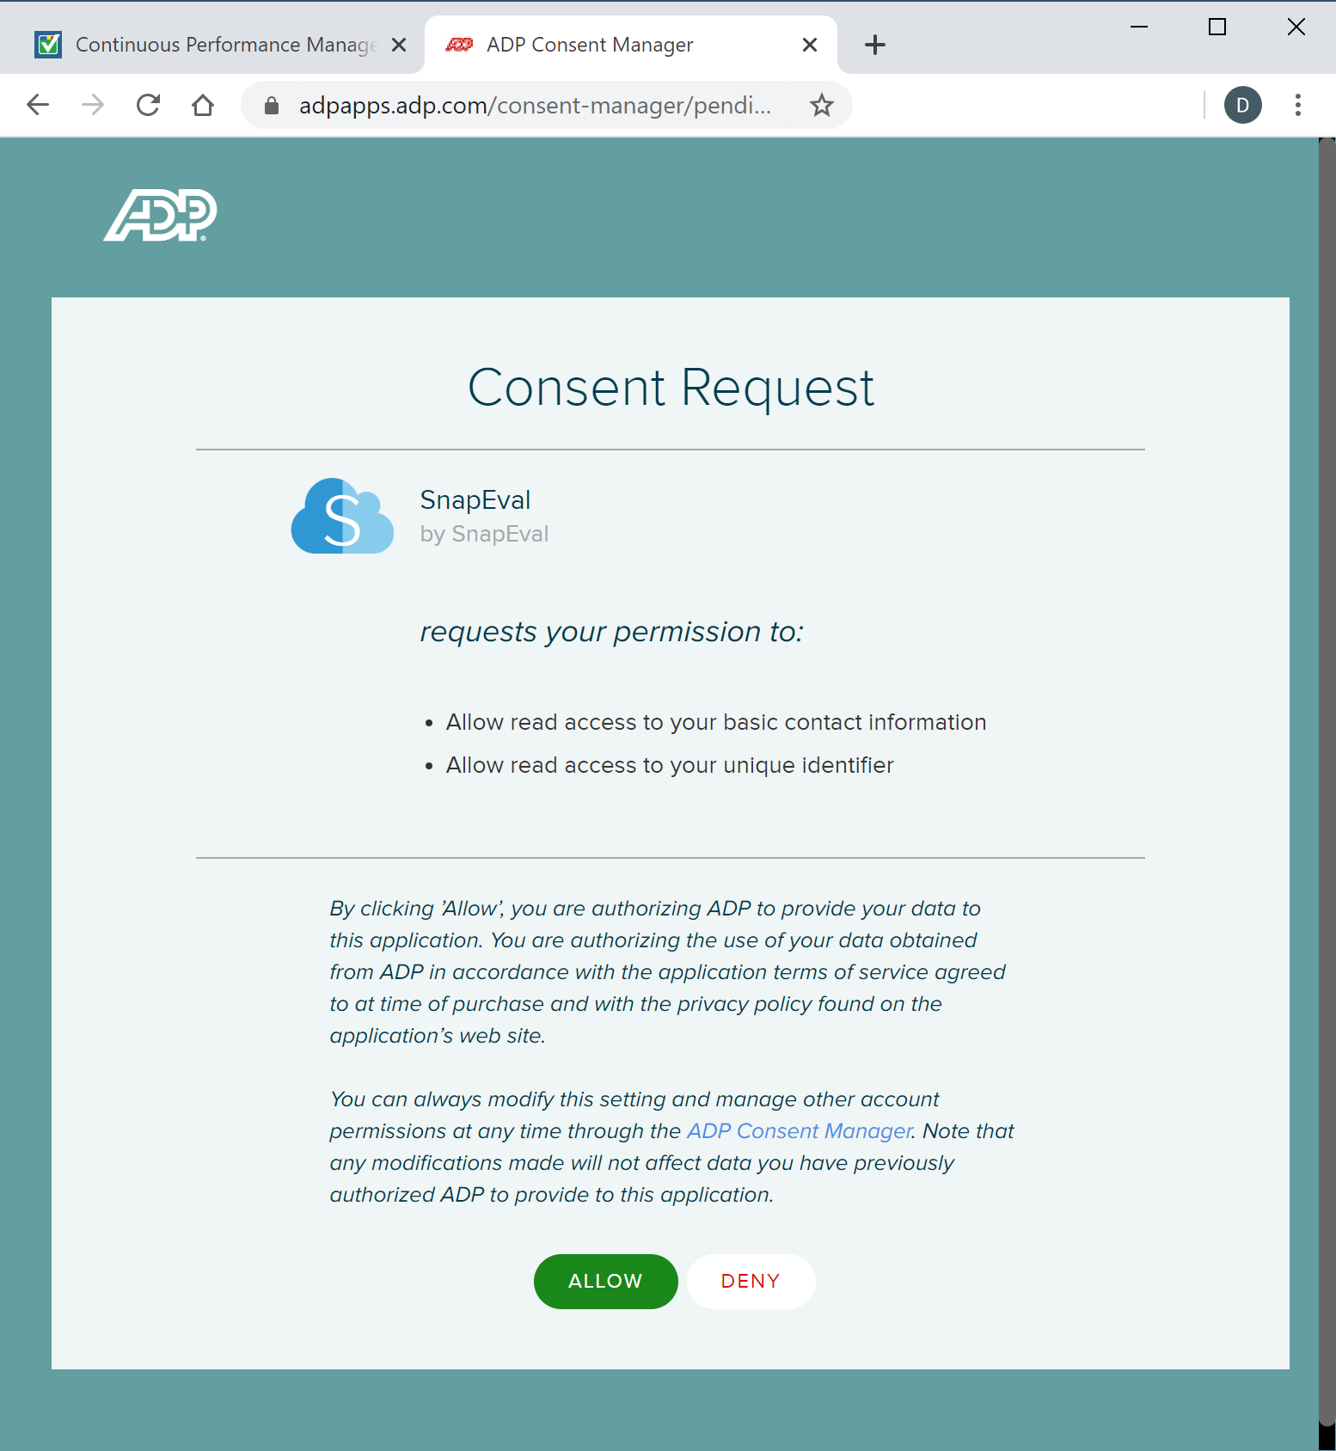
Logging into the SnapEval Web Portal
7. Click the ‘Allow’ button

Slide 11
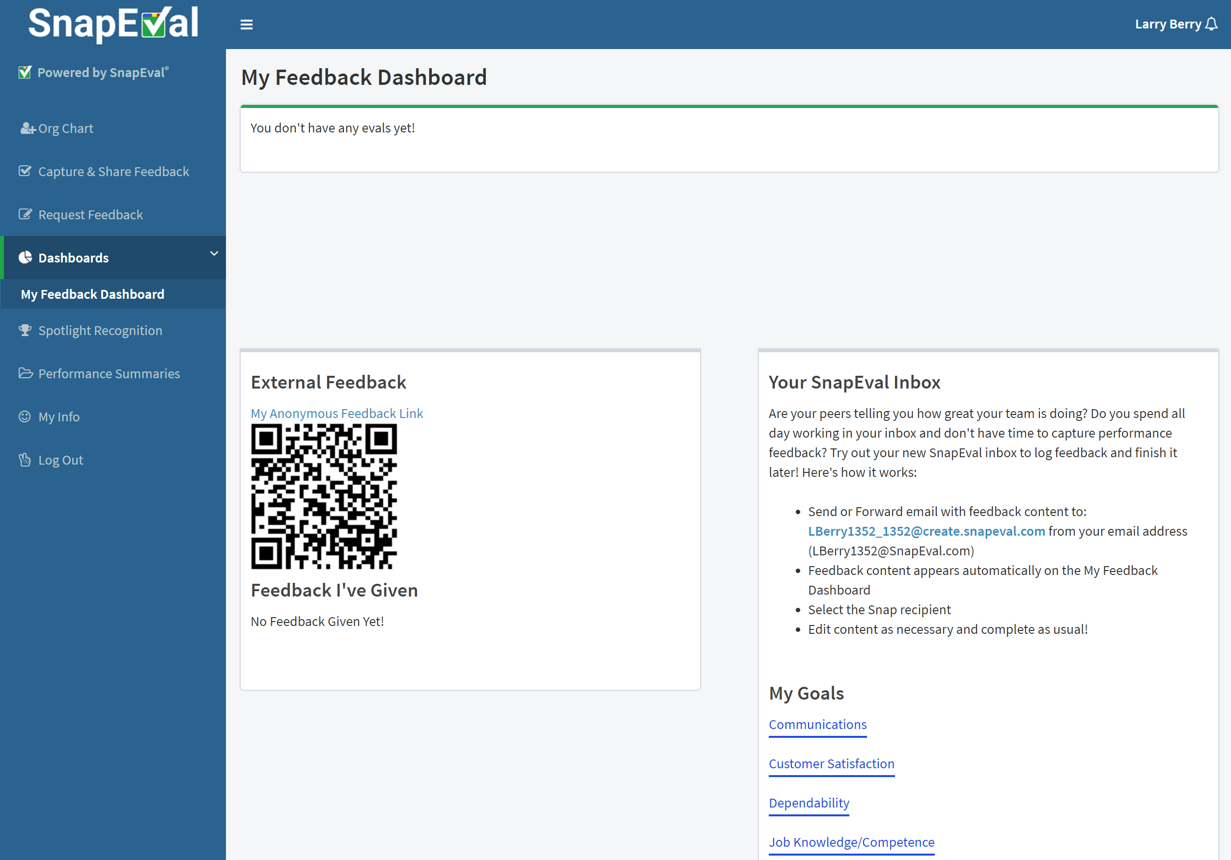
You’re logged in!
You’re logged in!
You can bookmark this page for fast access!

Slide 12
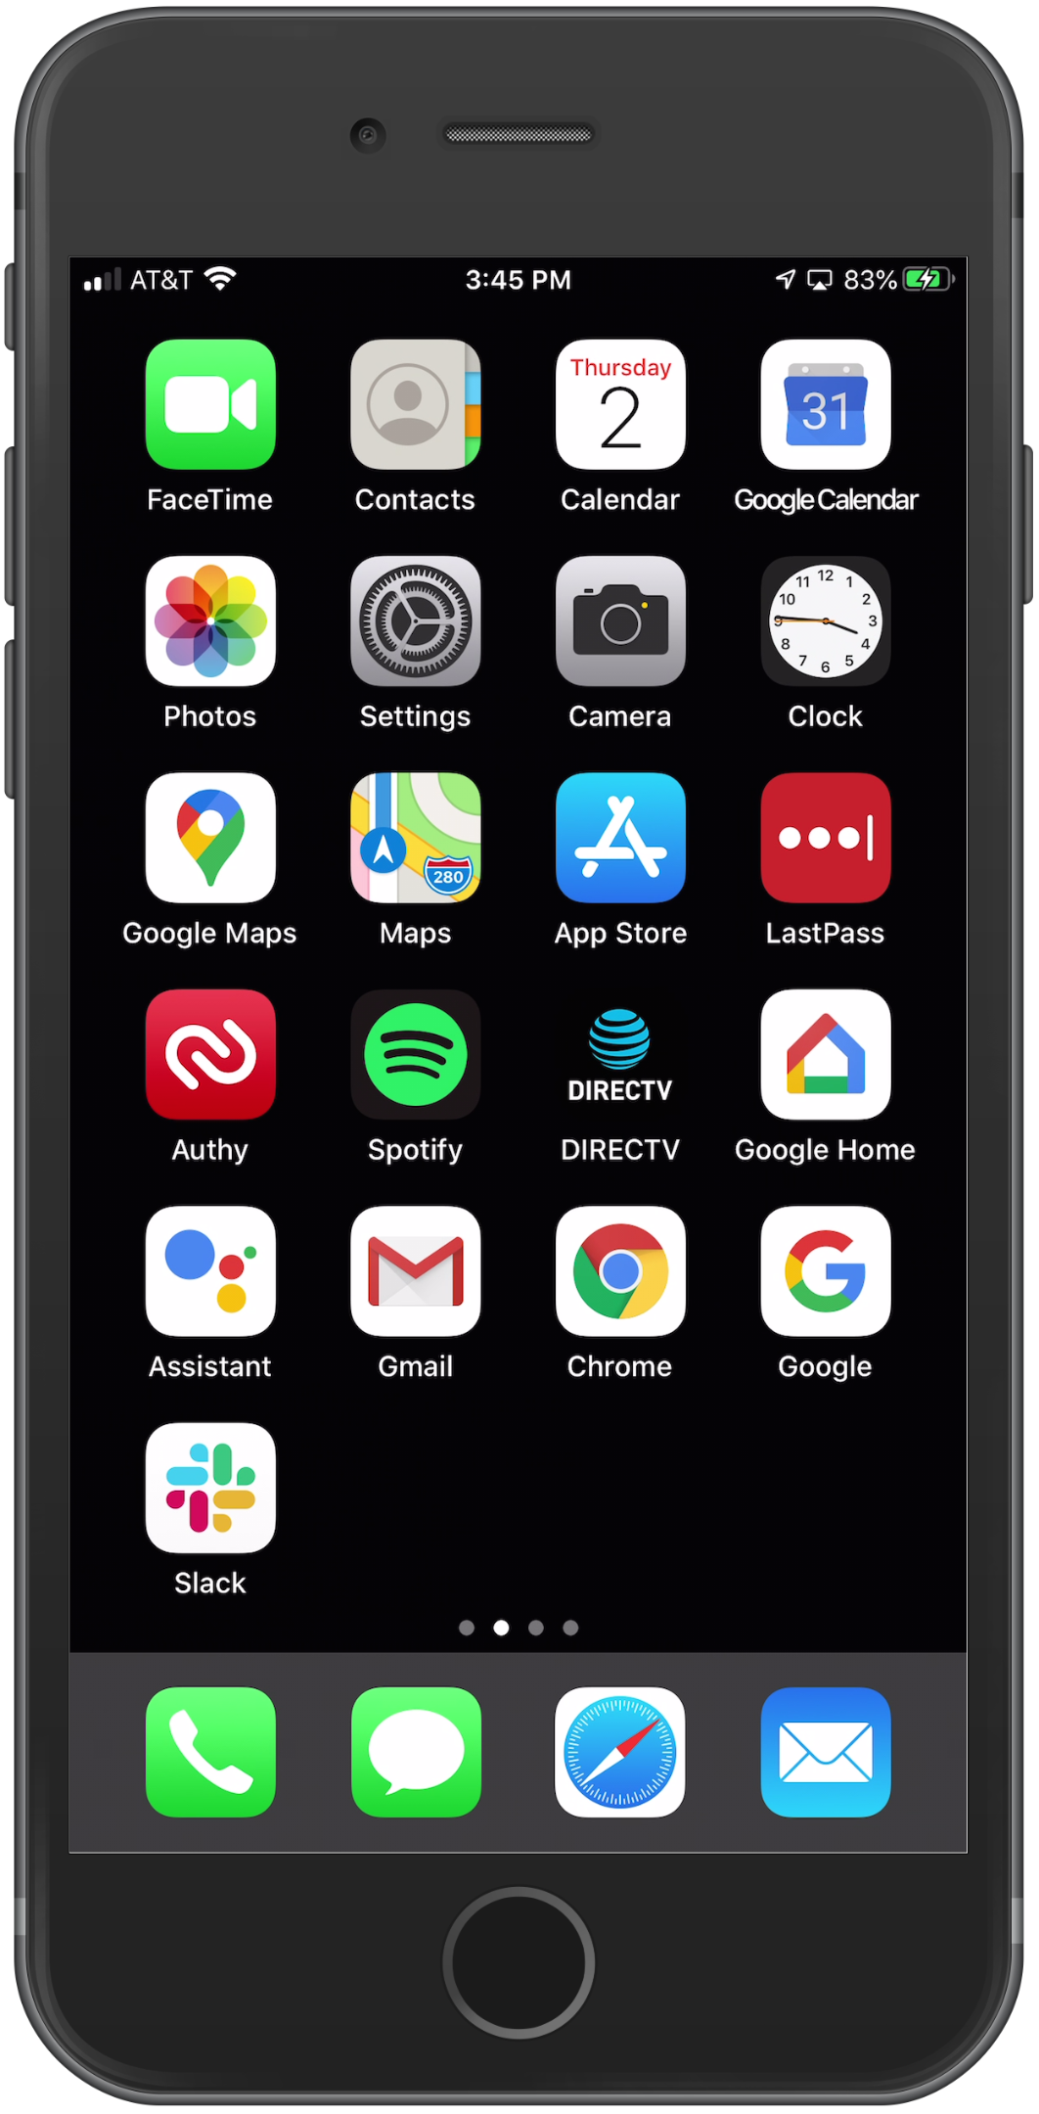
Logging into the SnapEval Mobile App
1. Open the Apple App Store/Google Play app

Slide 13
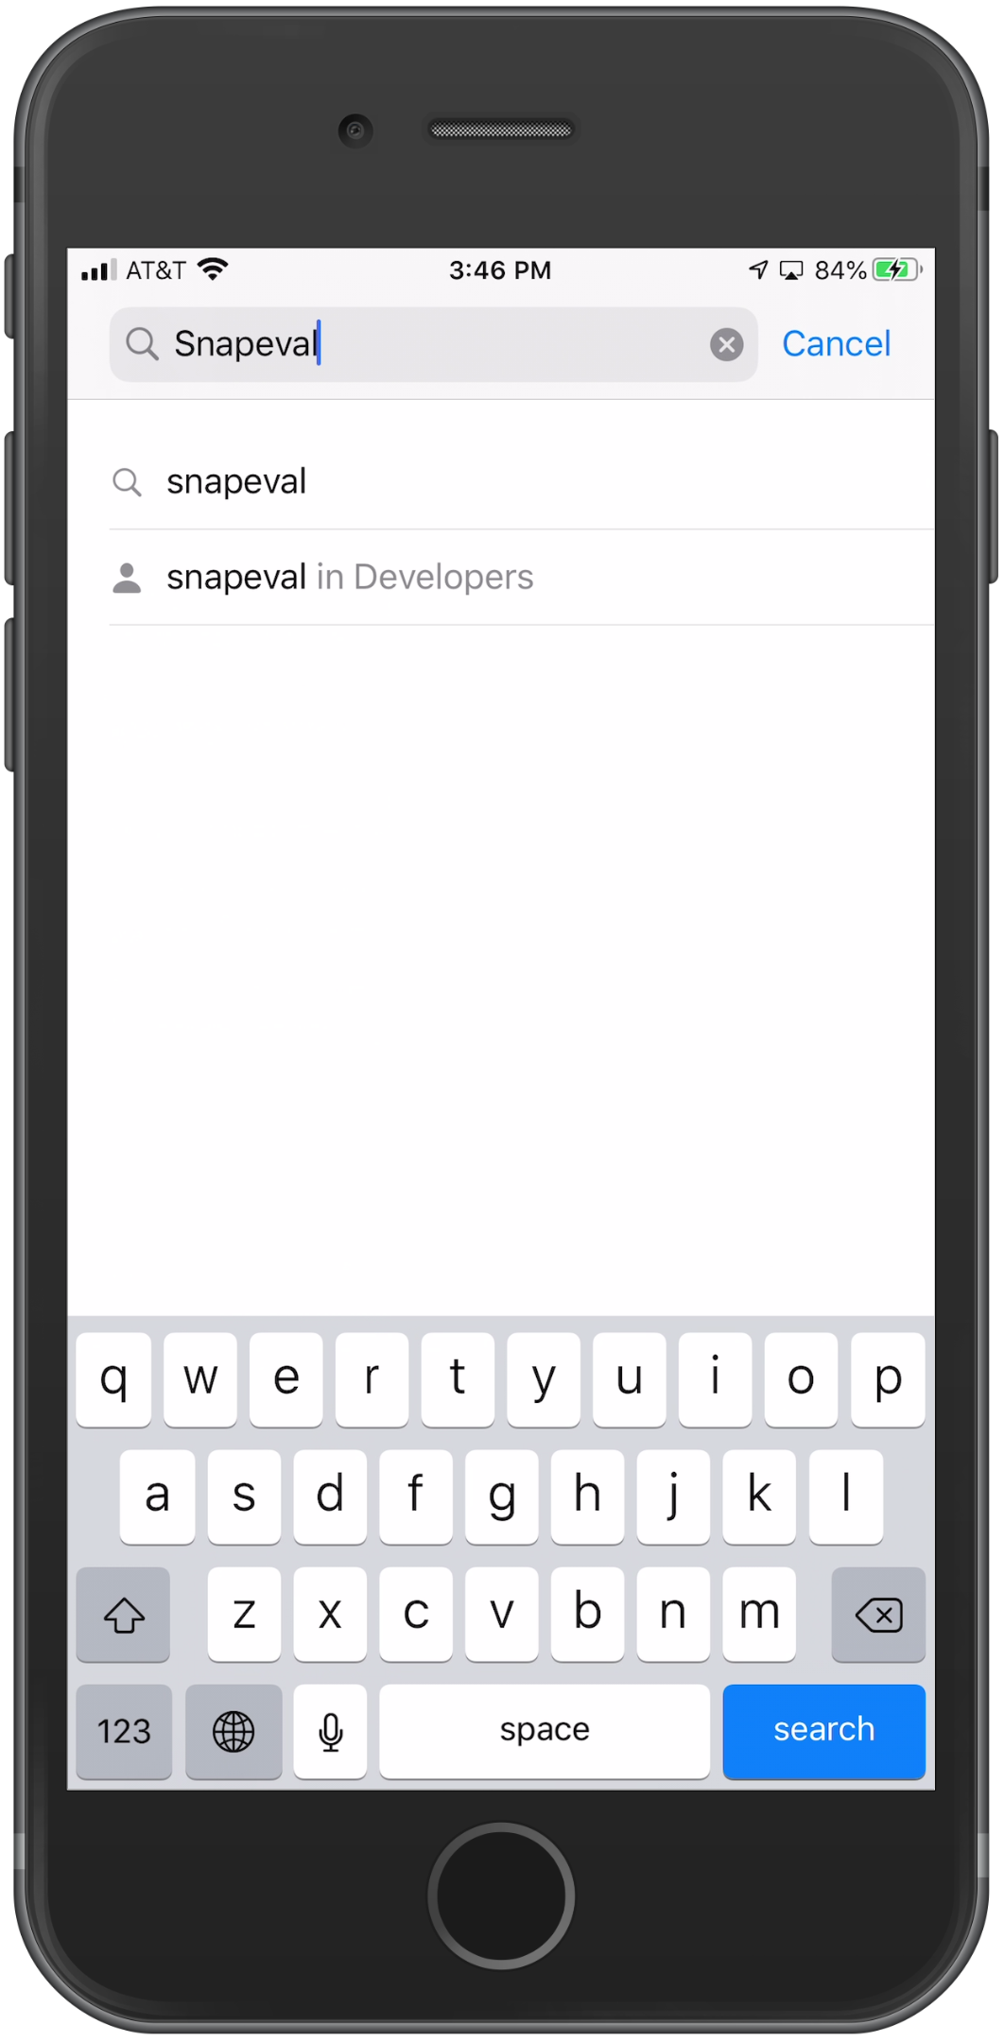
Logging into the SnapEval Mobile App
2. Search for and select SnapEval

Slide 14
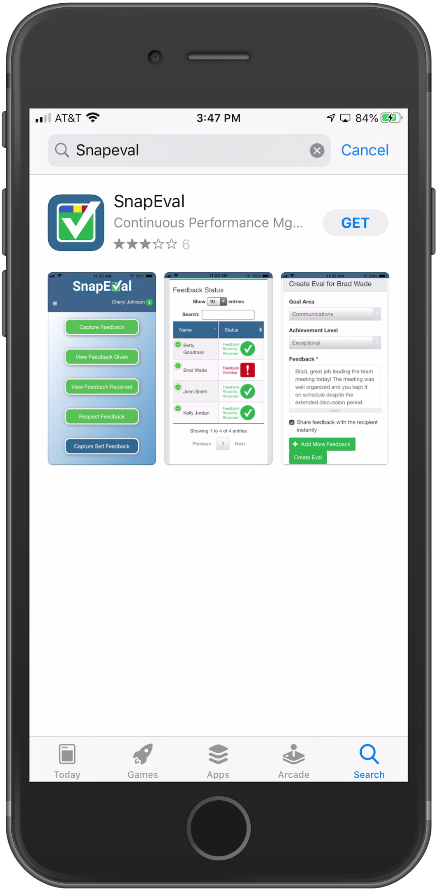
Logging into the SnapEval Mobile App
3. Select SnapEval (it’s free)

Slide 15
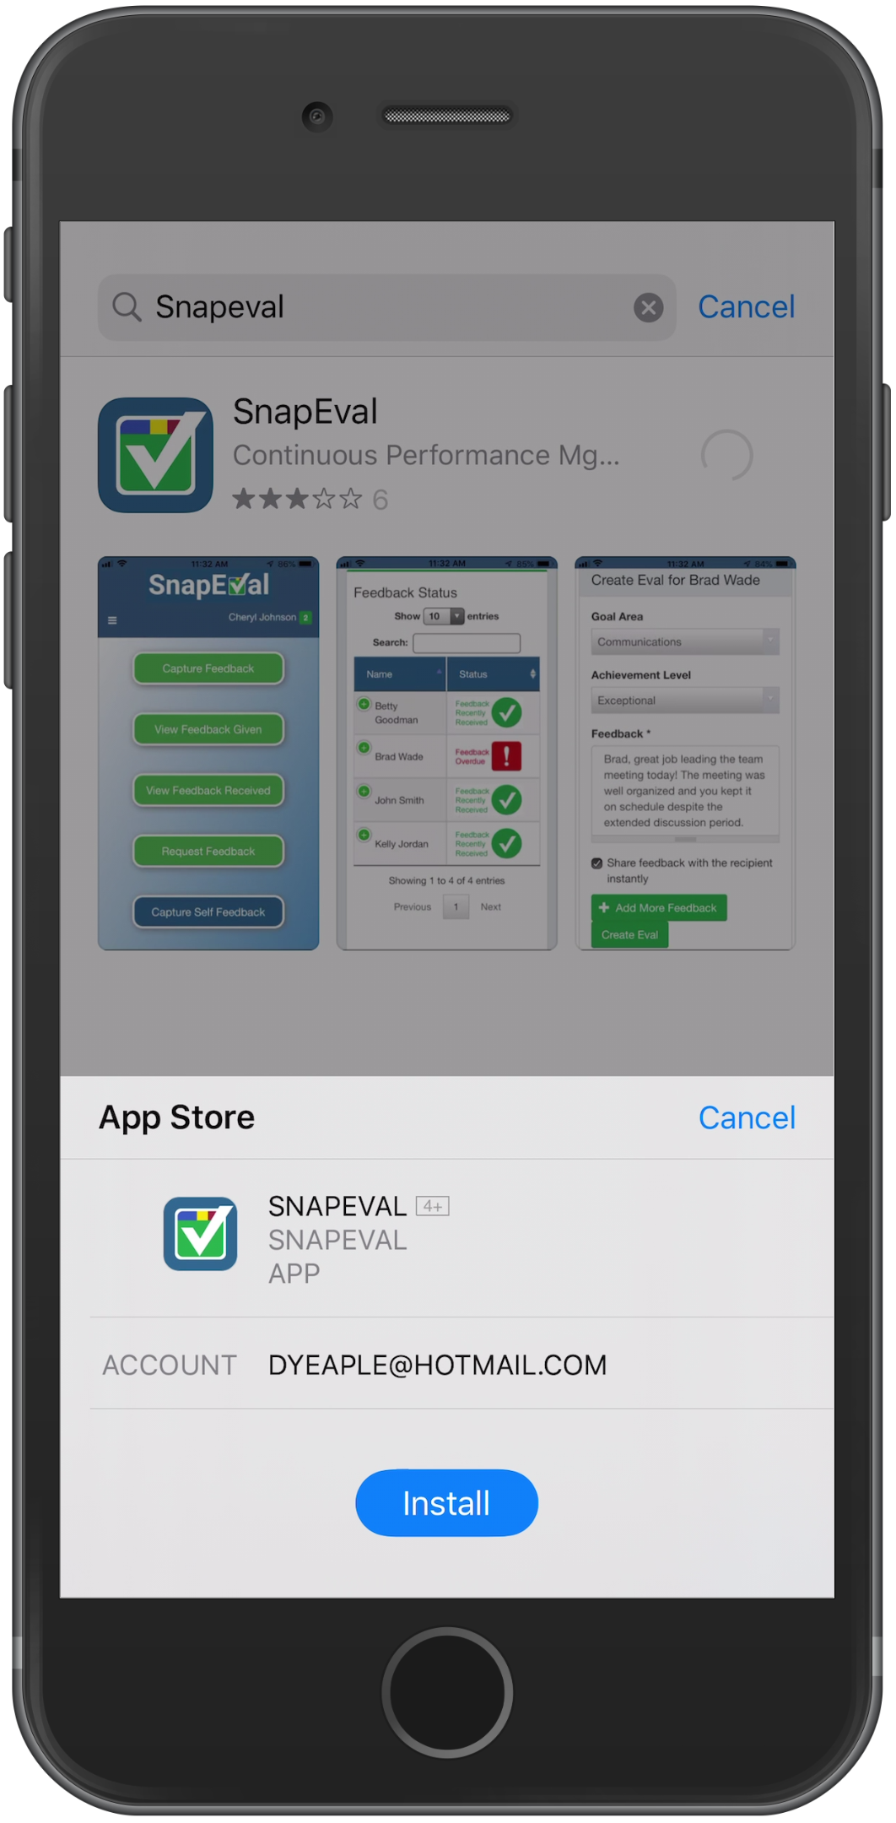
Logging into the SnapEval Mobile App
4. Install the SnapEval app

Slide 16
Logging into the SnapEval Mobile App
5. Open the app from the App Store/Google Play or by tapping the SnapEval icon on the smartphone home screen

Slide 17
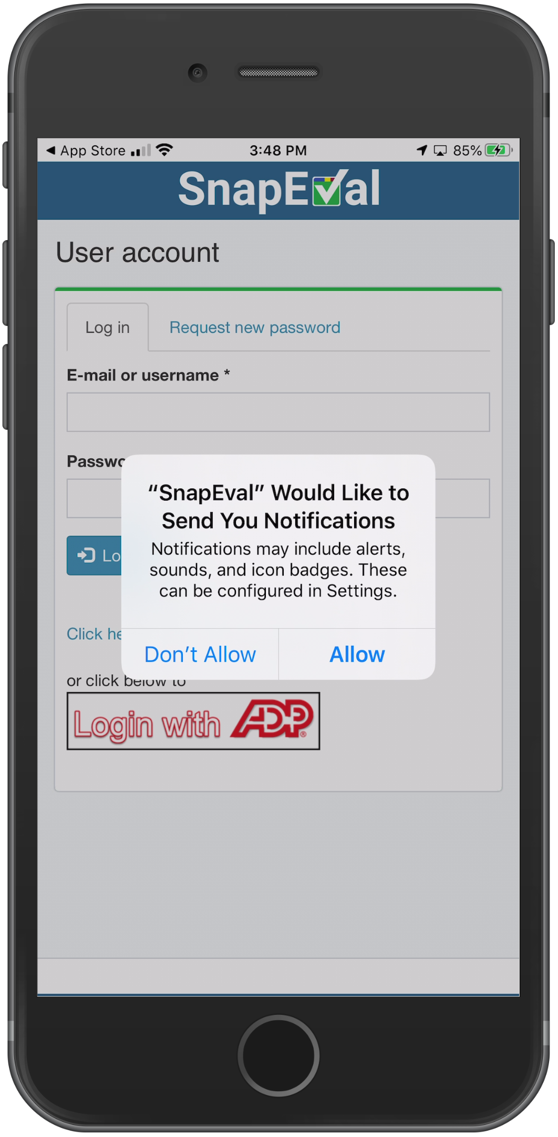
Logging into the SnapEval Mobile App
6. Allow SnapEval Notifications

Slide 18
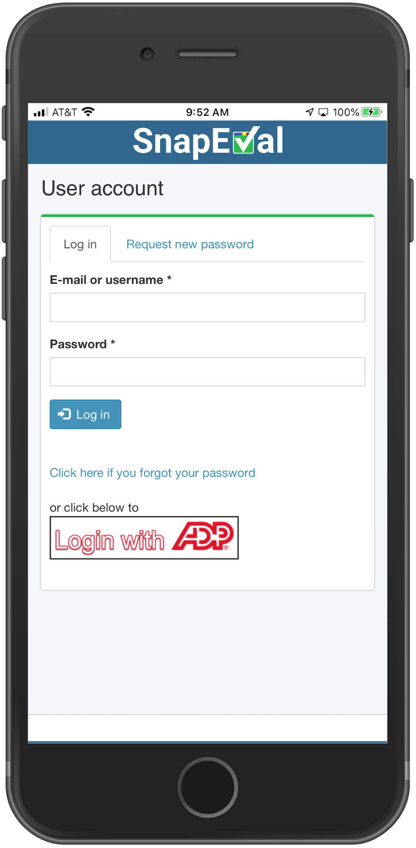
Logging into the SnapEval Mobile App
7. Click the ‘Login with ADP’ button

Slide 19
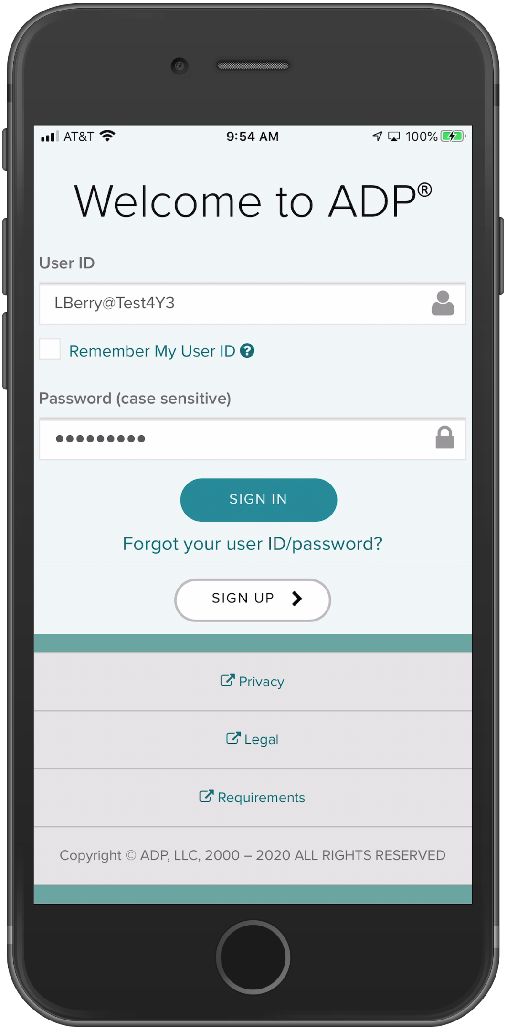
Logging into the SnapEval Mobile App
8. Enter your ADP UserID
9. Enter your ADP password
10. Click the ‘Sign In’ button
Click here to reset your ADP password if you’ve forgotten it.

Slide 20
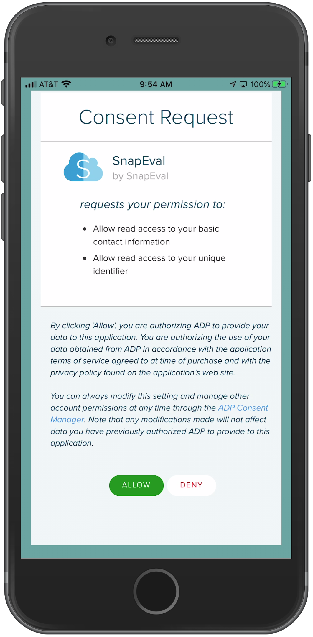
Logging into the SnapEval Mobile App
If you haven’t already logged into the SnapEval web portal and accepted the ADP Consent Request, you’ll be prompted to do so now.
11. Click the ‘Allow’ button to continue

Slide 21
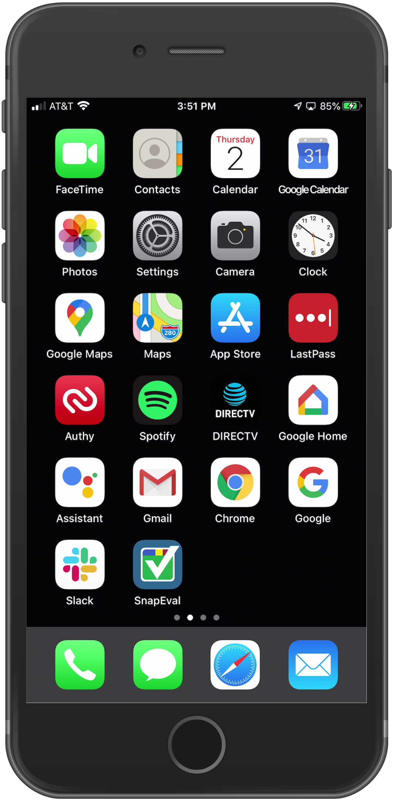
Logging into the SnapEval Mobile App
You’re logged in!
You won’t need to login again.
Now…
Close the app
Restart your smartphone
Use the SnapEval icon to open the mobile app!
These steps register the SnapEval mobile app with the SnapEval push notification service.

Slide 22
Using the SnapEval Web Portal

Slide 23
SnapEval Roles: User, Manager, Group Administrator
All individuals are ‘Users’ when added to SnapEval
When Subordinate(s) are assigned, a User also receives the ‘Manager’ role
Defines ‘who can give feedback to whom’
Can be augmented with 360-degree feedback enabled (anyone can give feedback to anyone)
A Manager can only view Snaps that the Manager gives to a Subordinate + Subordinate’s Self-Snaps
A ‘Group’ is a collection of Users (e.g. a department, team, job function, etc.)
Managers are often also assigned as ‘Group Administrators’
A Group Administrator can view all Snaps that members of the group give or receive
User 1
Manager
Group Administrator
User 2
User 3

Slide 24
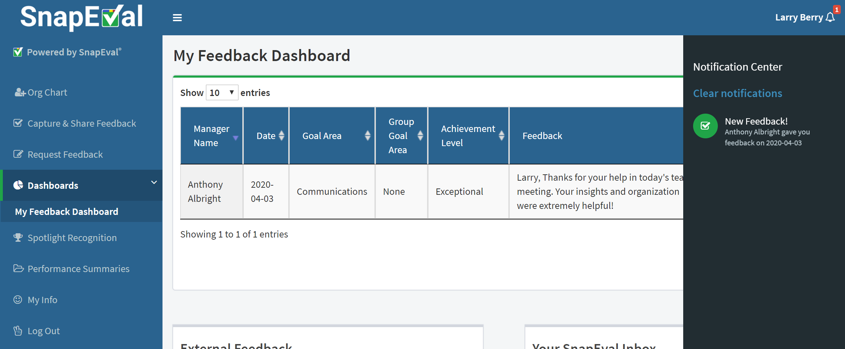
SnapEval Web Portal Features
Click to go to home page
Click to expand or minimize Navigation Menu
Click to open Notification Center
Click on a Notification to view or take action
Navigation Menu
Links vary by role.

Slide 25
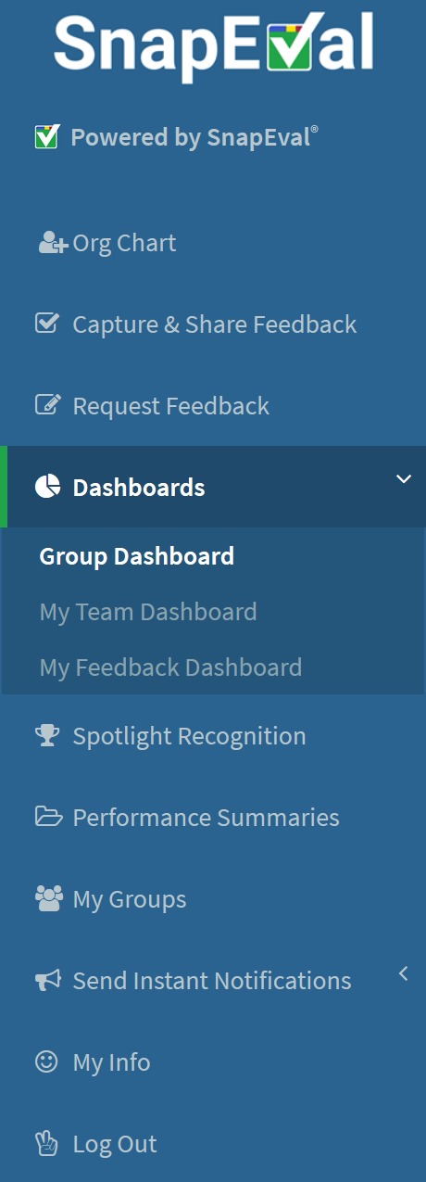
SnapEval Web Portal Navigation Menu
Go to home page
View Org Chart
View and manage performance of your assigned group(s) [e.g. Department(s)]*
Capture & share feedback for yourself or others
Request feedback from others
View and manage feedback you’ve given and received
View and manage performance of your assigned team member(s) [e.g. Employee(s)]**
Create & view Performance Summaries
Sent custom push notifications to others’ smartphones*
View Recognition of Performance Excellence
View details about your assigned group(s) [e.g. membership, goals]*
Your info/ADP Marketplace
*Group Administrators Only
**Managers Only

Slide 26
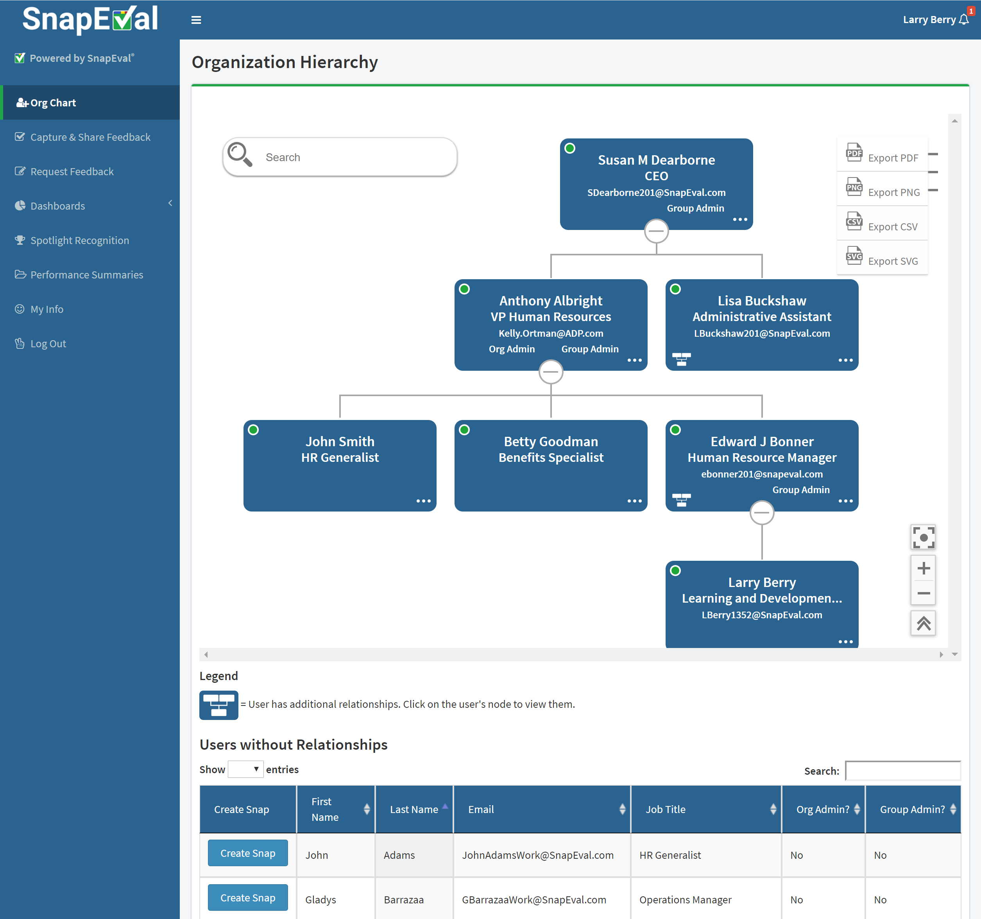
Org Chart (All Users)
Search for a user
Export Org Chart data
View user details (click on node)
User has additional relationships (click on node for details)
User has Group Admin Role
Change Org Chart size/view
Create Snap (click on …)
Users without relationships

Slide 27
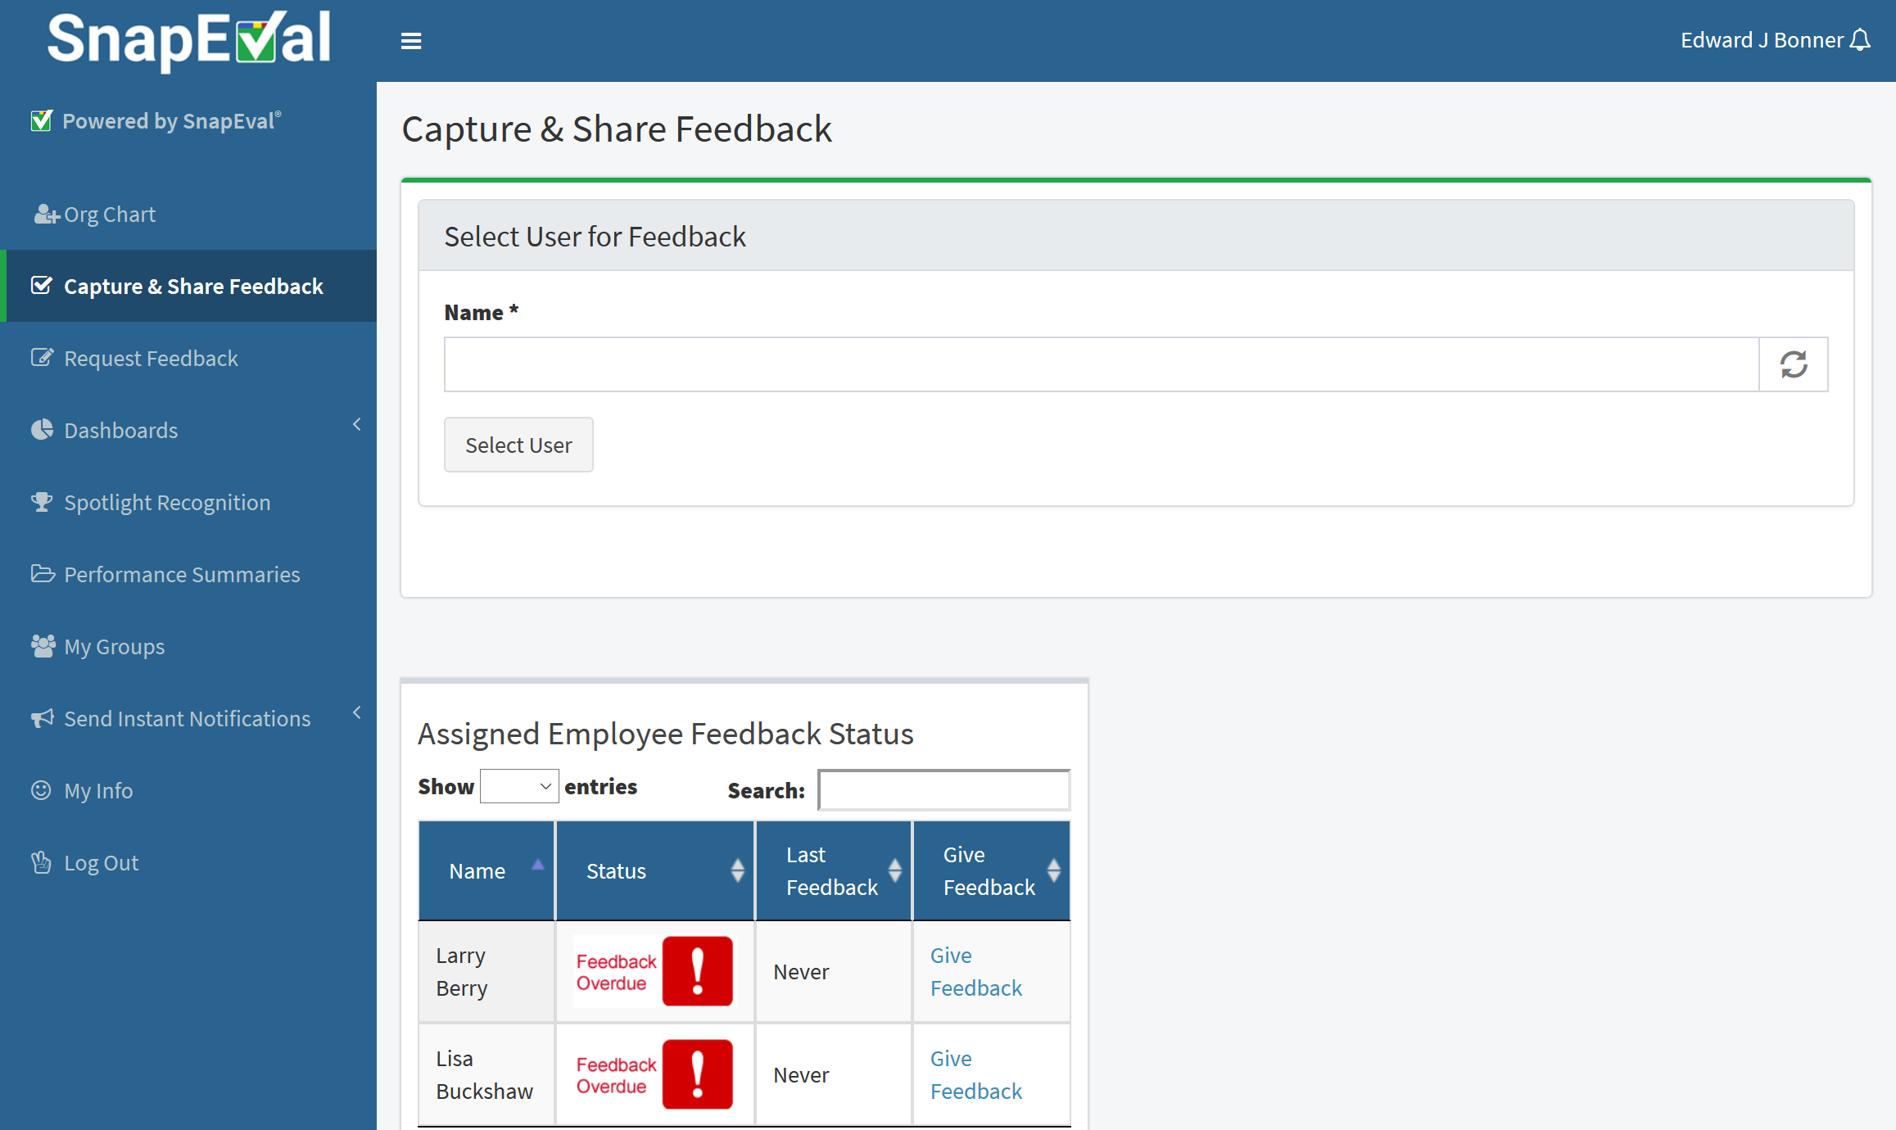
Select a User to Give Feedback to (All Users)
Type any letter(s) of a user’s name and click ‘Select User’ to give feedback. Enter your own name for self-feedback.
Or, select an assigned team member to give feedback to*
*Managers Only

Slide 28
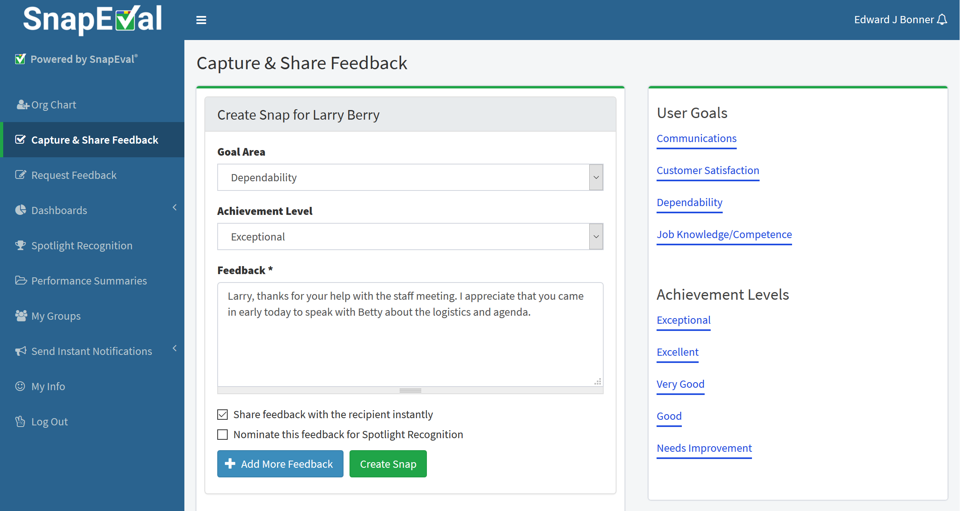
Capture and Share Feedback (All Users)
Select a Goal Area
Select an Achievement Level
Add text note providing feedback details
Share instantly or defer sharing and save as ‘draft’
(Optional) Nominate the feedback for Recognition of Performance Excellence (if enabled)
Capture multiple Snaps for this user
Click ‘Create Snap’ button

Slide 29
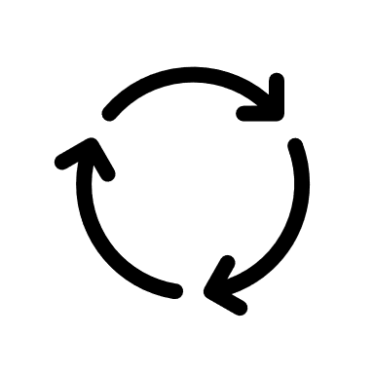
Communicating feedback using Snaps
Instantly Create a Snap
Capture feedback when thinking of or observing performance so it isn’t forgotten
Use any computer, tablet or smartphone
Voice-to-text support in mobile app. No typing required!
Immediately share the Snap
Perfect for ‘thank you’ or acknowledgement
Recipient receives email, push notification
Recipient can view Snap in web portal and mobile app
Defer sharing the Snap
Ideal for a developmental Snap
No email or notification to recipient
Recipient cannot view Snap in web portal or mobile app
Snap Creator can edit Snap prior to sharing (e.g. after in-person discussion with recipient)
Share after the discussion to document the developmental feedback
Never share the Snap
Useful for taking notes about an employee
Unshared Snaps cannot be viewed by recipient, even if recipient is a Manager or Group Administrator
Unshared Snaps can be viewed by Organization Administrators and non-recipient Group Administrators

Slide 30
Performance Management & Performance Recognition
Performance Management and Performance Recognition are separate processes
Feature | Action
Feedback Creator (Manager)
SnapEval Administrator
(HR Professional)
Feedback Recipient (Employee)
Performance
Feedback Queuing Enabled
Feedback that meets predefined criteria is automatically queued for review by SnapEval Administrator before delivery to Feedback Recipient.
Performance
Feedback Queuing Disabled
All feedback is delivered directly to Feedback Recipient without review by SnapEval Administrator
Submit Snap Content
Inappropriate
Language¹?
Meets Queuing Criteria²?
No
No
Shared?
Yes
Feedback Received*
Performance Management
No
Yes
*Feedback is visible only to employee, employee’s manager(s), and SnapEval Administrators
Email notification
Yes
Hold until Shared
Queued for Review
End
Feedback can be nominated for recognition of performance excellence.
Everyone in Organization
Spotlight Performance Recognition Enabled
Feedback cannot be nominated for recognition of performance excellence.
Spotlight Performance Recognition Disabled
Nominated for Spotlight recognition?
Nomination Reviewed
Yes
Accepted
Recognition Published**
Performance Recognition
**Recognition is visible to everyone in organization through Spotlight Recognition Dashboard
No
Declined
End
End
¹Automatic, built-in dictionary of 400+ unacceptable words
²Administrator configurable organization-specific criteria

Slide 31
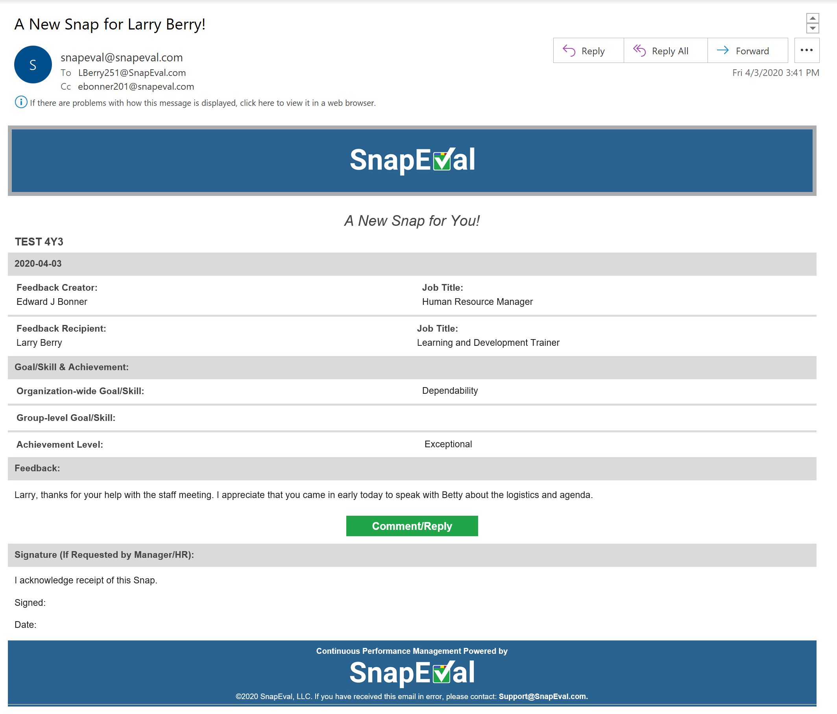
Confirming Snap Email (When Snap is shared with Recipient)
The Snap Creator and Recipient both receive a confirming Snap email
Details about the feedback
Click to reply or add comments about the Snap
When necessary, print a copy for manual signature if the Recipient doesn’t have email.

Slide 32
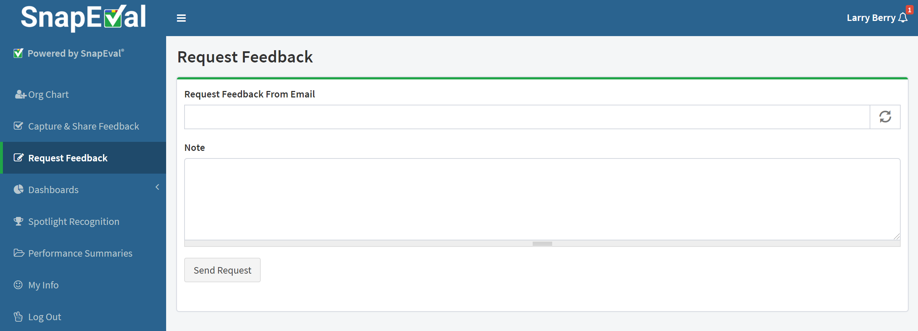
Request Feedback from Others (All Users)
Type the name or email address of the user you’d like to receive feedback from
Add an optional note with details to include with the request
Click ‘Send Request’ button

Slide 33
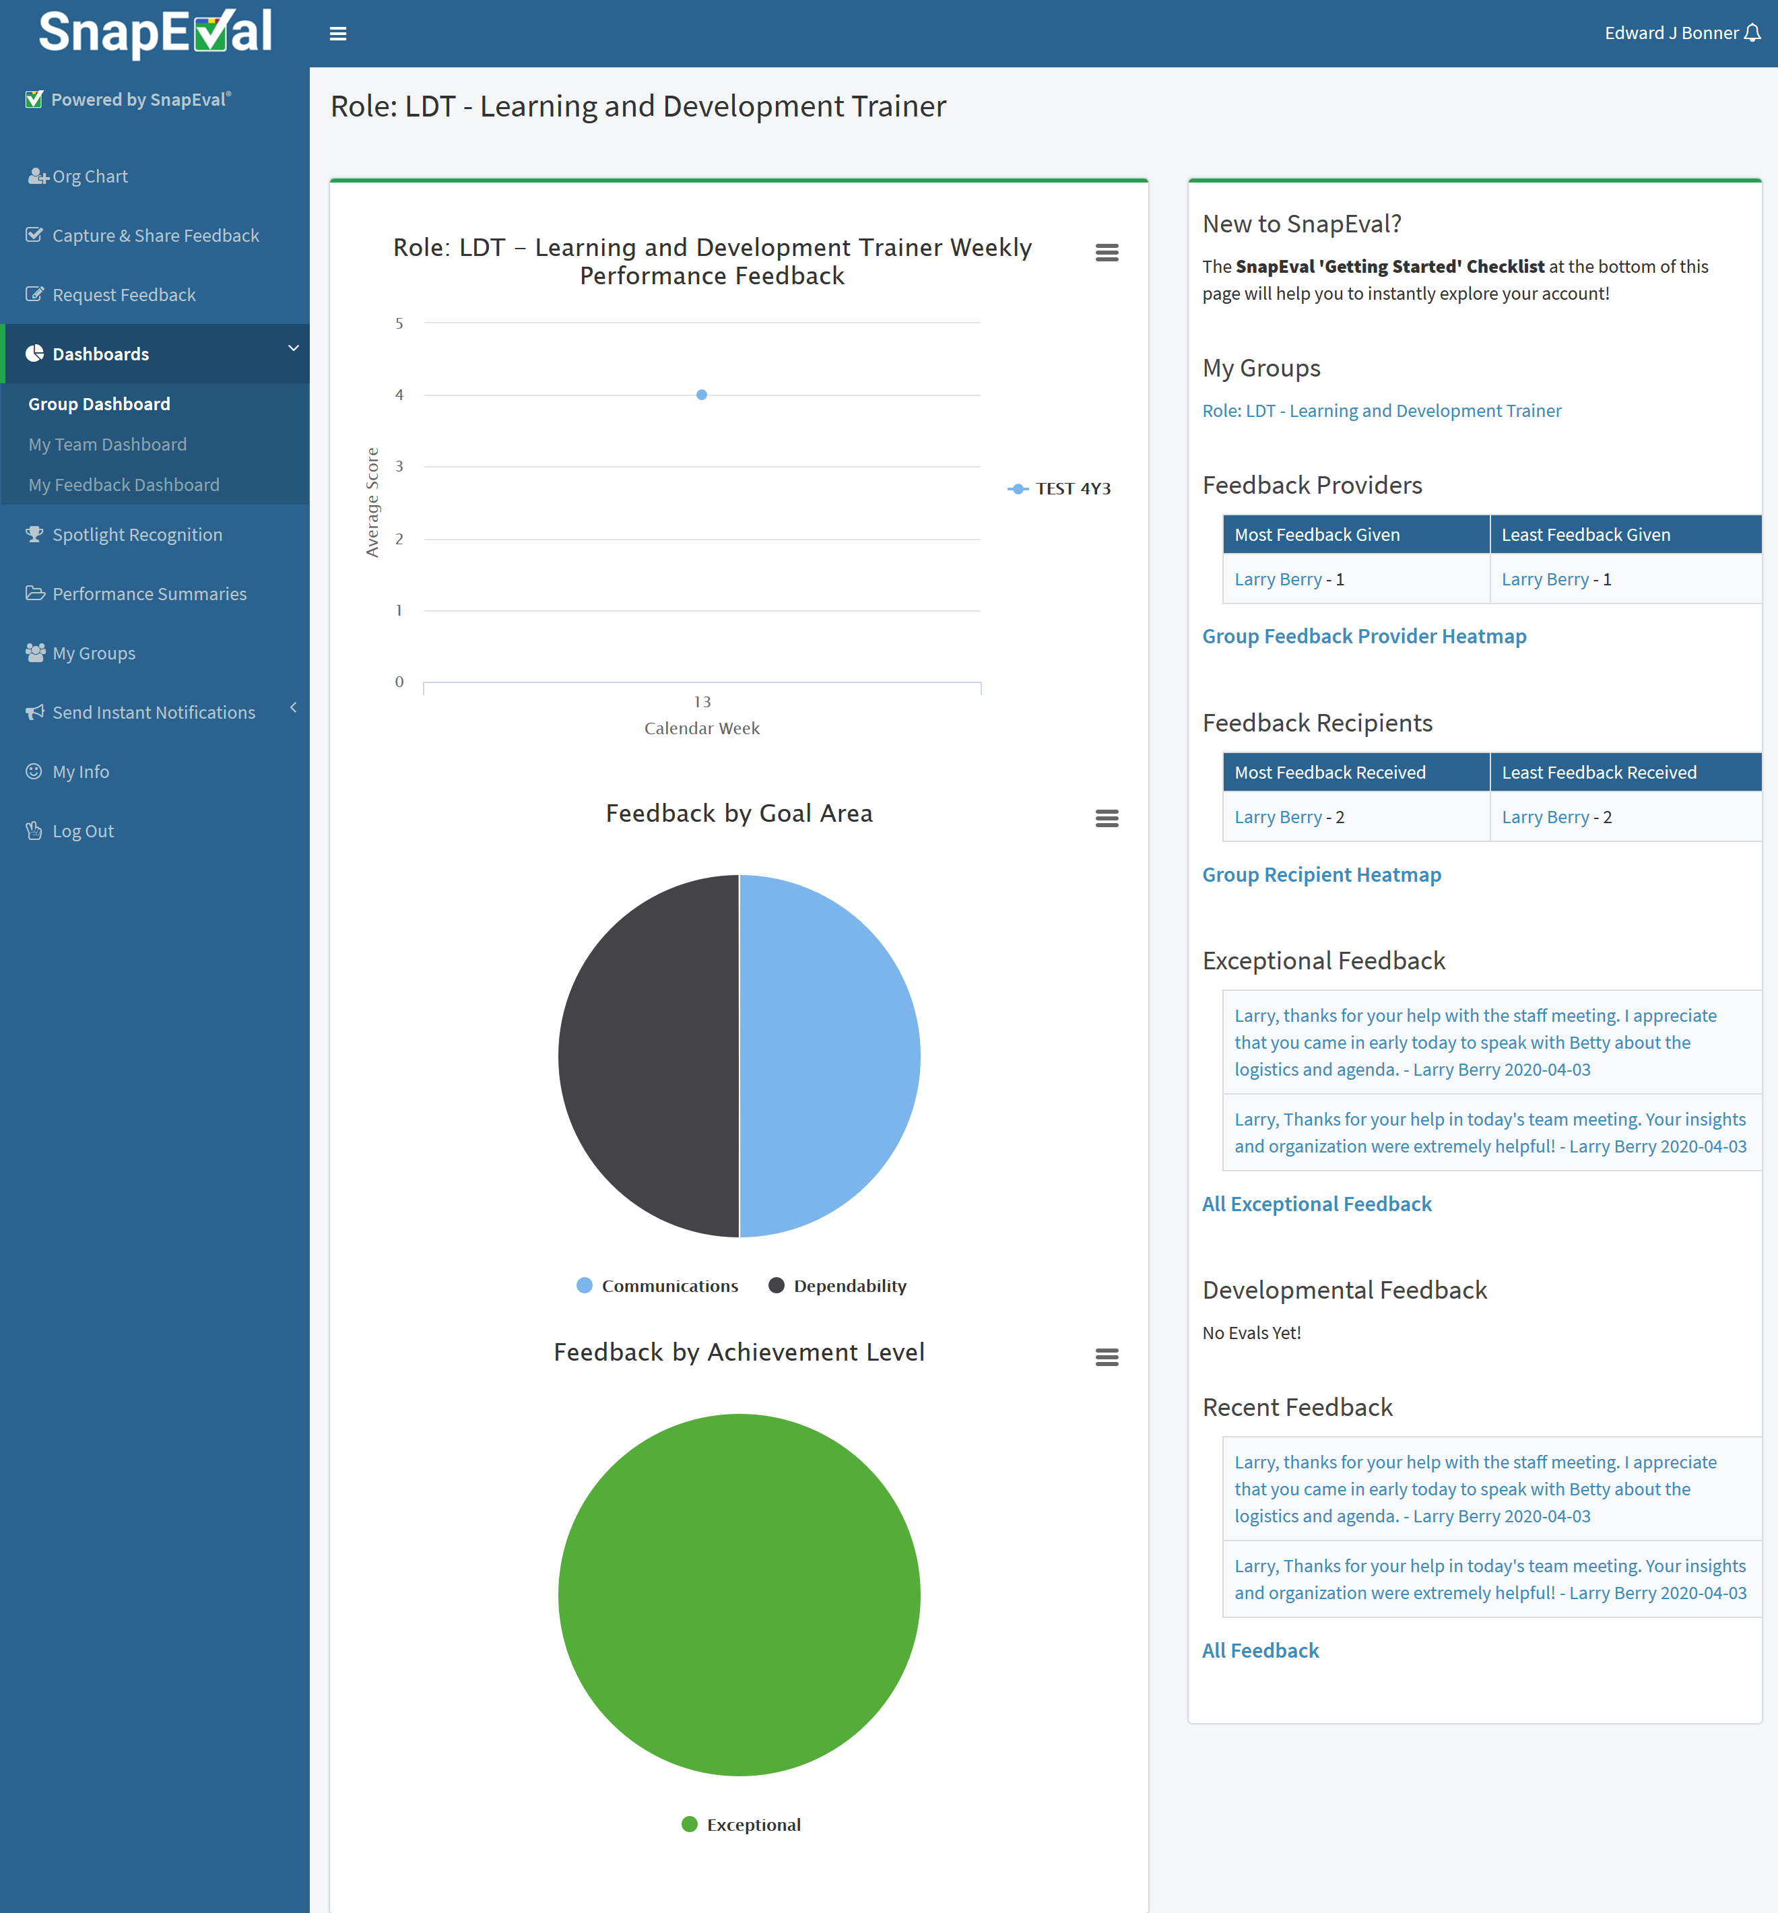
Group Dashboard (Group Administrators Only)
Group(s) you’re a Group Administrator for
Most and least feedback providers in this group
Feedback Provider Heatmap for this group
Most and least feedback recipients in this group
Feedback Recipient Heatmap for this group
Feed of Exceptional Feedback for this group
Feed of Developmental Feedback for this group
Feed of All Recent Feedback for this group
All feedback received by members of this group
Graphic data for this group

Slide 34
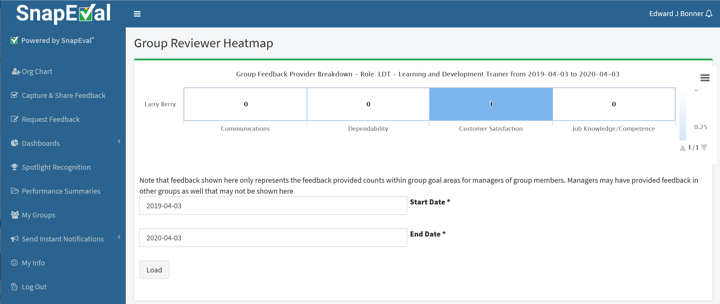
Feedback Provider Heatmap (Group Administrators Only)
Reviewer heatmap
Select date range
Click ‘Load’ button
Click on the user’s name for detailed info

Slide 35
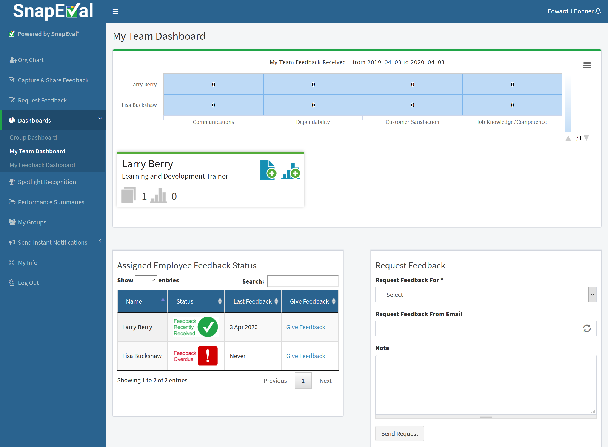
My Team Dashboard (Managers Only)
Heatmap of feedback given by manager to assigned user(s)
Performance summary card for each assigned user. Click for details.
Feedback status for assigned user(s)
Request feedback for an assigned employee

Slide 36
My Feedback Dashboard (All Users)
Feedback I’ve Received
QR Code/Link for External Feedback (if enabled)
My SnapEval Inbox
Feedback I’ve Given
My Goals
Self-Feedback

Slide 37
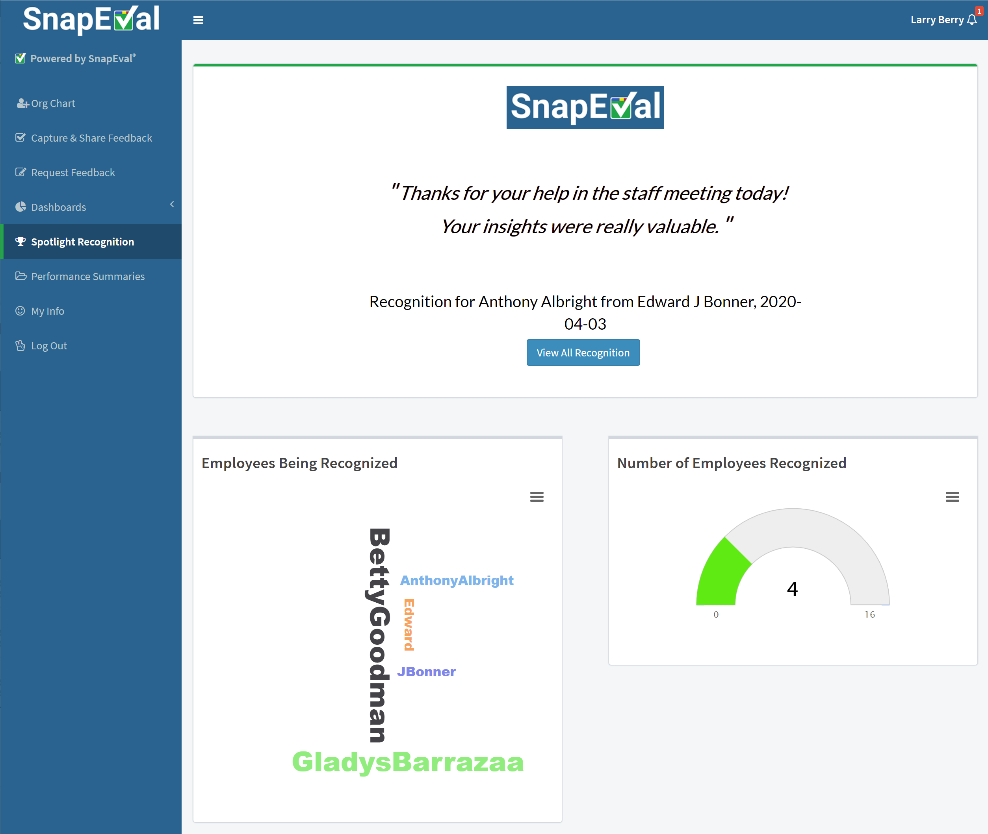
Spotlight Performance Recognition (All Users – If Enabled)
Recognition Marquee
View all recognition
Number of Employees Recognized
Recognized Employees Word Cloud

Slide 38
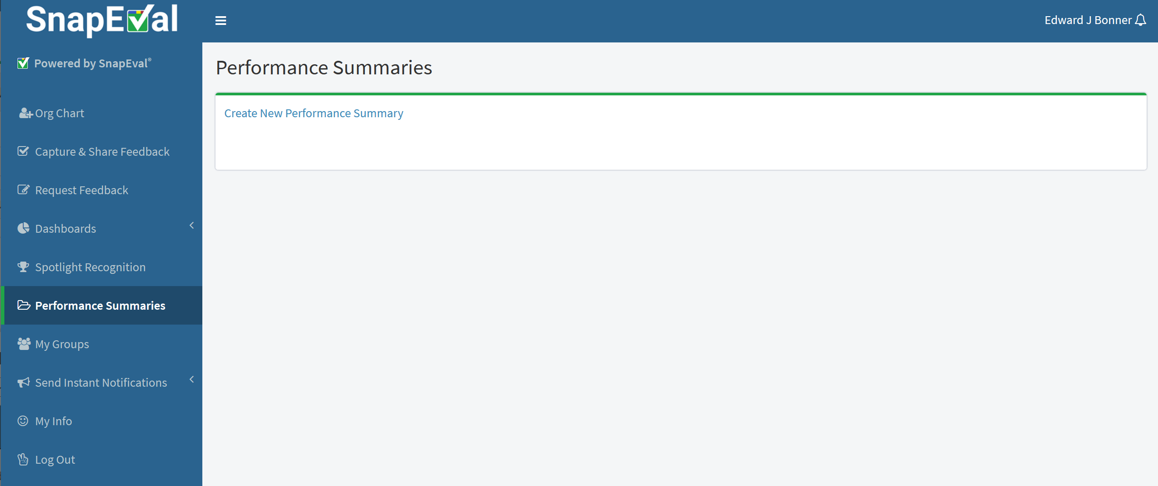
Performance Summaries (All Users)
Create a Performance Summary

Slide 39
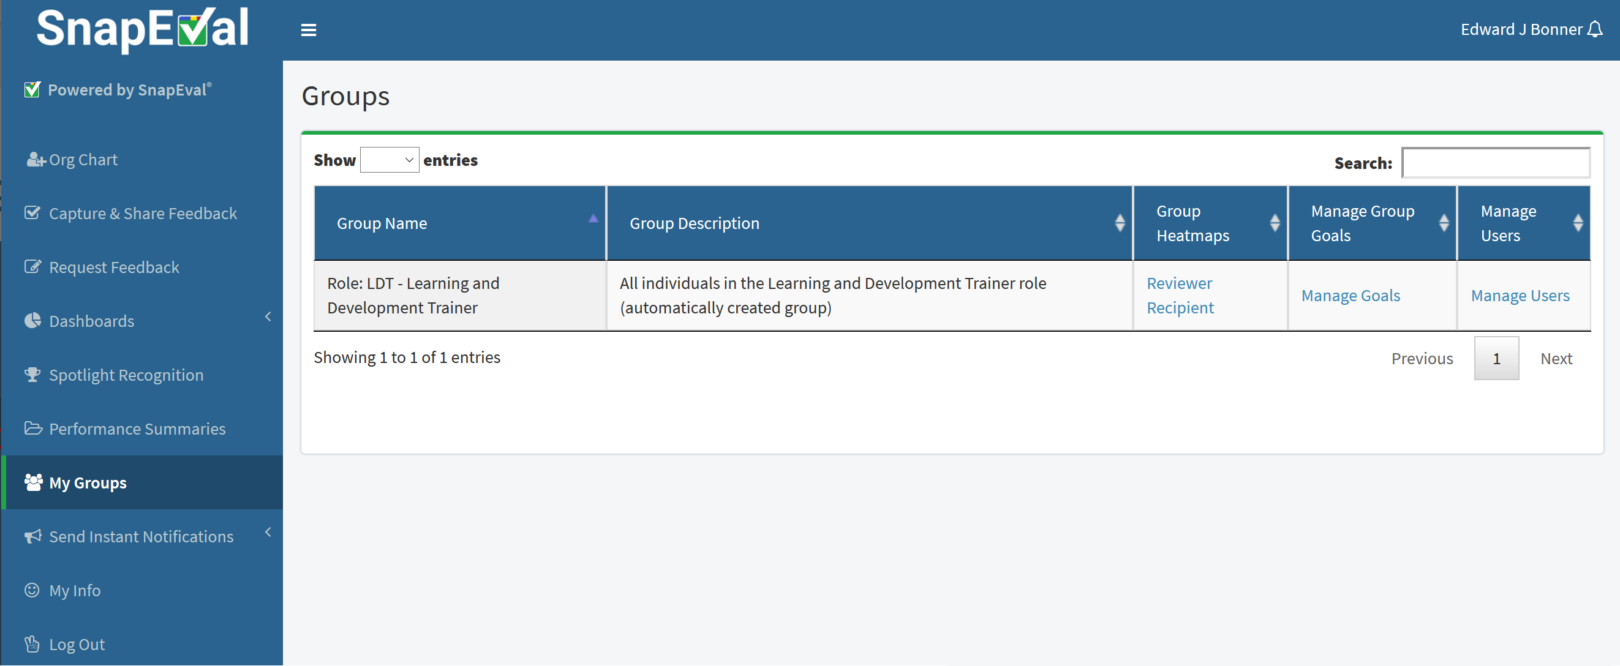
Group Details (Group Administrators Only)
Details about my assigned group(s)

Slide 40
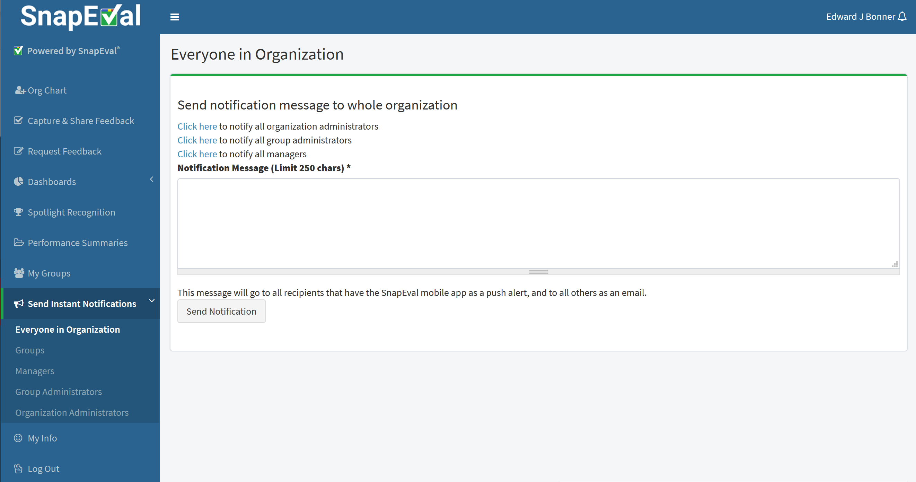
Send Instant Notifications (Group Administrators Only)
Send custom push notifications (and emails) to individuals based on their group membership or role

Slide 41
SnapEval Mobile App (All Users)
Create a Snap for another individual
View Snaps that you’ve given
View Snaps that you’ve received
Request feedback
Capture Self-Snap
View Self-Snaps
View all Snaps recognized for performance excellence

Slide 42
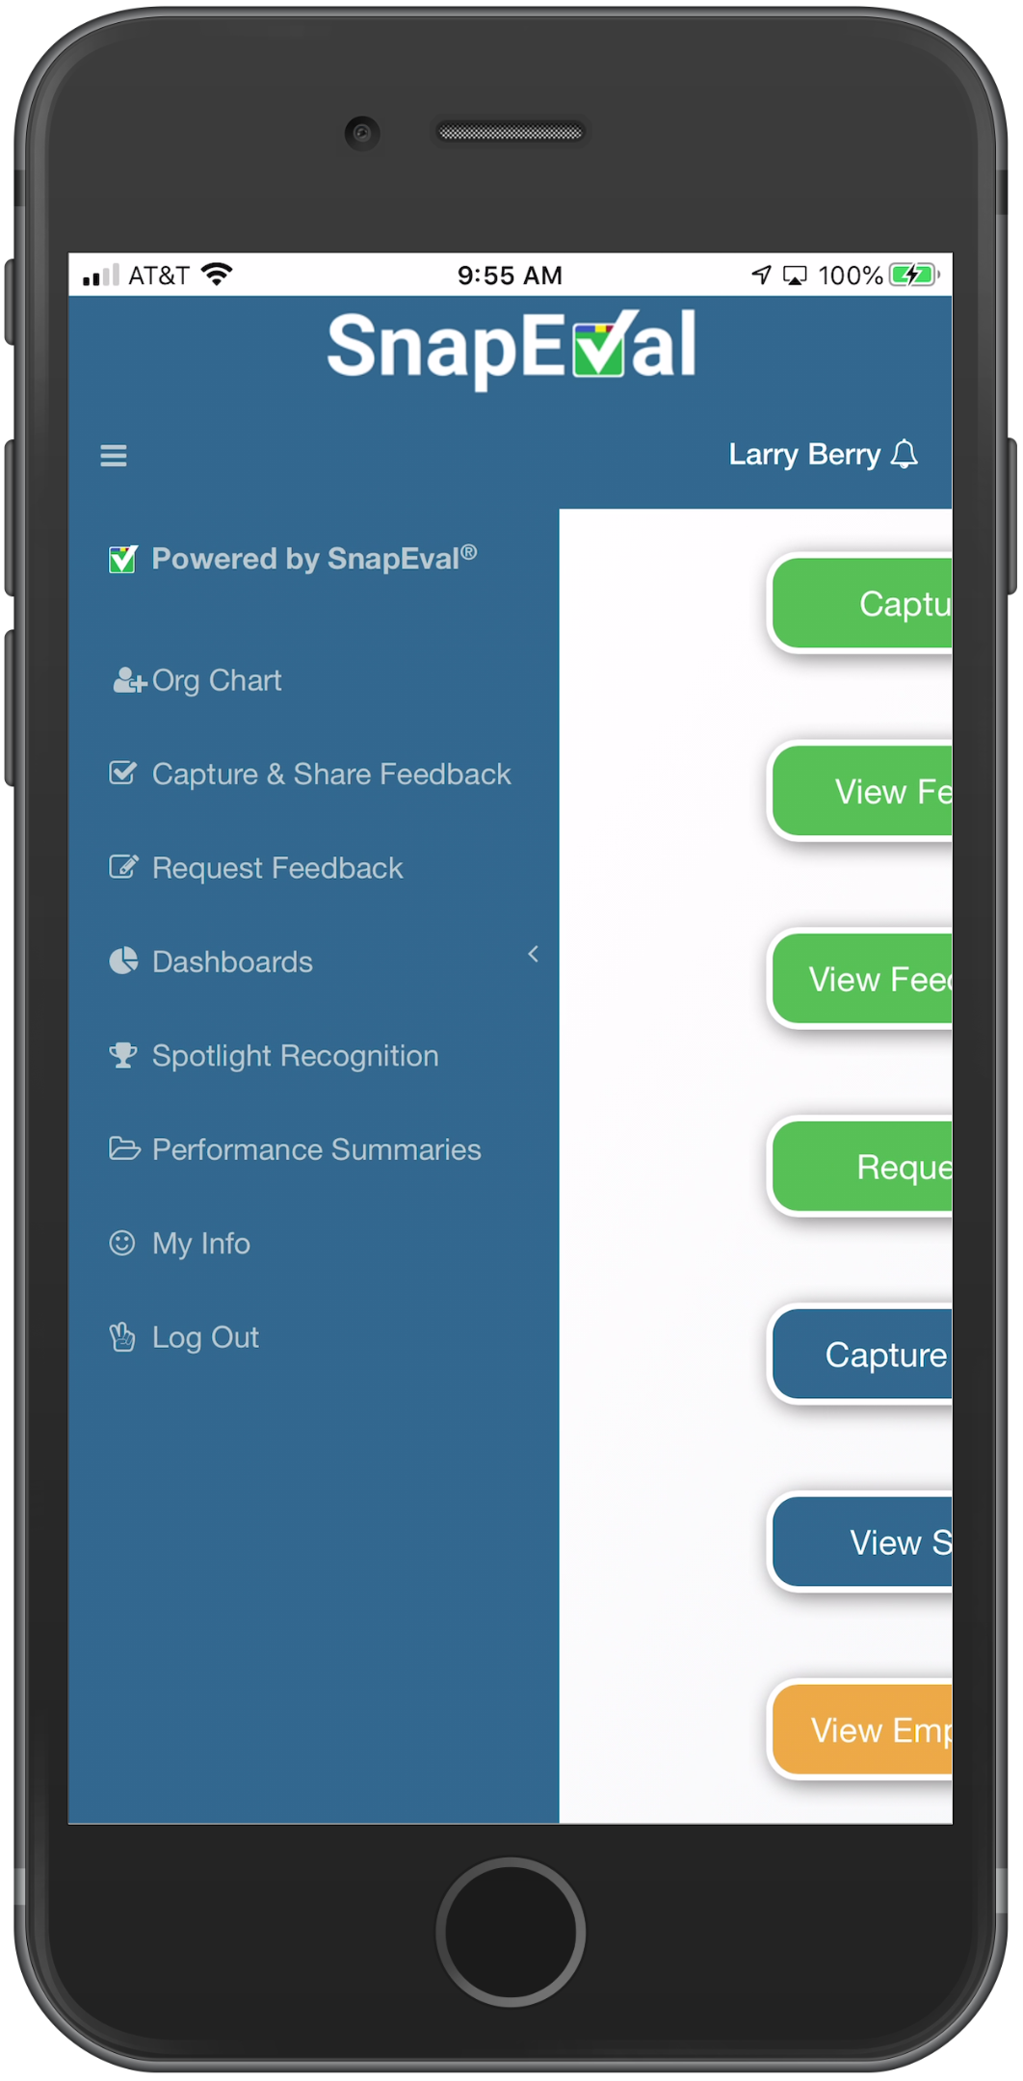
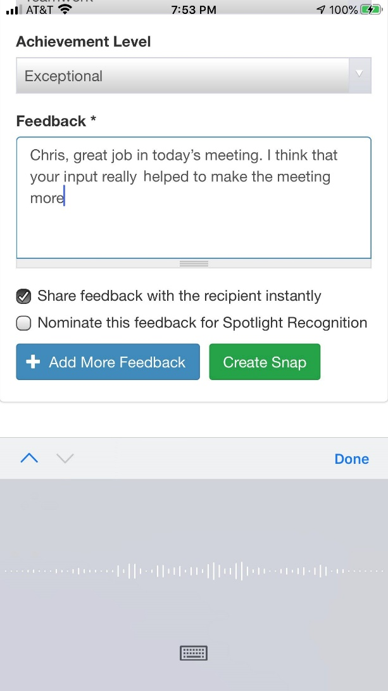
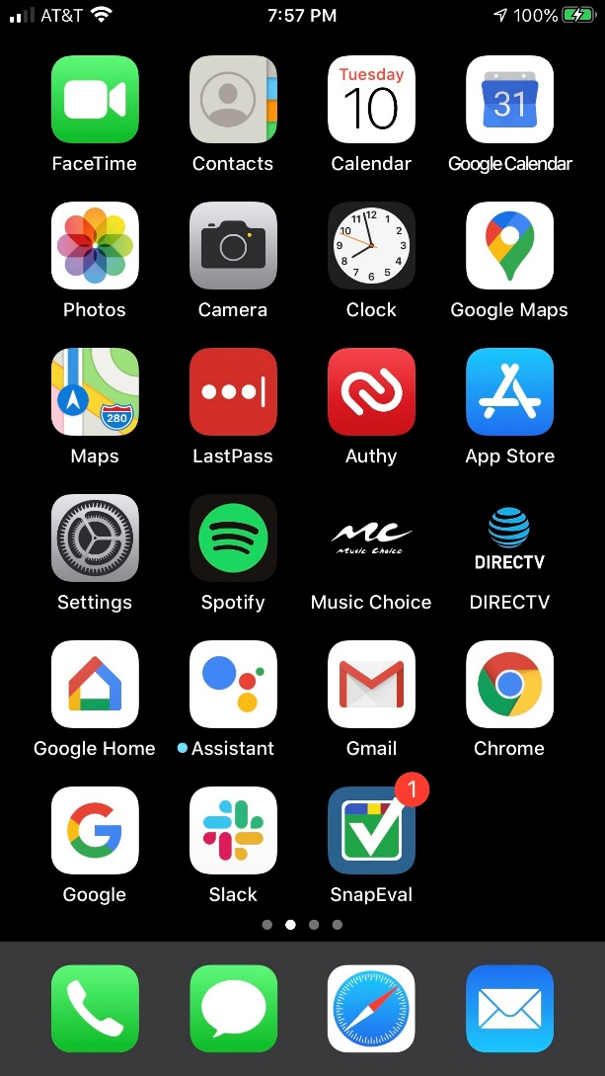
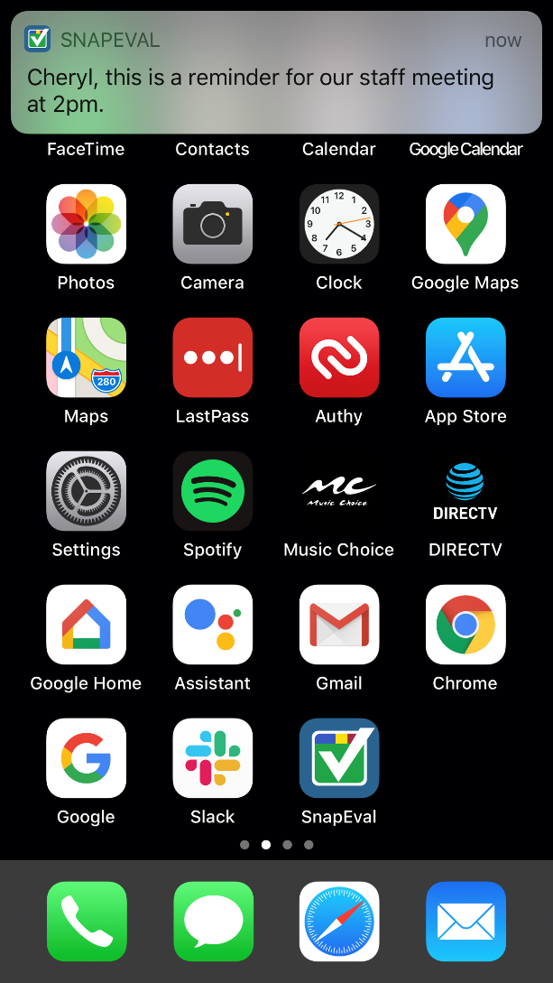
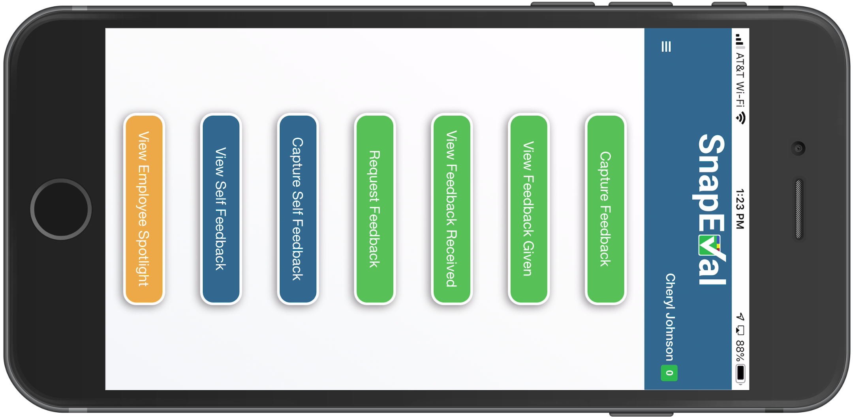
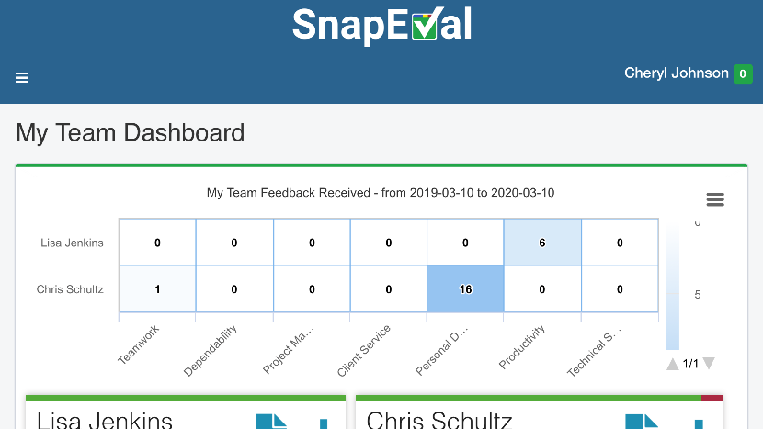
SnapEval Mobile App (All Users)
Mobile buttons are shortcuts to common functions
Full functionality of the web portal
Push notifications
Badging
Voice-to-text
Portrait and landscape modes

Slide 43
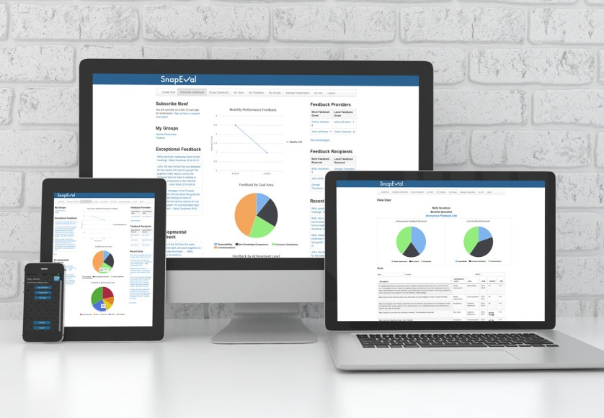
Homework Assignment!
Log into your SnapEval account
Log into web portal
Agree to ADP Consent form
Download & install mobile app
Log into mobile app
Capture ‘practice’ feedback for each other

Slide 44
Have questions? Need help?
SnapEval Support
Email: Support@SnapEval.com
Phone: (585) 414-5000

Slide 45
Trouble shooting: If you can’t login to SnapEval
Browse to: ‘adpapps.adp.com/consent-manager’
1. Enter your ADP UserID
2. Enter your ADP password
3. Click the ‘Sign In’ button
Click here to reset your ADP password if you’ve forgotten it.

Slide 46
Trouble shooting: If you can’t login to SnapEval
1. Scroll down to ‘Pending Consents’ and allow any Pending SnapEval Consents
2. Scroll down to ‘Rejected Consents’
3. Click the Allow button for ALL SnapEval applications

