Slide 1

Introduction to
SnapEval®
SnapEval® for ADP Workforce Now®
SnapEval® for RUN Powered by ADP®
David Yeaple
VP of Business Development & Product Management
SnapEval, LLC
Notes:
Hi, I’m David Yeaple.
In this video, we’re going to introduce how to use and configure SnapEval.

Slide 2
Thank you for creating a free 10-user SnapEval account!
SnapEval is
Simple and effective → You and your team members will use it
Designed for small and mid-sized organizations → Administration is easy
Free 10-user SnapEval account
Use with up to 10 team members
All features included
No time limitation (it’s not trial software)
We’ll help to configure your SnapEval instance (it’s a free service)
Want to enroll more than 10 team members?
Cost is $2.25/user/month (e.g. 15 users x $2.25/user/month = $33.75/month)
Billed monthly based on actual enrollments
Cost is prorated for users that are added or removed mid-billing cycle
No startup fees. No upfront costs. No contracts. (pay as you go)
Cancel anytime and take all of your data with you
Notes:
First, please accept our thanks for creating a free 10-user SnapEval account for your team!
SnapEval is simple and effective, so your team members will use it.
SnapEval is specifically designed for small and mid-size organizations, so administration is easy.
Your free 10-user SnapEval instance includes all SnapEval features and there’s no time limitation.
This means that you can use SnapEval with up to 10 team members (including yourself) indefinitely!
We’ll also help you to configure your SnapEval instance with your organization’s goals and other settings.
This is a free service!
If you want to use SnapEval with more than 10 team members, the cost is only $2.25/user/month, billed monthly, based on actual enrollments.
There are no startup fees, upfront costs, or contracts.
You can cancel anytime and take all of your data with you.

Slide 3
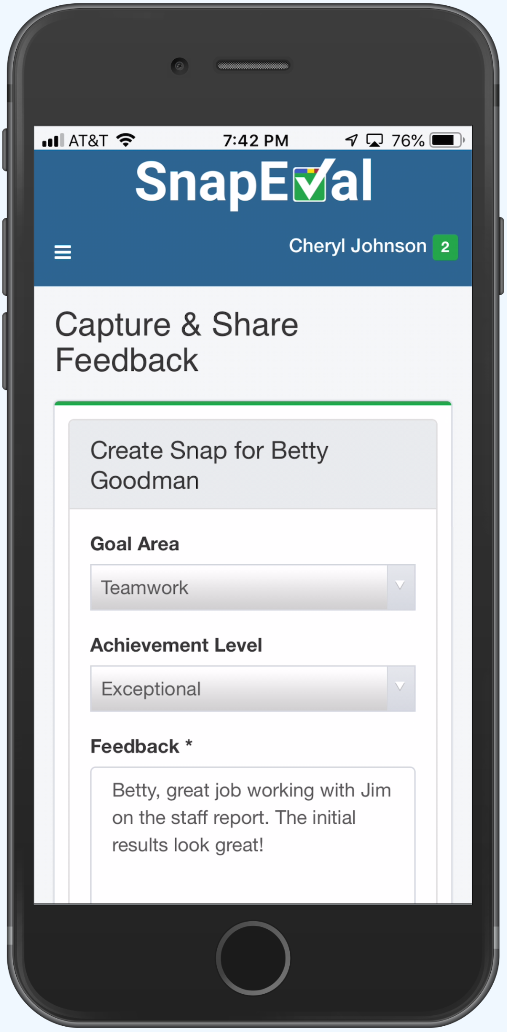
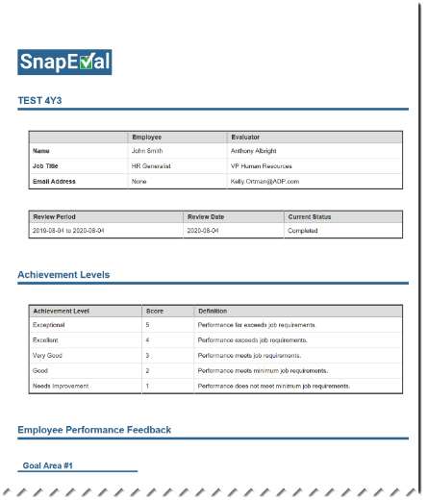
Start using SnapEval in Minutes!
Create your free 10-user SnapEval account
Add goals
Add team members
Start using SnapEval
Instantly capture and share real-time feedback
Create and share Performance Summaries
Notes:
You can start using SnapEval in minutes.
First, create your free 10-user SnapEval Account.
Then, add your goals and team members.
You can immediately begin capturing and sharing real-time feedback for your employees.
You can also immediately create can share Performance Appraisals (what we call Performance Summaries) with your employees.
Note that it’s not required to capture and share real-time feedback as a prerequisite for creating Performance Summaries.

Slide 4
SnapEval Overview
Notes:
(no voice narration)

Slide 5
Not all Continuous Performance Management (CPM) is the same!
 | SnapEval | Most CPM Products
Designed for
Business Terms/Pricing
PM process prior to CPM
CPM Objective
Focus of CPM solution
Cultural shift
Technology required?
Use in conjunction with annual reviews?
Small and Midsize Organizations
Midsize and Large Organizations
≤10 Users: Free 10-user account. All features included. No time limit.
>10 Users: Enroll any number of users (e.g. department, team, etc.)
No minimum cost
Ultra-affordable ($2.25/user/month)
Billed monthly based on actual enrollment size
No contract. Cancel anytime. Take all of your data.
No setup/configuration fees or upfront costs
Free phone/email technical support.
Free training.
Trial: Free 30-day trial
Deployment: Must enroll all users in organization
or Minimum cost
Expensive per user pricing (>$5.00/user/month)
Billed annually (pay for full year subscription upfront)
Annual or multi-year contract with early termination
Setup/configuration fees
Technical support limitations/cost?
Training cost?
Manual, ineffective, or non-existent process
Functional process that needs improvement
Provide a simple, easy-to-use, effective CPM solution that provides timely, actionable feedback
Radically overhaul process through CPM tasks such as journaling, OKRs, or frequent pulse surveys
To capture and share performance feedback instantly using light-touch, ad hoc ‘snapshots’ of performance feedback
To maximize employee engagement by deeply integrating CPM tasks with job workflows
Small change. Low risk of failure
Large change. High risk of failure
Only for managers capturing feedback
For all managers and all employees
Yes, if desired. Snaps can automatically be incorporated into an employee’s Performance Appraisal.
Generally not. Content from OKRs, journaling, and pulse surveys isn’t designed to integrate with the format of traditional Performance Appraisals.
Notes:
Let’s start by comparing SnapEval with other Continuous Performance Management products.
First, SnapEval is specifically designed for small and mid-size organizations.
This means organizations with less than 10 employees all the way up to organizations with thousands of employees.
By contrast, most Continuous Performance Management Products are designed for organizations with at least 100 employees.
SnapEval offers a free 10-user account with all features included and no time limitations. It’s not trial software.
For organizations with more than 10 users, SnapEval can be deployed to any number of users such as a team, a department, or the whole organization.
There are no minimum deployment sizes or minimum costs.
At $2.25/user/month, SnapEval is ultra-affordable.
The cost is billed monthly based on the actual deployment size.
There’s no contract.
You can cancel anytime and take all of your data with you.
There are no setup fees, configuration fees, or upfront costs.
It’s strictly ‘pay-as-you-go’ based on the deployment size that month.
SnapEval includes free phone and technical support as well as free training for administrators, managers and employees.
Most Continuous Performance Management products offer a free 30-day trial.
Once the trial is complete the entire organization must be enrolled or there’s a minimum cost, which is typically in the many thousands of dollars.
The pricing is often more than $5.00/user/month and it’s billed annually and must be paid for up-front.
An annual or multi-year contract is required, and there are substantial fees for early termination.
In addition, there are often setup or configuration fees.
Many organizations have a manual, ineffective, or non-existent performance management process prior to using SnapEval.
By contrast, most Continuous Performance Management products are designed for organizations that have a functional performance management process that needs improvement.
SnapEval is specifically designed as a simple, easy-to-use, effective Continuous Performance Management solution that provides timely, actionable feedback to employees.
The objective of most Continuous Performance Management products is to radically overhaul an organization’s performance management process by implementing tasks such as journaling, OKRs, or frequent pulse surveys.
In SnapEval, capturing and sharing feedback is primarily event-driven, meaning that feedback ‘snapshots’ are captured and shared with the employee when there’s something meaningful to communicate.
Most Continuous Performance Management products are primarily schedule-driven, meaning that the Continuous Performance Management tasks are deeply integrated into job workflows and must be attended to frequently, often daily, by both managers and employees.
Changing an organization’s culture is extremely difficult and often fails.
SnapEval utilizes familiar concepts from traditional Performance Appraisals, so the cultural shift to implement SnapEval is small, which minimizes the risk of failure.
Continuous Performance Management products that utilize OKRs, journaling, or frequent pulse surveys require a large cultural shift, which carries a much higher risk of failure.
In SnapEval, only managers are required to utilize computers, tablets, or smartphones to capture and share feedback with their assigned employees. If the employees don’t have access to technology, they can receive the feedback verbally or by hardcopy when required.
Most Continuous Performance Management products require that managers and all employees have access to computers, tablets, or smartphones as they are required to continually track their own progress against OKRs, create journal entries, or respond to pulse surveys.
In SnapEval, real-time feedback for an employee can automatically be incorporated into an employee’s Performance Appraisal.
By contrast, content from OKRs, journaling, and pulse surveys isn’t designed to integrate with the format of traditional Performance Appraisals.

Slide 6
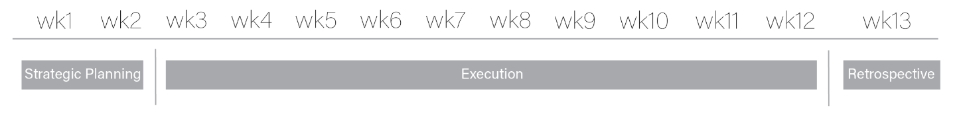
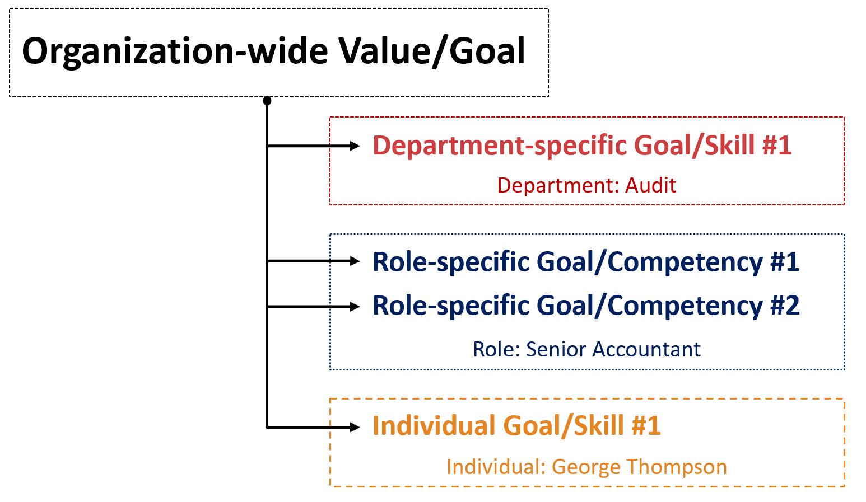
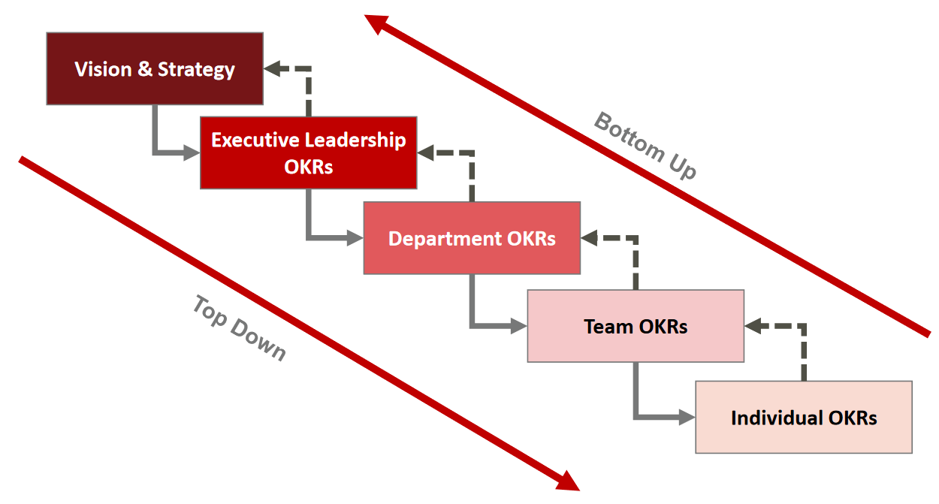
SnapEval vs. OKRs-based Solutions
 | SnapEval | Objectives & Key Results (OKRs)
Designed for
Best Cultural Fit
Goals/OKRs Planning Cycle
Goals/OKRs Structure
Measurement
Feedback/Tracking Methodology
Manager/Employee Check-ins?
Use in conjunction with annual reviews?
Small and Midsize Organizations
Midsize and Large Organizations
Ad hoc. Dynamic. Qualitative/Quantitative Mix.
Process-oriented. Highly Structured. Strongly Quantitative.
Typically, annually for Organization-wide goals/values.
As needed for tactical goals/job competencies.
Can be updated at any time and as needed to meet changing conditions.
Fixed, 13-week cycle
Two-tier Cascading Goals
- Tactical goals/job competencies
are cascade from
Organization-wide goals/values
- Loosely coupled. Tactical goals
can be updated independently
of Organization-wide goals.
Integrated OKRs
- Cascaded downward and upward
across all levels
- Tightly coupled. All OKRs are
updated simultaneously
at each 13-week cycle.
Goals: May be qualitative or quantitative
Objectives: Qualitative Key Results: Quantitative
Snap = Goal Area + Achievement Level + Feedback Text Note
Numerical tracking of Key Results
Yes
Yes
Yes, if desired. Snaps can automatically be incorporated into an employee’s Performance Appraisal.
Generally not. OKRs don’t integrate well with traditional Performance Appraisal format.
Notes:
Now, let’s look specifically at SnapEval versus OKRs-based Performance Management solutions.
SnapEval is specifically designed for small and mid-size organizations ranging from less than 10 employees to over 1000 employees.
Performance Management products utilizing OKRs are generally designed for organizations with hundreds of employees, or more.
SnapEval is ideal for organizations whose workers have a wide range of tasks that can vary greatly on any given day. Their job functions may yield a mix of qualitative and quantitative results.
OKRs work best in organizations that are very process-oriented, highly structured, and have many job functions that yield easily quantifiable results.
In SnapEval, organization-wide goals and values are typically updated annually. Job competencies, department goals, and individual goals can be updated at any time as required to meet changing conditions.
OKRs operate on a fixed, 13-week cycle that’s repeated four times each year. The first two weeks are strategic planning followed by ten weeks of execution. The last week of the cycle is used as a retrospective in preparation for the next 13-week cycle.
SnapEval utilizes a two-tier cascading goals approach. The tactical goals and job competencies cascade from organization-wide goals and values. The tactical goals and job competencies are loosely coupled to the organization-wide goals, meaning that they can be updated independently of the organization-wide goals as needed to meet changing conditions.
OKRs are cascaded both downward and upward across all levels of the organization. They are tightly coupled, meaning that they can only be updated at the beginning of each 13-week cycle.
The measurement employee performance against goals in SnapEval may be either qualitative or quantitative.
OKRs measure Objectives qualitatively and Key Results quantitatively.
In SnapEval, feedback is delivered as a combination of a Goal Area, plus some level of Achievement, plus a text note that provides Feedback Details that are relevant and actionable to the employee.
OKRs utilize numerical tracking of Key Results.
Periodic Manager/Employee Check-in meetings are utilized with both SnapEval and OKRs.
By design, real-time feedback for an employee can automatically be incorporated into the employee’s Performance Appraisal in SnapEval.
Content from OKRs isn’t designed to integrate with the format of traditional Performance Appraisals.

Slide 7
SnapEval Pricing
SnapEval
UNLIMITED EDITION
for
SMALL TEAMS
Includes ALL SnapEval features:
- Continuous Performance Management - Modern Performance Appraisals
- Performance Recognition
- Org Charts
- Custom Push Notifications
For up to 10 users
Absolutely FREE!
Use indefinitely. No time limitations!
No feature limitations!
Not a 'trial version' of software!
SnapEval
PERFORMANCE MANAGEMENT EDITION
for
LARGE TEAMS
Includes:
- Continuous Performance Management - Modern Performance Appraisals
- Org Charts
- Custom Push Notifications
For 11 or more users
Ultra-affordable subscription plan: $2.25/user/month
Works out to less than 8¢ per Enrolled Employee per Day!
SnapEval
UNLIMITED EDITION
for
LARGE TEAMS
Includes ALL SnapEval features:
- Continuous Performance Management - Modern Performance Appraisals
- Performance Recognition
- Org Charts
- Custom Push Notifications
For 11 or more users
Economical subscription plan: $3.25/user/month
Works out to less than 11¢ per Enrolled Employee per Day!
All SnapEval Editions Include
No setup fees of any kind
Cancel anytime without penalty or obligation and take all of your data with you
Cost based on actual enrollments
FREE Instant customization and configuration
Billed monthly to your credit card (non-ADP customers)
FREE Technical support and updates
- OR -
FREE Training
Included as a line item on your monthly ADP invoice
FREE SnapEval mobile app in Apple AppStore (iOS) and Google Play (Android)
No annual contract or commitment
Notes:
Whether you’re using SnapEval integrated with your ADP payroll platform or stand-alone, there are three SnapEval editions to choose from.
If your organization has just created a new SnapEval instance, it’s likely that you’re using the ‘Unlimited Edition for Small Teams.’ This edition is completely free and enables you to enroll up to 10 users in your SnapEval instance. You can even swap team members within the 10-user maximum so that all of your key decision makers can experience working with SnapEval.
This edition includes all SnapEval features and there’s no time limitation. We will help you to configure your SnapEval instance with your organization’s branding, goals & values, and customized settings. There’s no cost for this service.
The ‘Unlimited Edition for Small Teams’ is a terrific way to explore SnapEval with your team without risk, cost, or time pressure. For teams with 10 users or less, everything is included and it’s completely free!
For organizations that want to enroll more than 10 users in SnapEval, there are two choices:
‘The Performance Management Edition for Large Teams’ includes all SnapEval features except Performance Recognition. The cost is $2.25/user/month (billed monthly), which is less than 8 cents per user per day.
The ‘Unlimited Edition for Large Teams’ includes all SnapEval features. The cost is $3.25/user/month (billed monthly), which is less than 11 cents per user per day.
With all editions, there are no setup fees of any kind.
The cost is based on actual enrollments and is billed monthly, either directly to a credit card or as a line item on your ADP invoice.
There’s no annual contract or commitment and you can cancel anytime without penalty or obligation. You can also take all of your data with you.
In addition to the free configuration and customization, technical support and training are also included at no cost.
Lastly, we invite you to download the free SnapEval mobile app for iOS and Android devices.

Slide 8





FREE Customization and Configuration
→
Custom Branding
Extend your organization’s brand to managers and employees
Organization’s logo and a complementary color theme
Web portal, mobile app, emails
  Custom Goals, Values, Competencies
  Goals specific to your organization,
  job functions, departments, etc.
  Two-tier cascaded group-level goals from
  organization-wide goals
  Custom Achievement Levels
  Support for your organization’s
  Performance Management strategy
  3, 4, or 5 Achievement Levels
  Custom Achievement Names and Descriptions
  Custom Configuration
  Specific configuration for your organization
  Reporting relationships, grouping,
  feedback delivery settings, feedback queuing criteria, performance summary settings
Notes:
SnapEval includes FREE Customization and Configuration for each organization’s SnapEval instance.
The SnapEval instance is customized with the organization’s logo and a complementary color theme that is utilized in the SnapEval web portal, mobile app, and emails.
Custom goals, values, and competencies, are implemented for the organization. This includes both organization-wide goals and values as well as job competencies, department goals, and even individual goals.
Custom achievement levels are also created. SnapEval supports 3, 4, or 5 levels of achievement with customizable names and descriptions.
Configuring reporting relationships, creating groups, and configuring SnapEval settings is also included with the free service.

Slide 9







SnapEval Key Features
Continuous Performance Management
Instantly capture and share feedback ‘snapshots’ using smartphones and computers
Modern Performance Appraisals
Automatically incorporate continuous feedback snapshots into a Performance Summary
Performance Recognition (optional)
Nominate a feedback snapshot for public recognition of performance excellence within the organization
Organization Charts
Drag and drop nodes to establish relationships.
Explore organization structure 'what ifs.’
Export org chart as PDF, PNG, SVG or CSV file.
Push Notifications
Instantly notify administrators, managers, and employees with customized push notification messages to smartphones.
Notes:
Now, let’s introduce the key features included with SnapEval
Continuous Performance Management enables managers and employees to instantly capture feedback ‘snapshots’ using smartphones and computers.
Modern Performance Appraisals enable feedback snapshots to automatically be incorporated into an employee’s Performance Summary document.
Organization Charts enable reporting relationships to be established by dragging and dropping user nodes over one another. Complex relationships with multiple managers for an employee are supported. Organization structure ‘what ifs’ can be created and exported as PDF, PNG, SVG or CSV files.
Push notification messages instantly notify users about important events such as a reminder to give feedback or a request for feedback from a team member. SnapEval administrators can create Custom Rich Push Notifications to instantly deliver critical, important messages to targeted users’ smartphones.
SnapEval’s optional Spotlight Performance Recognition feature enables a performance feedback snapshot to be nominated for public recognition of performance excellence within the organization.

Slide 10

SnapEval Benefits
Simple, easy-to-use
Employees receive timely, goal-aligned, actionable feedback
FREE or ultra-affordable
HR Professionals can proactively coach feedback creators (feedback queuing)
Support for non-hierarchal, team, and complex reporting relationships
Comprehensive visibility to feedback for current and former employees for HR Professionals
(Wrongful Termination Defense)
Feedback is communicated electronically when it’s most effective (sharing)
Notes:
When introducing SnapEval benefits, we like to use the analogy of an iceberg. There are some obvious benefits similar to the portion of the iceberg above the waterline, but there are also many more subtle (but equally important) benefits that are analogous to the portion of the iceberg below the waterline.
Some of the more obvious benefits are:
SnapEval is simple and easy to use
Employees receive timely, actionable, goal-aligned feedback that helps to increase employee engagement and results.
SnapEval is FREE or ultra-affordable
Examples of some of the more subtle benefits include:
HR Professionals can proactively coach feedback creators prior to the recipient receiving the feedback
Feedback can be communicated electronically to the recipient when it’s most effective, immediately when it’s captured or at a future point in time
SnapEval supports non-hierarchal, team, and complex reporting relationships
SnapEval provides HR Professionals with comprehensive visibility to positive and developmental feedback for current and former employees

Slide 11
Capture and Share Real-Time Feedback

Slide 12





SnapEval Definitions
Snap – (a.k.a. ‘Eval’) A method to instantly capture Performance Feedback ‘snapshots’ using familiar concepts from traditional performance appraisals
Sharing – Electronically communicating a feedback snapshot (Snap) to the Snap Recipient.
Group – A collection of users such as a department, job function, team, or individual.
Performance Summary – A Performance Appraisal document that can automatically include the employee’s Snaps
Performance Management – All feedback is private to the recipient, the recipient’s manager(s), and administrators
Performance Recognition – A feedback snapshot can be nominated for public recognition of performance excellence
within the organization
Notes:
Next, let’s introduce a few definitions that will help when using SnapEval…
A ‘Snap,’ also known sometimes as an ‘Eval,’ is a method to instantly capture a Performance Feedback ‘snapshot’ using familiar concepts from traditional performance appraisals.
‘Sharing’ is the process of electronically communicating a Snap to the Snap recipient. This can be done instantly at the same time a Snap is captured, or at a later point in time.
A ‘Group’ is a collection of users such as a department, job function, team or individual. Groups are used to report performance across a collection of users. Groups are also used to create specific goals that apply to members of the group such as job competencies or goals for an individual.
With ‘Performance Management,’ all feedback is private to the recipient, the recipient’s manager(s), and administrators.
A ‘Performance Summary’ is a Performance Appraisal document that can automatically include the employee’s Snaps.
‘Performance Recognition’ enables a Snap to be nominated for public recognition of performance excellence within the organization.

Slide 13
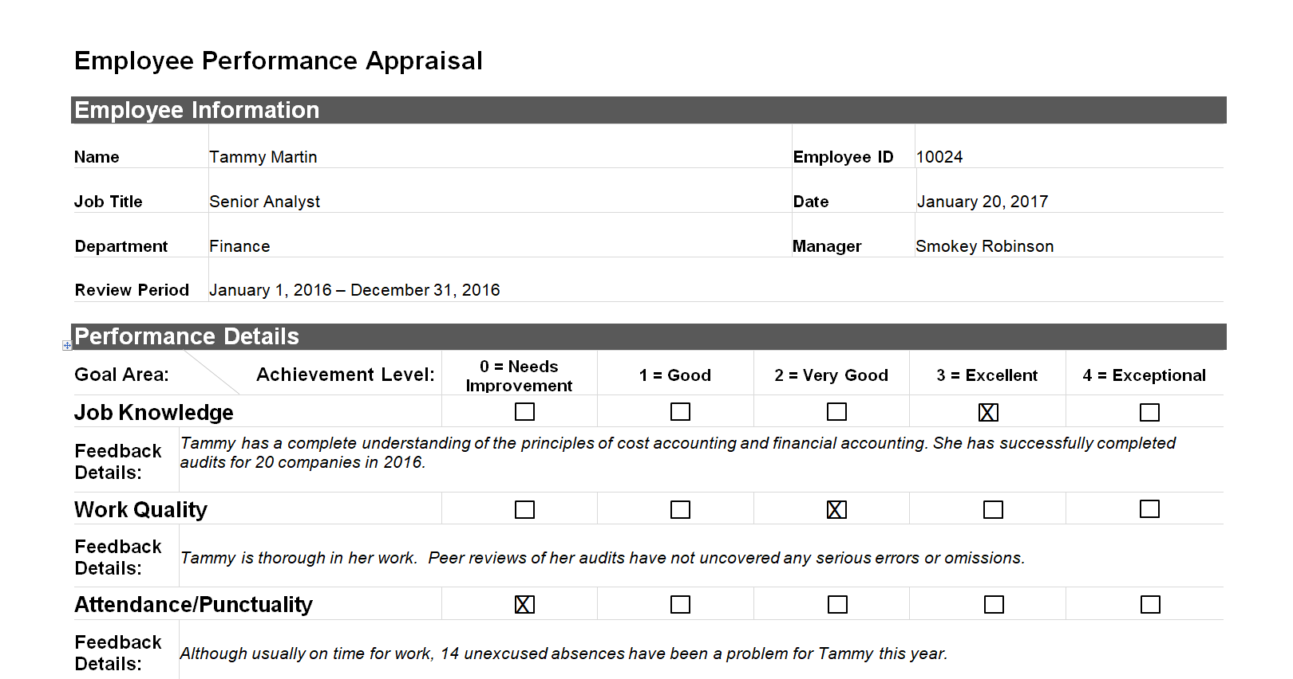
Traditional Performance Appraisal
Capturing Feedback (a ‘Snap’)
SnapEval
Notes:
Now, let’s introduce the concept of feedback ‘snapshots’ or ‘Snaps’ as we call them…
Many traditional performance appraisals are designed around organization goals, values, job competencies, and individual goals. We simply call them ‘Goal Areas.’
When completing a performance appraisal, the manager selects an ‘Achievement Level’ for each Goal Area. The manager also includes ‘Feedback Details’ to explain the Achievement Level selected and provide the employee with information about what they are doing well and what they need to improve in their performance.
Because the concepts of Goal Areas, Achievement Levels, and Feedback Details are familiar to most managers and employees from traditional performance appraisals, SnapEval uses these same elements when capturing a ‘Snap’ of performance feedback for an employee.
Each Snap focuses on a single Goal Area, Achievement Level, and Feedback Details for the recipient. A Snap can be captured on any internet-connected computer or tablet. The SnapEval mobile app’s voice-to-text support enables a Snap to be captured in seconds, even if the feedback details are extensive.

Slide 14




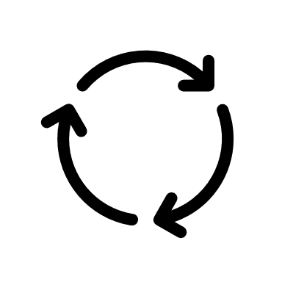




Communicating feedback using Snaps
Instantly Create a Snap
Capture feedback when thinking of
or observing performance so it isn’t forgotten
Use any computer, tablet or smartphone
Voice-to-text support in mobile app. No typing required!
  Immediately share the Snap
  Perfect for ‘thank you’ or acknowledgement
  Recipient receives email, push notification
  Recipient can view Snap in web portal and mobile app
  Defer sharing the Snap
  Ideal for a developmental Snap
  No email or notification to recipient
  Recipient cannot view Snap in web portal or mobile app
  Snap Creator can edit Snap prior to sharing
  (e.g. after in-person discussion with recipient)
  Share after the discussion
  to document the developmental feedback
  Never share the Snap
  Useful for taking notes about an employee
  Unshared Snaps cannot be viewed by recipient,
  even if recipient is a Manager or Group Administrator
  Unshared Snaps can be viewed by
  Organization Administrators and
  non-recipient Group Administrators
Notes:
It’s important to capture a Snap for an employee when thinking of or observing performance so that the feedback isn’t forgotten.
However, a Snap isn’t required to be communicated instantly to the feedback recipient at the time it’s created. Rather, there are three choices:
First, the Snap can be shared immediately when it’s created. The recipient instantly receives an email and smartphone push notification. The recipient can also view the Snap content in the SnapEval web portal and mobile app. This is perfect for a ‘thank you’ or other positive feedback.
Second, the Snap Creator can defer sharing the Snap to a future point in time. This is ideal for a Snap with developmental feedback. By not sharing a Snap when it’s created, the Snap recipient doesn’t receive an email or push notification when the Snap is submitted. The Snap recipient also can’t view the feedback in the SnapEval web portal or mobile app. This provides the Snap Creator the opportunity to discuss the feedback with the recipient, the recipient’s manager, or a SnapEval administrator in-person prior to sharing the Snap electronically. It also enables the Snap Creator to edit the content prior to sharing it with the recipient. This may be important to incorporate elements of the in-person discussion. It is important that the Snap is shared after the discussion to document the developmental feedback.
Third, a Snap may never be shared with the recipient. This is useful for taking notes about an employee that are only shared with other managers and SnapEval administrators. The Snap recipient cannot view the unshared Snap, even if the recipient is a Manager or a Group Administrator in SnapEval.

Slide 15
Performance Management
Feature | Action
Feedback Creator
(Manager)
SnapEval Administrator
(HR Professional)
Feedback Recipient
(Employee)
Performance
Feedback Queuing Enabled
Feedback that meets predefined criteria is automatically queued for review by SnapEval Administrator before delivery to Feedback Recipient.
Performance
Feedback Queuing Disabled
All feedback is delivered directly to Feedback Recipient without review by SnapEval Administrator
Submit Snap Content
Inappropriate
Language¹?
Meets Queuing Criteria²?
No
No
Shared?
Yes
Feedback
Received*
Yes
No
Yes
Hold until Shared
*Feedback is visible only to employee, employee’s manager(s), and SnapEval Administrators
Email notification
Queued for Review
End
¹Automatic, built-in dictionary of 400+ unacceptable words
²Administrator configurable organization-specific criteria
Notes:
In SnapEval, a ‘Snap’ is used to capture and share performance feedback with an employee.
Let’s look at the workflow that occurs when a Snap is created.
There are three key individuals in this process:
The Feedback Creator, who is the Feedback Recipient’s Manager or Peer (if 360-degree feedback is enabled)
The HR Professional, who typically has the Organization Administrator role in SnapEval
And the Feedback Recipient
Unfortunately, people will sometimes say things electronically about another individual that they would never say to that individual in-person. We’ve all seen this behavior in email and social media.
For this reason, we built multi-layered Snap content safeguards into SnapEval.
At a core level, we included an automatic, built-in inappropriate language filter. It contains a dictionary of about 400 words that are generally considered to be unacceptable for business communications.
If the text includes any of these words when the Feedback Details content is submitted for the creation of a Snap, the content is rejected, and both the Feedback Creator and the Organization Administrator(s) receive an email notification with the rejected content and Feedback Creator’s identity. We don’t allow a Snap to be created if it contains any of the words in the inappropriate language dictionary.
If there aren’t any inappropriate words in the Snap, then it goes to the next step in the process.
If the Snap has been shared with the Feedback Recipient, then the Recipient receives an email and smartphone push notification, and the Recipient can view the Snap in the SnapEval web portal and mobile app.
If the Snap hasn’t been shared with the Feedback Recipient, then the Recipient can’t view it in the SnapEval web portal or mobile app.
Notice that the SnapEval Organization Administrator has full visibility to both shared and unshared Snaps.
The inappropriate language filter helps with preventing Snaps with unacceptable words, but what about content that’s unhelpful or ‘potentially problematic’?
For example, what if the Feedback Details for a Snap are, “You are a bad employee. You should get a new job.”
Because there’s no foul language, the inappropriate language filter won’t prevent the Snap from being created.
For this reason, we’ve included an additional layer of protection called ‘Feedback Queueing.’
With Feedback Queuing enabled, an Organization Administrator can specify criteria that will cause a Snap to be queued for review and approval before it can be shared with the Feedback Recipient. The Snap Creator cannot release their own Snap from the queue, even if the Snap Creator is a Group Administrator. This provides the HR Professional with an opportunity to proactively review, edit and coach a Snap Creator, if necessary.
Example criteria that will cause a Snap to be queued for review are:
Negative sentiment in the Feedback Details text
Specific words or emojis added to the customizable dictionary.
Specified achievement levels such as ‘Needs Improvement’ or ‘Unacceptable.’
Specified feedback recipients, such as a new employee during their probation period
Specified feedback creators, such as a new manager
For our example of a Snap with the Feedback Details text, “You are a bad employee. You should get a new job,” the Negative Sentiment criteria would automatically score this feedback as being very negative, so it would be queued for review.
It is important to note that just because a Snap is queued for review, it doesn’t mean that the Snap Creator has done anything wrong. For example, if a queuing criteria is, ‘Queue all Snaps with the lowest level of Achievement,’ and a Manager creates a ‘Needs Improvement’ Snap for an employee that isn’t meeting job requirements, the Manager is correct in doing so. Whether or not the Snap is shared when it’s created, it will still be queued for review when the Manager submits it. This provides the HR Professional with a ‘heads up’ that the employee is having difficulty meeting job requirements and an opportunity to proactively discuss this issue with the Manager.

Slide 16
Performance Management & Performance Recognition
Performance Management and Performance Recognition are separate processes
Feature | Action
Feedback Creator
(Manager)
SnapEval Administrator
(HR Professional)
Feedback Recipient
(Employee)
Performance
Feedback Queuing Enabled
Feedback that meets predefined criteria is automatically queued for review by SnapEval Administrator before delivery to Feedback Recipient.
Performance
Feedback Queuing Disabled
All feedback is delivered directly to Feedback Recipient without review by SnapEval Administrator
Submit Snap Content
Inappropriate
Language¹?
Meets Queuing Criteria²?
No
No
Shared?
Yes
Feedback
Received*
Performance Management
No
Yes
*Feedback is visible only to employee, employee’s manager(s), and SnapEval Administrators
Email notification
Yes
Hold until Shared
Queued for Review
End
Feedback can be nominated for recognition of performance excellence.
Everyone in Organization
Spotlight Performance Recognition Enabled
Feedback cannot be nominated for recognition of performance excellence.
Spotlight Performance Recognition Disabled
Nominated for Spotlight recognition?
Nomination Reviewed
Yes
Accepted
Recognition
Published**
Performance Recognition
**Recognition is visible to everyone in organization through Spotlight Recognition Dashboard
No
Declined
End
End
¹Automatic, built-in dictionary of 400+ unacceptable words
²Administrator configurable organization-specific criteria

Slide 17








Comprehensive Snap Visibility for Organization Admins
Data Element | Snap Created | Snap Shared | Snap Edited | Comments Added to Snap² | Snap Initially Viewed by Recipient | Active Snaps | Archived Snaps | Deleted Snaps | Snaps for Terminated Workers⁴
Snap Creator (Name, Job Title)
Snap Recipient (Name, Job Title)
Organization-wide Goal Area
Group-level Goal Area
Achievement Level
Feedback Details (Text)
Date/Time of Event
Sharing Status (Shared/Unshared)
Snap Editor (Name, Job Title)
Comment Creator (Name)
Comments (Text)
✓
✓
✓
✓
✓
✓
✓
✓
✓
✓
✓
✓
✓
✓
✓
✓
✓¹
✓
✓
✓
✓
✓
✓
✓¹
✓
✓
✓
✓
✓
✓
✓¹
✓
✓
✓
✓
✓
✓
✓¹
✓
✓
✓
✓
✓
✓
✓
✓
✓
✓³
✓³
✓³
✓³
✓
✓
✓¹
✓
✓
✓
✓
✓
✓
✓
✓
✓
✓
✓
✓
✓
✓
✓
¹Includes content/setting before and after the edit was made
²Comments can be made and viewed by Snap Creator, Administrators, Snap Recipient (if/when Snap is shared)
³Includes Date/Time when Snap created, shared, initially viewed by recipient, comments added
⁴Terminated workers are unassigned from SnapEval (so no subscription cost). This is important Documentation for Wrongful Termination Defense.
Notes:
It’s critical that HR Professionals have comprehensive access to all Snap feedback data throughout the lifecycle of a Snap.
When a Snap is created, the following data is included:
Who created the Snap
Who the Snap Recipient is
What the Organization-wide Goal Area is
What the associated Group-level Goal Area is (if any), such as a specific job competency or individual goal
What the Achievement Level is
The Feedback Details text content (including emojis)
The Date/Time that it was created
Whether or not it was shared with the recipient when it was created
When a Snap is shared, all the same data is included.
When a Snap is edited, the event is logged in SnapEval’s Change Audit Log report. This report shows the content of the Snap prior to and after the change including the Goal Area, Achievement Level, Feedback Details and Sharing Status. It also shows who made the change and when it was made.
Comments can be added to a Snap by the Snap Creator, Snap Recipient and SnapEval Administrators. The comments are all associated with the Snap as a tracked conversation and cannot be edited or deleted. Comments by an employee are especially important for developmental feedback.
SnapEval also logs when a Snap Recipient initially views a Snap in the SnapEval web portal or mobile app. This is important evidence that an employee has seen the feedback that they’ve been given and is especially critical for developmental feedback.
HR Professionals have full visibility to all Snap data for active Snaps, archived Snaps, and deleted Snaps. They even have full visibility to all Snap data for terminated workers who are no longer assigned to the SnapEval system. This is important documentation for a Wrongful Termination defense.

Slide 18
Adding and Configuring Users

Slide 19


SnapEval Roles: User, Manager, Group Administrator
All individuals are ‘Users’ when added to SnapEval
When Subordinate(s) are assigned, a User also
receives the ‘Manager’ role
Defines ‘who can give feedback to whom’
Can be augmented with 360-degree feedback enabled (anyone can give feedback to anyone)
A Manager can only view Snaps that the Manager gives to a Subordinate + Subordinate’s Self-Snaps
A ‘Group’ is a collection of Users
(e.g. a department, team, job function, etc.)
Managers are often also assigned as
‘Group Administrators’
A Group Administrator can view all Snaps that members of the group give or receive
User 1
Manager
Group Administrator
User 2
User 3
Notes:
Employee Performance Feedback data is highly sensitive and should only be accessed by authorized personnel. To manage this access automatically, SnapEval includes role-based access control.
There are four roles in SnapEval: User, Manager, Group Administrator, and Organization Administrator. An individual can have one, two, three, or all four of these roles.
When an individual is assigned to SnapEval, they are automatically assigned the ‘User’ role. Users can capture feedback about their own performance. This is known as a Self-Snap. They can also view Snaps that they’ve received from other individuals.
When subordinates are assigned to a User, the User is also automatically assigned the ‘Manager’ role. Managers can create Snaps for their assigned subordinates, so this defines ‘who can give feedback to whom.’
If 360-degree feedback is enabled, all Users can give feedback to anyone else in the organization. A User can view the Snaps that the User has created for other individuals.
A Manager can only view the Snaps that the Manager has created for their subordinates plus any Self-Snaps that the subordinates have created. The Manager cannot view Snaps that their subordinates have received from other Managers or Peers (if 360-degree feedback is enabled). This restriction enables organizations with shift supervisors to prevent these supervisors from viewing feedback from other supervisors. For example, a supervisor for an employee on the ‘A’ shift can’t view feedback that the employee received from another supervisor on the ‘B’ shift.
A ‘Group’ is a collection of Users such as a department, team or job function. Groups can be created automatically or manually. When a User is assigned as a ‘Group Administrator,’ they have visibility to all Snaps that all members of their assigned Group(s) have given or received. For this reason, Managers are often also assigned as Group Administrators for group(s) that have their subordinates as group members.

Slide 20
Primary and Secondary Reporting Relationships
Primary Relationships
Each user can have one Primary Manager and multiple Primary Reports
Can be automatically imported and updated from
ADP Workforce Now ‘Reports to’ relationships
Secondary Relationships
Each user can have multiple Secondary Managers and multiple Secondary Reports
Are identical in function to Primary Relationships in SnapEval, except they aren't displayed in the Hierarchical Organization Chart
Primary Manager
Secondary Manager 1
Secondary Manager 2
…
Secondary Manager N
Employee
Primary Report 1
Primary Report 2
Secondary Report 1
…
Secondary Report N
Notes:
SnapEval supports Primary and Secondary reporting relationships.
Each user can have one Primary Manager and multiple Primary Reports.
If an organization is using SnapEval integrated with ADP Workforce Now, the Primary relationships in SnapEval can automatically be imported and updated from the ADP Workforce Now ‘Reports to’ relationships.
In addition to Primary relationships, each user can also have Secondary relationships.
Each user can have multiple Secondary Managers and multiple Secondary Reports.
Secondary relationships are identical to Primary relationships in SnapEval, except that they aren’t displayed in SnapEval Org Charts. In other words, a Secondary Manager for an employee can do exactly the same things that the Primary Manager for the employee can do.

Slide 21
Complex Relationship Support
Primary Manager
Secondary Manager 1
Secondary Manager 2
…
Secondary Manager N
Example Applications:
Matrix Management
Supervisors for various shifts
Team Leaders who augment/replace traditional organization hierarchy for performance feedback
Employee
Multiple managers allowed for an employee
Note: Only Managers who also have the Group Administrator role can see feedback the employee receives from other Managers, peers, etc.
Managers
User 1
User 2
User 3
…
User N
Example Applications:
360-degree feedback within a team
Co-Executives responsible for giving each other feedback
Employee
Reports
User 1
User 2
User 3
…
User N
Circular relationships allowed
Notes:
In SnapEval, each employee can have multiple managers.
This enables configurations such as matrix management and multiple supervisors for an employee across various shifts.
It also enables team structures where Team Leaders replace or augment traditional organization hierarchies for providing performance feedback. This structure is very popular in CPA and Law firms.
SnapEval also supports circular reporting relationships, where a user is both a manager and a report to an employee.
This enables configurations such as 360-degree feedback within a team and configuring Co-Executives as responsible give feedback to each other.

Slide 22
SnapEval Roles: In-Depth
 | Organization Administrator | Group Administrator | Manager (Supervisor) | User (Employee)
Can capture and share feedback?
Can request feedback from others?
Visibility to employee feedback?
Can view unshared Snaps for oneself?
Can view/edit queued Snaps for oneself?
Can create a Performance Summary?
Can add users and configure settings?
Can add groups and assign group admins?
Can manage group goals?
Can send custom push notifications?
Based on User and/or Manager role
Based on User and/or Manager role
Yes, to assigned employee(s)
Yes, Self-Snaps only. Also, others if 360º feedback is enabled
Based on User and/or Manager role
Based on User and/or Manager role
Yes, for assigned employee(s)
Yes, for oneself
All feedback for all Users
All feedback to/from any User in assigned group(s)
Only feedback given by manager to assigned employee(s)
Only shared feedback received for own performance
Yes
No
No
No
Yes
No
No
No
Yes, for anyone in the organization
Yes, for any user in assigned group(s)
Yes, for assigned employee(s)
Yes, for oneself
Yes
No
No
No
Yes
No
No
No
Yes, for all groups
Yes, for assigned groups only
No
No
Yes
Yes
No
No
Notes:
Here’s a more in-depth look at the capabilities for each of the four SnapEval roles.
Since an individual can have multiple SnapEval roles, the highest level of functionality in each of the individual’s roles defines the functions the individual can perform. For example, an individual can have the User, Manager, and Group Administrator roles.
Based on the User role the individual can:
Capture Self-Snaps
Capture Snaps for peers if 360-degree feedback is enabled
View all shared Snaps that the individual has received
Create their own draft Performance Summary
Based on the Manager role, the individual can:
Create Snaps for their assigned subordinates
Create draft Performance Summaries for their assigned subordinates
Based on the Group Administrator role, the individual can:
View all shared and unshared Snaps to any member of their assigned Group(s)
View all shared and unshared Snaps from any member of their assigned Group(s), except if the individual is the recipient of an unshared Snap
Create a Performance Summary for any member of their assigned Group(s)
Collaborate in viewing and editing Performance Summaries with Organization Administrators, Group Administrators and the Performance Summary creator
Create group-level goals for their assigned group(s)
Create and send Custom Rich Push Notification Messages
‘Organization Administrators’ have full access to all SnapEval data and settings for the organization. Organization Administrators also configure reporting relationships to assign the Manager role and assign Group Administrators to groups. Because of the Organization Administrator’s full access to all data and settings, this role is typically only given to HR Professionals in the organization.
This slide is a handy reference document when planning the roles to assign to each individual in an organization.

Slide 23
Configuring Groups, Goal Areas, and Achievement Levels
Notes:
Now, let's look at configuring Groups, Goal Areas, and Achievement Levels in SnapEval.

Slide 24



Grouping Concepts
A ‘Group’ is a collection of users (department, role, team, individual, etc.)
Group creation and membership
  Groups can be manually created and populated by Organization Administrators
  Groups can be automatically created and populated
    Individual Groups
    ADP Workforce Now: Role (job code/job title) and Department (department code/department name)
    RUN Powered by ADP: Department (department code/department name)
  A user can be a member of multiple groups
Group Administrators
  Are assigned by Organization Administrators
  A user can be a Group Administrator for multiple groups
  A group can have multiple Group Administrators
  A user can be both a Group Administrator and a member of a group
Group-level goals/competencies
  Can be created for a group by Group Administrators and Organization Administrators
  When a user joins a group, all group-level goals are automatically assigned to the user for new feedback
  When a user leaves a group, the user no longer has the group-level goals for new feedback,
  but all feedback received with these group-level goals is retained for the user
Notes:
In SnapEval, a ‘Group’ is a collection of users such as a department, job function, team, or individual. Grouping is used to report overall performance for the collection of users, such as performance for a department. It also enables custom Goal Areas to be specified that automatically apply to all members of the group. For example, job competencies that apply to all members of a specific job function.
Groups can be manually created and populated with users by Organization Administrators
If SnapEval has been deployed as an integrated solution with ADP, then groups can be automatically created and populated with users by importing and syncing data from ADP.
When used with ADP Workforce Now, Job Function and Department groups can automatically be created and populated with users
When used with RUN Powered by ADP, Department groups can automatically be created and populated with users
A User can be a member of multiple groups
Group Administrators are assigned to their group(s) by Organization Administrators
A User can be a Group Administrator for multiple groups
A group can have multiple Group Administrators
A User can be both a Group Administrator and a member of a group.
Group-level goals, such as job competencies or department goals, can be created, updated, and deleted by the group’s Group Administrator(s) and by Organization Administrators
When a user joins a group, all group-level goals for that group are automatically assigned to that user for new Snaps
When a user leaves a group, the user no longer has the group-level goals for new feedback, but all Snaps captured for the user with these group-level goals is retained for the user. We’ll demonstrate how this works on the next slide.

Slide 25
SnapEval Grouping
Group Admin for all Department groups
George Thompson
Organization-wide Values/Goals
Group Admin for all assigned Department, Team, & Role groups
Group Admin for assigned Team group
+
Department-specific Goals/Skills
Group Admin for
all groups
+
Role-specific Goals/Competencies
Group Admin for assigned Team and Individual groups
+
Individual Goals/Skills
Department: Audit
Department: Tax
Department: Human Resources
Role: Manager
Role: Director of HR
Department-specific goals or skills
Team Leader: Bill Wheeler
Team Leader: Kelly Jordan
Role: Senior Accountant
Individual: George Thompson
Role: HR Generalist
Role-specific goals or competencies
Role: Staff Accountant
Individual goals or skills
Notes:
Now, let’s look at a sample organization to see an example of how grouping works.
The dashed rectangles are SnapEval groups. In this example there are department, team, role and individual groups.
Notice that George Thompson is a member of four groups:
Department: Audit
Team Leader: Bill Wheeler
Role: Senior Accountant
Individual: George Thompson
Group-level goals can be created for each group and these group-level goals are automatically assigned to all group members. So, when creating a Snap for George Thompson, his Goal Areas could include a combination of Organization-wide Goals/Values, Audit department-specific Goals, Job competencies associated with being a Senior Accountant, and individual goals.
Chris Schultz is also a member of the Audit Department group, but he’s a Staff Accountant rather than a Senior Accountant, so he’s in the Staff Accountant Role group.
When a user leaves a group, the user no longer has the group-level goals for new feedback, but all Snaps captured for the user with these group-level goals is retained for the user.
For example, if a Chris Shultz moves from the ‘Staff Accountant’ group to the ‘Senior Accountant’ group due to a promotion, all of the Snaps that have been captured for Chris while in the Staff Accountant job function will still be associated with group-level job competencies from the Staff Accountant job. Any new Snaps captured for Chris after moving to the Senior Accountant job function will be associated with group-level job competencies for the Senior Accountant job function. This makes SnapEval administration very easy because the Organization Administrator doesn’t have to change job competencies for a user when the user changes job functions, the user only needs to be moved from one job function group to another job function group.
Let’s also look at the Manager and Group Administrator assignments.
Bill Wheeler is a Manager for George Thompson and Chris Shultz. If he only had the Manager role, he wouldn’t be able to see any Snaps that George and Chris receive from others such as Betty Goodman. However, because Bill is also a Group Administrator for the ‘Team Leader: Bill Wheeler’ group, he can view all the Snaps that George and Chris receive or give, because they are both members of Bill’s group.
As a Group Administrator for the ‘Individual: George Thompson’ group and the ‘Team Leader: Bill Wheeler’ group, Bill Wheeler can create, edit, or delete group-level goals for these groups.
Because Bill Wheeler isn’t a Group Administrator for the ‘Team Leader: Kelly Jordan’ group or the ‘Department: Tax’ group, he has no visibility into feedback that Betty Goodman, John Smith, or Kelly Jordan have received.
Senior Leaders are typically assigned as Group Administrators for all Departments. This gives them visibility into feedback across the organization without access to organization-wide settings. For example, Tom Willows is a Group Administrator for all department groups.
The Organization Administrator Role is generally reserved for HR Professionals. As an Organization Administrator, Cheryl Johnson has direct access to Performance Feedback for all users and all SnapEval settings for her organization.

Slide 26
Automatic Groups
Individual: Tom Willows
Group Admin for assigned Individuals
Group Admin for all Departments & assigned Individuals
Automatic Individual Groups
Group Admin for assigned Individuals
Created for each user
Group Admin for assigned Departments & Individuals
Individual: John LaFrance
User assigned as Group Member
User’s Manager(s) assigned as
Group Admin(s)
Group Admin for
all groups
Group Admin for assigned Individuals
Group Admin for assigned Individuals
Group Admin for assigned Individuals
Group Admin(s) automatically update w/reporting relationship changes
Department: Audit
Department: Tax
Department: Human Resources
Role: Manager
Role: Director of HR
Individual: Bill Wheeler
Individual: Kelly Jordan
Individual: Cheryl Johnson
Department-specific goals or skills
Role: Senior Accountant
Role: HR Generalist
Individual: George Thompson
Individual: Betty Goodman
Individual: Lisa Jenkins
Role-specific goals or competencies
Role: Staff Accountant
Individual: Chris Shultz
Individual: John Smith
Individual goals or skills
Notes:
SnapEval includes settings that enable some Groups to be created and populated automatically.
For example, Individual Groups can be created and populated automatically.
The user is assigned as the only member of their own Group and their manager or managers are assigned as Group Administrators for their Group.
What makes this really powerful is if a user changes managers, the Group Administrator assignments are automatically changed.
For example, if Betty Goodman is unassigned as Kelly Jordan's direct report and is assigned as Bill Wheeler's direct report, then the SnapEval system will automatically unassign Kelly Jordan as a Group Administrator for the ‘Individual: Betty Goodman Group,’ and assigned Bill Wheeler as a Group Administrator for the ‘Individual: Betty Goodman Group.’
If Betty had both Kelly and Bill as managers, they would both be assigned as Group Administrators for her Individual Group.
This automated process makes administration much easier for Organization Administrators.
Of course, individual goals or skills can be assigned to each of these Groups, and they can be used in conjunction with the Groups that we've already introduced.

Slide 27
SnapEval Two-tier Cascading Goals
Organization-wide Value/Goal: Productivity
Department: Audit
Department-specific Goal/Skill #1: Less than 10 hours for basic audits
Role: Senior Accountant
Role-specific Goal/Competency #1: Exceed annual billable hours target
Role-specific Goal/Competency #2: Record billable hours each week
Individual: George Thompson
Individual Goal/Skill #1: Complete 3 audits per month
George Thompson
Productivity
Productivity – Less than 10 hours for basic audits
Productivity – Exceed annual billable hours target
Productivity – Record billable hours each week
Productivity – Complete 3 audits per month
Notes:
SnapEval uses a two-tier cascading goals approach for group-level goals.
This means that each Group-level goal is associated with an Organization-wide Goal Area.
For example, the job competency for Senior Accountants of ‘Exceed annual billable hours target’ is cascaded from the Organization-wide Goal Area of ‘Productivity.’
If we were to create a Snap for George Thompson, one of his goal areas would be ‘Productivity – Exceed annual billable hours target.’
Based on his membership in various groups and their group-level goals, he could also have additional Group-level goals related to the same organization-wide Goal Area of Productivity. For example, ‘Productivity – Less than 10 hours for basic audits’ based on his membership in the ‘Department: Audit’ group.
This ‘two-tiered cascading goals’ approach is a balance of ensuring that each group-level goal supports an organization-wide goal without the complexity of creating multi-tiered goals that cascade from Senior Leadership all the way down to front-line support staff.

Slide 28
Creating Performance Summaries
Notes:
Now let's look at creating Performance Summaries.

Slide 29
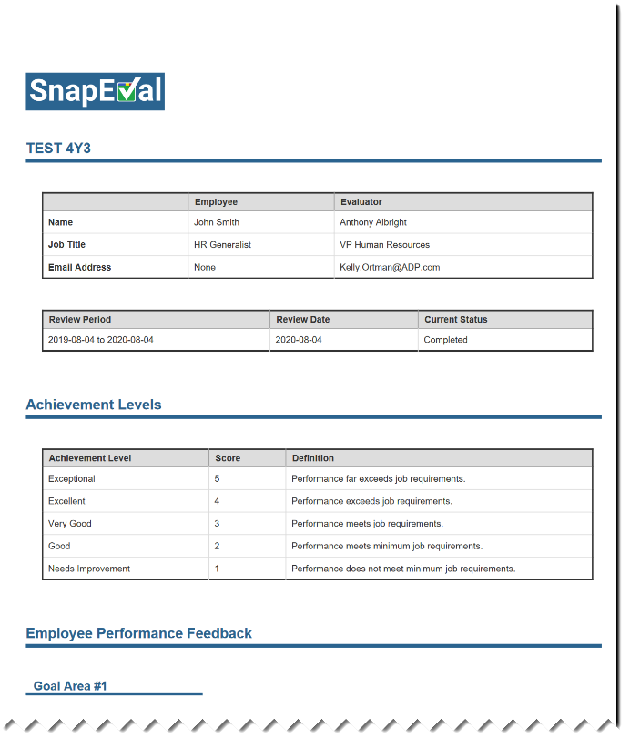
Performance Summary Introduction
A ‘Performance Summary’ is a Performance Appraisal document that can automatically include the employee’s Snaps
Snaps aren’t required to create a Performance Summary for an employee
A Performance Summary can be created at any time
Multiple concurrent draft Performance Summaries can be created for an employee
Includes the same Goal Areas that are available for capturing Snaps for the employee
  Organization-wide goals/values
  Job competencies
  Individual goals
All Snaps shared¹ with the employee during the Performance Summary date range can be included
  Snaps from Employee’s Manager(s)
  Snaps from Employee’s Peer(s)
  Employee’s Self-Snaps
Can include custom content such as Employee Comments, Development Plans, etc.
‘Overall Achievement’ can be selected manually or an automatically calculated value
Can be submitted as ‘complete’ and shared with employee by Organization Admin or any Collaborator²
¹Default setting. Organization Administrator can change to allow all Snaps (shared and unshared) to be included.
²Default setting. Organization Administrator can change to only allow Organization Admins to submit as ‘complete’ and share with employee.
Notes:
Now that we’ve covered capturing and sharing ‘Snaps,’ let’s introduce how they can be automatically incorporated into a Performance Appraisal document for the employee.
A ‘Performance Summary’ is a Performance Appraisal document that can automatically include the employee’s Snaps.
A Performance Summary can be created for an employee at any time.
Individuals that can create a draft Performance Summary include the employee, any of the employee’s Manager(s), Group Administrators for any group that the employee is a member of, and Organization Administrators.
Depending on who created the draft Performance Summary, some or all of these individuals can collaborate in editing the draft Performance Summary.
Multiple concurrent draft Performance Summaries can be created for an employee. For example, an employee can create one and the employee’s manager can create a separate one for the employee. The employee cannot view or edit the one created by the Manager, but the Manager can view and edit the one created by the employee.
A Performance Summary includes the same Goal Areas that are available for capturing Snaps for the employee. This can include:
Organization-wide goals/values
Job competencies
Individual goals
All Snaps shared¹ with the employee during the Performance Summary date range can be included. This can include:
Snaps from the Employee’s Manager(s)
Snaps from the Employee’s Peer(s)
The Employee’s Self-Snaps
However, Snaps aren’t required to create a Performance Summary for an employee. You can create Performance Summaries in SnapEval even if no Snaps have been captured.
In addition to performance feedback, a Performance Summary can include custom content such as Employee Comments and Development Plans.
Only an Organization Administrator can submit a Performance Summary as ‘complete.’ This means that the completed Performance Summary is shared electronically with the employee and a PDF document can be downloaded for signatures.

Slide 30
Steps to Create a Performance Summary
Select the Employee to receive the Performance Summary
Select the date range for the Performance Summary
Automatically include an Employee’s Snaps in a Performance Summary
  All Snaps shared¹ with the employee during the date range are automatically listed including:
    Employee’s Self-Snaps
    Snaps from Employee’s Peer(s)
    Snaps from Employee’s Manager(s)
  Select the specific Snaps from the list to include in the Performance Summary
  Selected Snaps are automatically organized by Goal Area² in the draft Performance Summary
Add comments for each Goal Area²
Select an Overall Achievement Level for each Goal Area²
Add summary comments for the Performance Summary
Select an Overall Achievement Level for the Performance Summary³
¹Default global setting. Organization Administrator can change to allow all Snaps (shared and unshared) to be included.
²Includes Organization-wide and Group-level goals specific to the Employee
³Alternately, an Overall Achievement Score may be calculated automatically
Notes:
Here are the simple steps to create a Performance Summary.
First, select the employee to receive the Performance Summary.
Second, select the date range for the Performance Summary.
Third, automatically include the employee's Snaps in the Performance Summary.
All Snaps shared with the employee during the selected date range are automatically listed, including the employee's Self-Snaps, Snaps from the employee's peer(s), and Snaps from the employee's manager(s).
Select the specific Snaps from this list to include in the Performance Summary.
The selected Snaps are then automatically organized by Goal Area into the draft Performance Summary document.
Then, add comments for each Goal Area in the Performance Summary.
Select an overall achievement level for each Goal Area.
And add comments that summarize the employee’s overall performance.
Lastly, either manually select an overall achievement level for the Performance Summary or let the SnapEval system automatically calculate an overall achievement score.

Slide 31
Performance Summary Scoring Calculation
Goal Area: The Employee’s Goal Areas that will be included in the final Performance Summary
Goal Weight: The configured weight of the Organization-wide Goal Area.
  If there’s an associated Group-level Goal Area, the Group-level Goal Area weight is used in the calculation and the Organization-wide Goal Area weight is ignored.
  Weights are simply a relative measure of importance (100 = highest) of a Goal Area and do not need to add up to 100 for an employee.
  Organization Administrators can set Organization-wide Goal Area weights and Group-level Goal Area weights.
  Group Administrators can set Group-level Goal Area weights for the Group Administrator’s assigned group(s).
Weight Coefficient: An internally calculated value (not visible to the user).
Achievement Score: The score associated with the Achievement Level selected by the Performance Summary creator for each Goal Area.
Weighted Score: An internally calculated value (not visible to the user).
Overall Achievement Score: The Overall Achievement Score as published in the final Performance Summary.
 | A | B | C | D | E
1 | Goal Area | Goal Weight | Weight Coefficient | Achievement Score | Weighted Score
2 | #1 | 80 | 80/(80+5+6) = 0.88 | 3 | 0.88*3 = 2.64
3 | #2 | 5 | 5/(80+5+6) = 0.05 | 2 | 0.05*2 = 0.11
4 | #3 | 6 | 6/(80+5+6) = 0.07 | 4 | 0.07*4 = 0.26
5 |  |  |  |  | 2.64+0.11+0.26 = 3.01
 | A | B | C | D | E
1
2
3
4
5
Goal Area
Goal Weight
Weight Coefficient
Achievement Score
Weighted Score
#1
1 to 100
= B2/(B2+B3+B4)
1 to 5
= C2*D2
#2
1 to 100
= B3/(B2+B3+B4)
1 to 5
= C3*D3
#3
1 to 100
= B4/(B2+B3+B4)
1 to 5
= C4*D4
Overall Achievement Score
Overall Achievement Score
= sum (E2:E4)
Notes:
Here's how the automated scoring and SnapEval works.
First, the Goal Areas are selected that will go into the Performance Summary.
Each Goal Area has a weight that can be configured from one to 100 by an Administrator in the SnapEval system. The higher the weight, the more important the Goal Area.
The Goal Area weights are used to automatically calculate a 'Weight Coefficient' for each Goal Area included in the Performance Summary.
These are internally calculated values and not visible to the Performance Summary creator.
When drafting a Performance Summary, the Performance Summary creator selects an achievement level for each Goal Area in the Performance Summary document.
Each achievement level is associated with an achievement score that can range from one to five. One being the lowest level of achievement and five being the highest level of achievement.
The SnapEval system then uses the weight coefficient and the achievement score for each Goal Area to calculate a weighted score for each Goal Area.
Again, this is an internally calculated value and not visible to the Performance Summary creator.
Finally, the weighted score for all of the Goal Areas in the Performance Summary are summed up. This is the overall achievement score.
Here's a numerical example of how the scoring works.

Slide 32
Performance Summary Collaboration
Notes:
In SnapEval, multiple individuals can work together on an employee's Performance Summary document.
We call this Performance Summary collaboration.

Slide 33
Performance Summary Collaborators
Performance Summary Creator | Individuals who are allowed to Collaborate
Employee
Employee
All Group Administrators for any group that the Employee is a member of
All Organization Administrators
Employee’s Manager¹
Employee’s Manager that created the Performance Summary²
All Group Administrators for any group that the Employee is a member of
All Organization Administrators
Group Administrator for any group that the Employee is a member of
All Group Administrators for any group that the Employee is a member of
All Organization Administrators
Organization Administrator
All Group Administrators for any group that the Employee is a member of
All Organization Administrators
¹Recall that the Manager role alone is only allowed to view Snaps that the Manager gives to the employee and the employee’s
Self-Snaps. Only the Manager’s Snaps for the employee and the employee’s Self-Snaps will be available to be included in the
Performance Summary.
²Note that other Managers for the employee aren’t allowed to collaborate unless they also have the Group Administrator role
Notes:
The rules that define who can collaborate on an employee's Performance Summary are based on who initiates the Performance Summary document, and their relationship with the employee.
For example, if the employee initiates their own Performance Summary, then the employee, all Group Administrators for any Group that the employee is a member of, and all Organization Administrators can collaborate on the Performance Summary document.
If the employee's manager initiates the Performance Summary, then the manager, all Administrators for any Group that the employee is a member of, and all Organization Administrators can collaborate on the Performance Summary document.
If a Group Administrator for any Group that the employee is a member of initiates the Performance Summary, then all other Group Administrators for any Group that the employee is a member of can collaborate. All Organization Administrators are also allowed to collaborate.
If an Organization Administrator initiates a Performance Summary for an employee, then all Group Administrators for any Group that the employee is a member of can collaborate. Other Organization administrators can also collaborate.

Slide 34
Performance Summary Creation and Collaboration
Who can collaborate on a Performance Summary for an Employee?
Individual that initiates the Performance Summary
Tom Willows
Partner In-Charge
Group Admin. for all Depts.
+
All Group Admins for group(s) that the Employee is a member of
+
All Organization Administrators
John LaFrance
Partner, Audit & Tax
Group Admin. for Audit & Tax Depts.
Cheryl Johnson
Director of HR
Organization Administrator
Example: Performance Summary for George Thompson
 |  | Collaborators
 |  | George Thompson | Bill Wheeler | John LaFrance | Tom Willows | Kelly Jordan | Betty Goodman | Cheryl Johnson
Performance Summary Creator (Initiator) | George Thompson
 | Bill Wheeler
 | John LaFrance
 | Tom Willows
 | Kelly Jordan
 | Betty Goodman
 | Cheryl Johnson
Department: Audit
Department: Tax
Bill Wheeler
Manager, Audit
Manager
Kelly Jordan
Manager, Tax
Group Admin. for Kelly Jordan Team
Y
N¹
Y
Y
N
N
Y
George Thompson
Accountant, Audit
User
Team Leader: Kelly Jordan
Betty Goodman
Accountant, Tax
User
¹This is an N because Bill Wheeler only has the Manager role. As such, Bill is only allowed to see the employee’s Self-Snaps and Snaps that Bill has given to the employee.
The employee, Group Admins, and Org Admins can include all Snaps that have been shared with the employee (from all sources), some of which Bill may not be allowed to view.
Notes:
The basic rule for Performance Summary collaboration is that the employee who initiated the Performance Summary, plus all Group Administrators for any Group that the employee is a member of, plus all Organization Administrators can collaborate.
Let's look at an example of how the collaboration process works for employee George Thompson.
The column on the left side of the matrix lists each of the individuals in the organization who could potentially initiate a Performance Summary for George Thompson.
The row at the top of the matrix lists the individuals who could potentially collaborate on the Performance Summary.
For example, if George Thompson initiates a Performance Summary for himself, then he is also allowed to collaborate with others on this Performance Summary.
Bill Wheeler, who is George's manager, but doesn't also have a Group Administrator role isn't allowed to collaborate on this Performance Summary. The reason is because Bill only has the manager role, he's not allowed to see Snaps that George may have received from peers or other managers and George may have included in his own Performance Summary.
John LaFrance, who is a Group Administrator for the Audit Department Group that George is a member of, is allowed to collaborate on the Performance Summary.
Tom Willows, who is another Group Administrator for the Audit Department Group, can also collaborate.
Although Kelly Jordan is a Group Administrator, she isn't a Group Administrator for a Group that George is a member of. Therefore, she can't collaborate.
Betty Goodman is George's peer. She doesn't have an Administrator role and can't collaborate.
Cheryl Johnson is an Organization Administrator, so she can collaborate.

Slide 35
Performance Summary Creation and Collaboration
Who can collaborate on a Performance Summary for an Employee?
Individual that initiates the Performance Summary
+
All Group Admins for group(s) that the Employee is a member of
+
All Organization Administrators
Tom Willows
Partner In-Charge
Group Admin. for all Depts.
John LaFrance
Partner, Audit & Tax
Group Admin. for Audit & Tax Depts.
Cheryl Johnson
Director of HR
Organization Administrator
Example: Performance Summary for George Thompson
 |  | Collaborators
 |  | George Thompson | Bill Wheeler | John LaFrance | Tom Willows | Kelly Jordan | Betty Goodman | Cheryl Johnson
Performance Summary Creator (Initiator) | George Thompson
 | Bill Wheeler
 | John LaFrance
 | Tom Willows
 | Kelly Jordan
 | Betty Goodman
 | Cheryl Johnson
Department: Audit
Department: Tax
Bill Wheeler
Manager, Audit
Manager
Kelly Jordan
Manager, Tax
Group Admin. for Kelly Jordan Team
Y
N¹
Y
Y
N
N
Y
N
Y
Y
Y
N
N
Y
George Thompson
Accountant, Audit
User
Team Leader: Kelly Jordan
Betty Goodman
Accountant, Tax
User
¹This is an N because Bill Wheeler only has the Manager role. As such, Bill is only allowed to see the employee’s Self-Snaps and Snaps that Bill has given to the employee.
The employee, Group Admins, and Org Admins can include all Snaps that have been shared with the employee (from all sources), some of which Bill may not be allowed to view.
Notes:
If Bill Wheeler initiates a Performance Summary for George, George isn't allowed to collaborate.
Of course, Bill himself can collaborate.
Because John LaFrance and Tom Willows are both Group Administrators for a Group that George is a member of, they can collaborate.
Because Kelly Jordan isn't a Group Administrator for a Group that George is a member of, she can't collaborate.
As George's peer, Betty Goodman can't collaborate.
Because Cheryl Johnson is an Organization Administrator, she can collaborate.

Slide 36
Performance Summary Creation and Collaboration
Who can collaborate on a Performance Summary for an Employee?
Individual that initiates the Performance Summary
+
All Group Admins for group(s) that the Employee is a member of
+
All Organization Administrators
Tom Willows
Partner In-Charge
Group Admin. for all Depts.
John LaFrance
Partner, Audit & Tax
Group Admin. for Audit & Tax Depts.
Cheryl Johnson
Director of HR
Organization Administrator
Example: Performance Summary for George Thompson
 |  | Collaborators
 |  | George Thompson | Bill Wheeler | John LaFrance | Tom Willows | Kelly Jordan | Betty Goodman | Cheryl Johnson
Performance Summary Creator (Initiator) | George Thompson
 | Bill Wheeler
 | John LaFrance
 | Tom Willows
 | Kelly Jordan
 | Betty Goodman
 | Cheryl Johnson
Department: Audit
Department: Tax
Bill Wheeler
Manager, Audit
Manager
Kelly Jordan
Manager, Tax
Group Admin. for Kelly Jordan Team
Y
N¹
Y
Y
N
N
Y
N
Y
Y
Y
N
N
Y
N
N¹
Y
Y
N
N
Y
George Thompson
Accountant, Audit
User
Team Leader: Kelly Jordan
Betty Goodman
Accountant, Tax
User
N
N¹
Y
Y
N
N
Y
N/A
N/A
N/A
N/A
N/A
N/A
N/A
N/A
N/A
N/A
N/A
N/A
N/A
N/A
N
N¹
Y
Y
N
N
Y
¹This is an N because Bill Wheeler only has the Manager role. As such, Bill is only allowed to see the employee’s Self-Snaps and Snaps that Bill has given to the employee.
The employee, Group Admins, and Org Admins can include all Snaps that have been shared with the employee (from all sources), some of which Bill may not be allowed to view.
Notes:
If John, Tom, or Cheryl initiate a Performance Summary for George, George isn't allowed to collaborate.
Again, because Bill Wheeler only has a manager role, he isn't allowed to collaborate. If he had a Group Administrator role too, he could collaborate.
John and Tom can collaborate on all Performance Summaries for George. This is because George and Tom are both Group Administrators for a Group that George is a member of.
Kelly and Betty aren't allowed to collaborate.
Because she is an Organization Administrator, Cheryl can also collaborate on all Performance Summaries for George.
Kelly and Betty can't initiate a Performance Summary for George, so there isn't any collaboration.

Slide 37
Performance Summary Creation and Collaboration
Who can collaborate on a Performance Summary for an Employee?
Individual that initiates the Performance Summary
+
All Group Admins for group(s) that the Employee is a member of
+
All Organization Administrators
Tom Willows
Partner In-Charge
Group Admin. for all Depts.
John LaFrance
Partner, Audit & Tax
Group Admin. for Audit & Tax Depts.
Cheryl Johnson
Director of HR
Organization Administrator
Example: Performance Summary for George Thompson
 |  | Collaborators
 |  | George Thompson | Bill Wheeler | John LaFrance | Tom Willows | Kelly Jordan | Betty Goodman | Cheryl Johnson
Performance Summary Creator (Initiator) | George Thompson
 | Bill Wheeler
 | John LaFrance
 | Tom Willows
 | Kelly Jordan
 | Betty Goodman
 | Cheryl Johnson
Department: Audit
Department: Tax
Bill Wheeler
Manager, Audit
Group Admin. for Bill Wheeler Team
Kelly Jordan
Manager, Tax
Group Admin. for Kelly Jordan Team
Y
Y¹
Y
Y
N
N
Y
N
Y
Y
Y
N
N
Y
N
Y¹
Y
Y
N
N
Y
Team Leader: Bill Wheeler
Team Leader: Kelly Jordan
George Thompson
Accountant, Audit
User
Betty Goodman
Accountant, Tax
User
N
Y¹
Y
Y
N
N
Y
N/A
N/A
N/A
N/A
N/A
N/A
N/A
N/A
N/A
N/A
N/A
N/A
N/A
N/A
N
Y¹
Y
Y
N
N
Y
¹Bill Wheeler is now a Group Admin for a group(s) that George Thompson is a member of, so this is now a Y rather than a N
Notes:
Finally, if we add the Group Administrator role for Bill Wheeler, notice how he can now collaborate on all Performance Summaries for George Thompson.

Slide 38
SnapEval Integration with ADP
Notes:
SnapEval is a fully integrated solution with several of the ADP payroll platforms including RUN Powered by ADP, ADP Workforce Now, and ADP Total Source.
SnapEval has been in the ADP Marketplace since 2015 and hundreds of organizations have deployed SnapEval integrated with ADP.

Slide 39


SnapEval integration with ADP
+
  Automatically import and sync employee data
  Single Sign-on with ADP credentials
  Automated monthly billing through ADP
Notes:
There are three core elements to SnapEval's integration with ADP.
First, basic employee data is automatically imported and synced from the organization's ADP payroll instance. This data is updated automatically each day and can be synced on demand.
Second, all users sign into their SnapEval account using their ADP User ID and password. There are no SnapEval-specific User IDs or passwords to manage. This is known as single sign-on.
Third, if an organization decides to deploy SnapEval to more than 10 users, they will be billed for the SnapEval subscription as a line item on their monthly invoice from ADP.

Slide 40
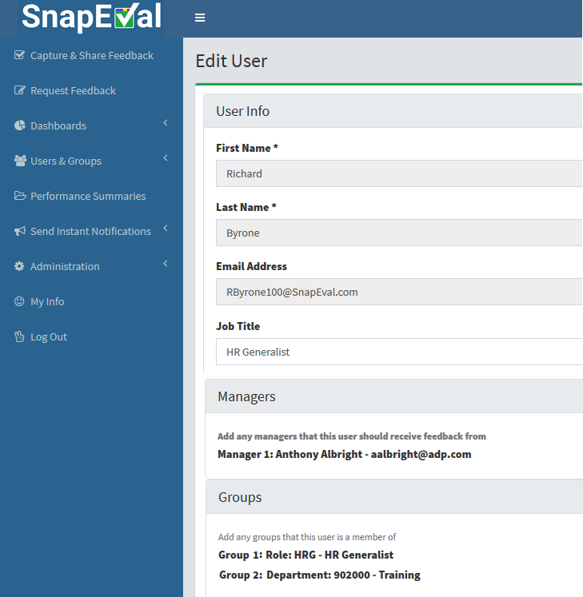
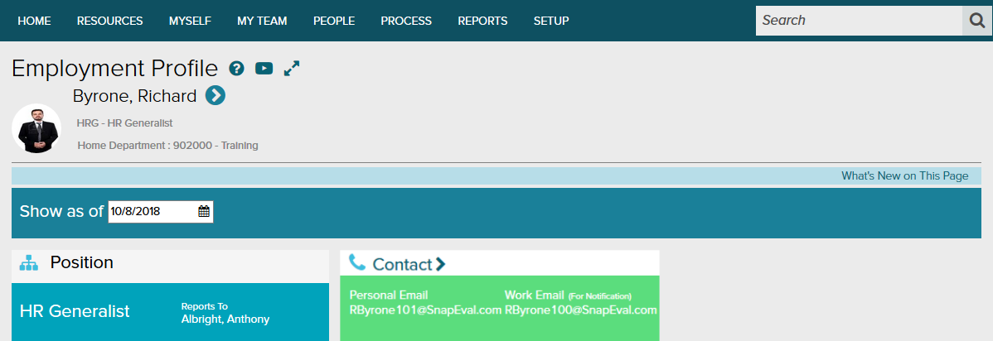
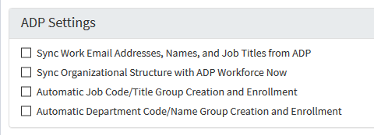
SnapEval ‘Zero-touch Administration’ (ADP Workforce Now)
✓
✓
✓
✓
Notes:
When integrated with ADP Workforce Now or ADP Total Source, SnapEval automatically imports and updates, employee name, work email address, job title, manager, job assignment, department assignment, hire date, and ADP status such as 'Active' or 'Terminated.’ This employee data is used to automatically configure and update each employee's profile in SnapEval.
If desired, employee data from ADP can be replaced or augmented with additional information. For example, additional managers can be assigned to an employee beyond the manager assigned to the employee in ADP.

Slide 41
How does SnapEval integrate with Workforce Now?
Workforce Now Modules
  Payroll + Tax is the only required Workforce Now module for full SnapEval integration
Payroll + Tax
Human Resources
Payroll + Tax
Time + Attendance
Benefits + ACA
Notes:
Only the ADP Workforce Now Payroll and Tax module is required for full integration with SnapEval.

Slide 42
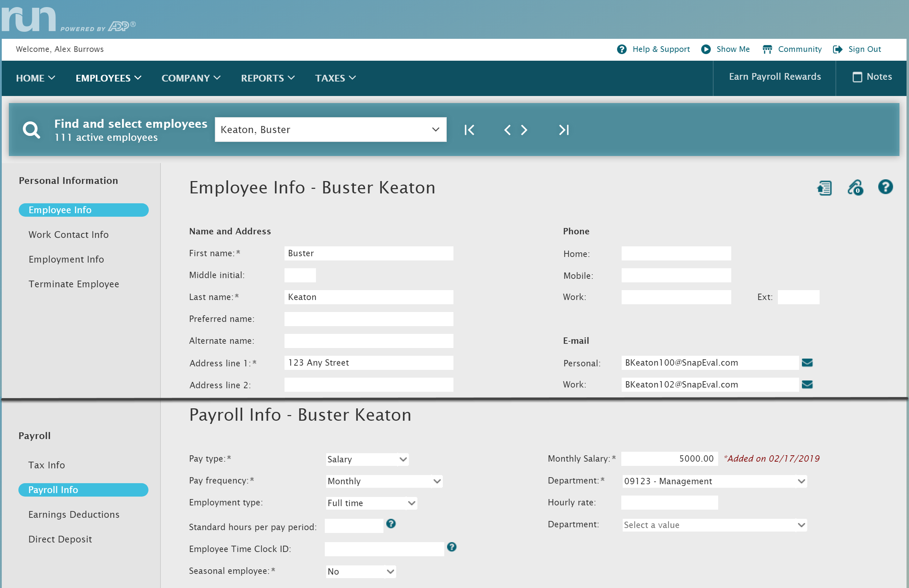
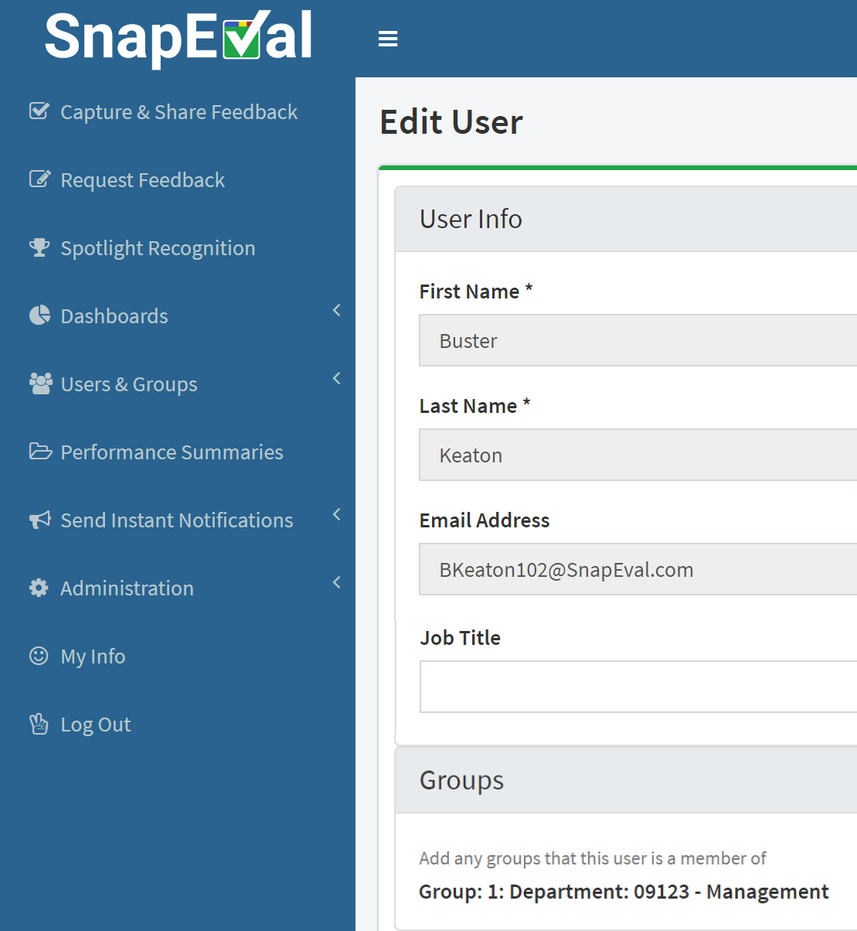
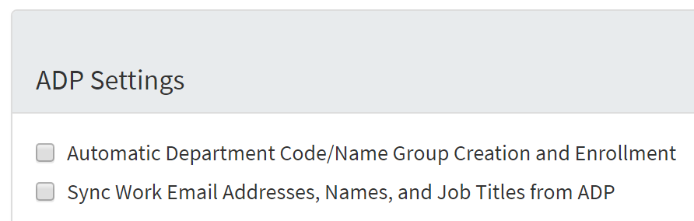
SnapEval Sync (RUN Powered by ADP)
✓
✓
Notes:
When integrated with RUN Powered by ADP, SnapEval automatically imports and updates employee name, work email address, department assignment, hire date, and ADP status.

Slide 43
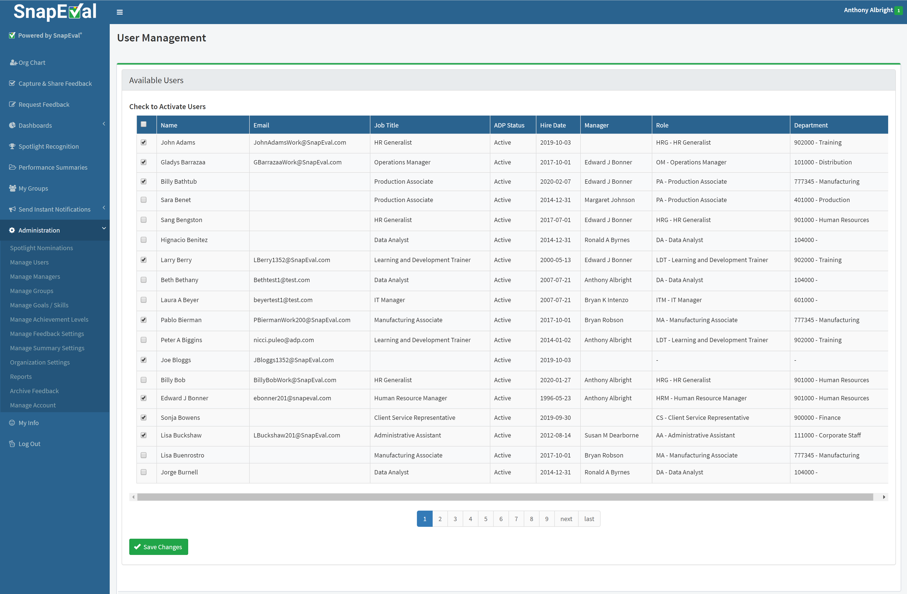
Assigning ADP Users to SnapEval – From Within SnapEval
Assign ADP users to SnapEval from within SnapEval application
Go to Administration>
Manage Users
Click ‘Add Users’
Select the users to add
Click ‘Save Changes’
Notes:
Using employee data synced from ADP, SnapEval automatically creates a User Staging Table in the SnapEval application.
By checking a check box by a user's name and clicking the Save Changes button, a SnapEval Organization Administrator uses the staging table to assign specific users from the organization to the SnapEval application.
Users can be unassigned by unchecking the check box by their name and clicking the 'Save Changes' button.

Slide 44
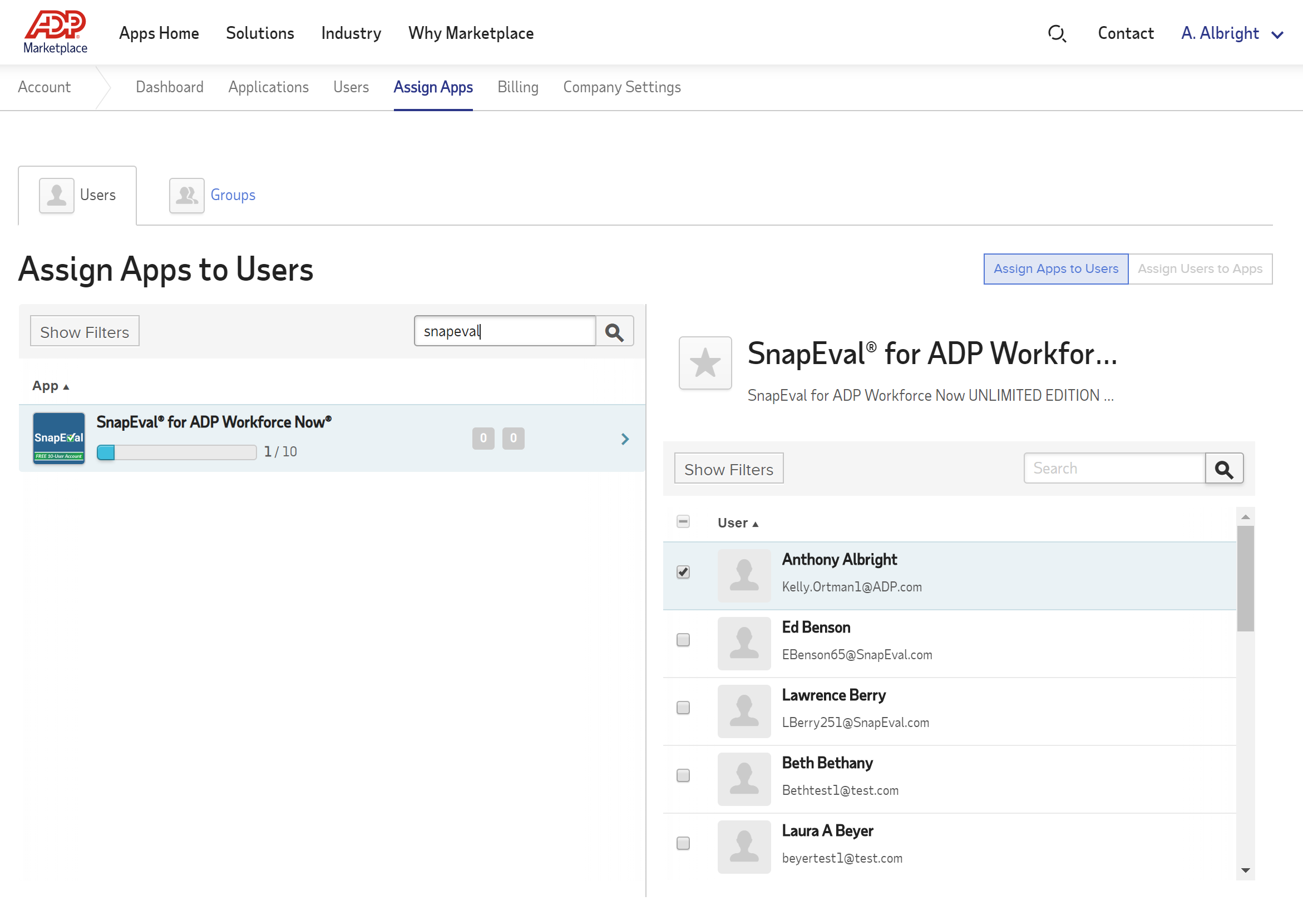
Assigning ADP Users to SnapEval – Not in ADP Marketplace
Leave your own (automatic) assignment to SnapEval in ADP Marketplace
Don’t assign other
users to SnapEval in
ADP Marketplace
Notes:
Please do not use the ADP Marketplace's 'Assign Apps' feature to assign users to the SnapEval application.

Slide 45
SnapEval Mobile App and Push Notifications
Notes:
SnapEval includes a free mobile app for iOS and Android devices.
You can download the SnapEval mobile app from the Apple App Store for iOS, and from Google play for Android.

Slide 46
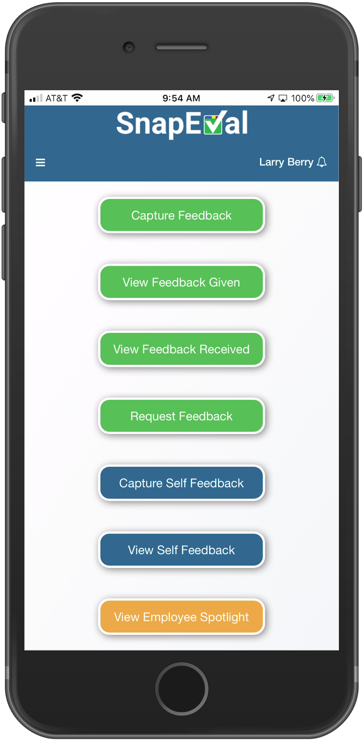
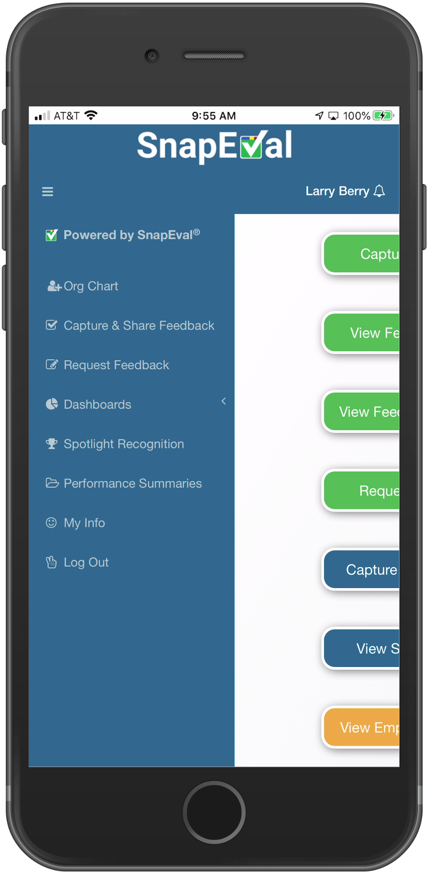
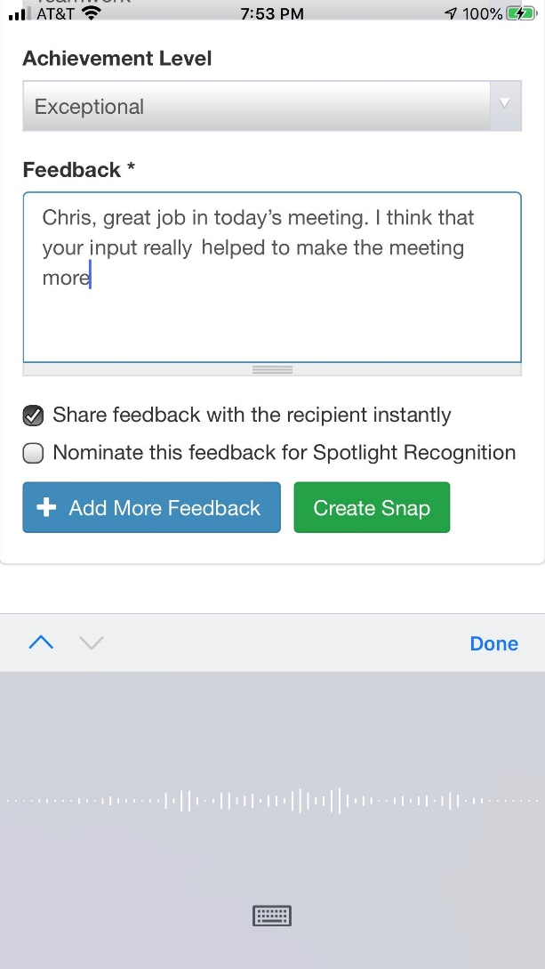
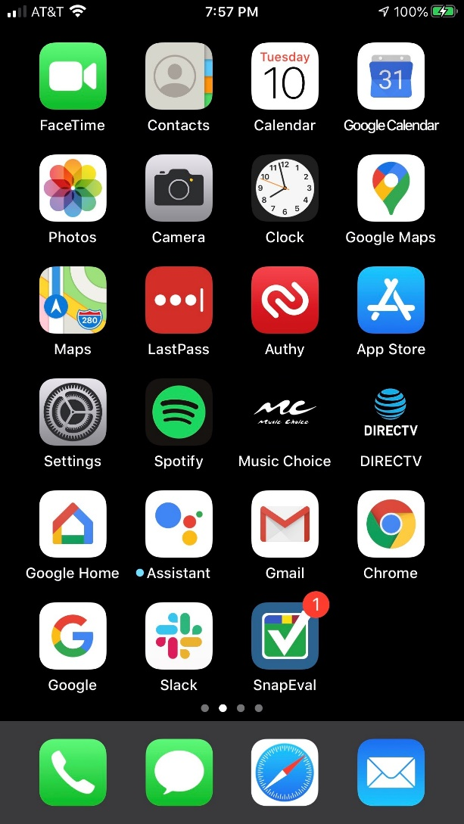
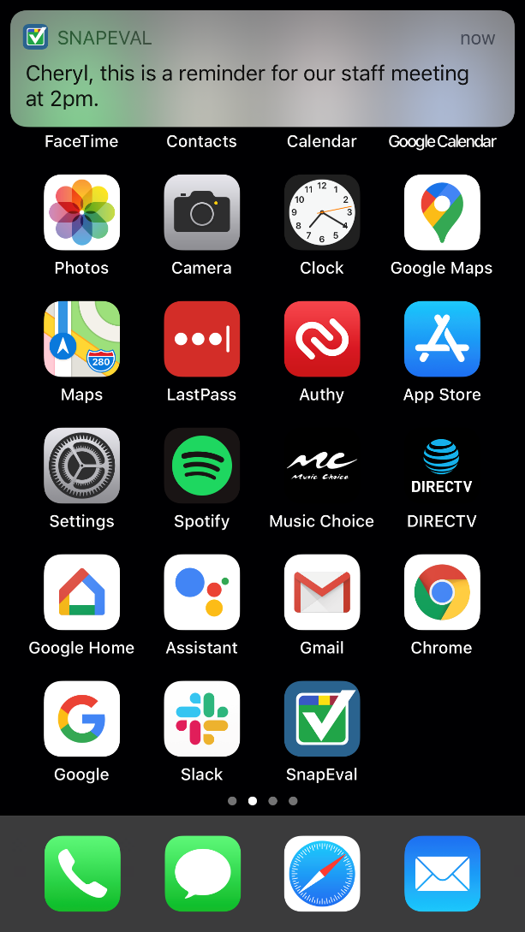
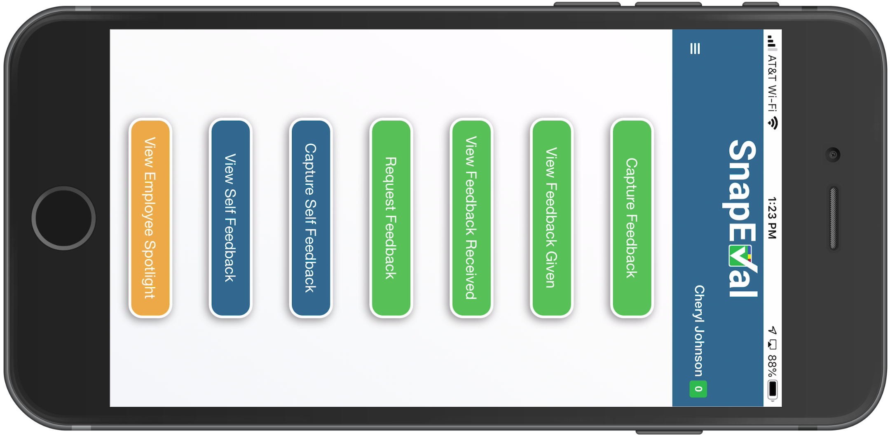
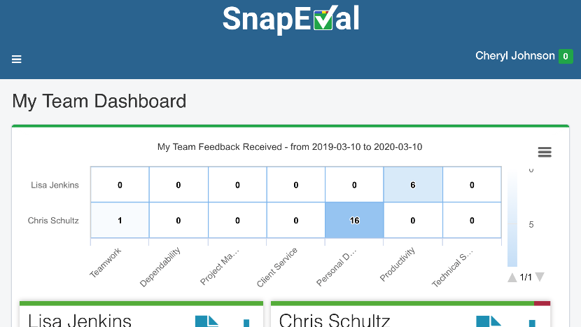
SnapEval Mobile App
Mobile buttons are shortcuts to common functions
Full functionality of the web portal
Custom and Automated Push Notifications
Badging
Voice-to-text
Portrait and landscape modes
Notes:
The home screen of the SnapEval mobile app displays buttons that are shortcuts for popular actions on a smartphone.
The green buttons relate to giving feedback to, or receiving feedback from, someone else.
The blue buttons relate to capturing or viewing self-feedback. The yellow button displays all Snaps recognized for performance excellence.
The mobile app also has the full functionality of the web portal.
Simply tap the menu button to review the full SnapEval menu.
Automated push notifications alert the user when a Snap, or a request from others for feedback, is received.
Tap on the push notification to automatically open the SnapEval mobile app and take action.
SnapEval Administrators can send urgent or important notifications with custom content to targeted users or the entire organization.
Icon badging reminds a user that there are open notifications for the user in SnapEval's Notification Center.
Voice-to-text support enables feedback details to be captured in Snaps, without typing!
The mobile app supports both portrait and landscape modes, so graphics can be viewed most easily.

Slide 47


Work from home and other remote employees
Work from home (WFH) employees and other remote workers must often multi-task without a typical office environment’s support services, computing technology, or infrastructure.
As a result, it can be difficult to reach them with:
Critical, urgent messages
Important reminders
Organization-wide announcements
Notes:
In response to the COVID-19 pandemic, many employees have transition from in-office to work from home locations.
These work from home employees and other remote workers must often multi-task without a typical office environment’s support services, computing technology, or infrastructure.
As a result, it can be difficult to reach them with
Critical, urgent messages
Important reminders, and
Organization-wide announcements.
To address this challenge, organizations need to employ new ways to effectively deliver urgent and important messages to these workers.

Slide 48



Message delivery solution requirements
A message delivery solution for a small or mid-size organization must:
Be highly effective at reaching all workers, including in-facility, WFH, and other remote employees
Enable message recipients to immediately act in response when necessary
Enable authorized users to quickly and easily create a message on a computer or a smartphone
Enable the desired recipient(s) to be targeted instantly
Be FREE of cost to the organization, the message sender, and message recipients
Notes:
A message delivery solution for a small or mid-sized organization must meet the following requirements:
Be highly effective at reaching all workers, including in facility work from home and other remote employees.
Enable message recipients to immediately act in response when necessary.
Enable authorized users to quickly and easily create a message on a computer or a smartphone.
Enable the desired recipients to be targeted instantly.
Be free of cost to the organization, the message sender, and message recipients.

Slide 49


Smartphones: Most effective communications platform
In 2019, adults in the USA spent an average of nearly 3 hours per day* on their smartphone.
Smartphones are always connected and automatically switch between cellular and Wi-Fi.
Unlike computers, which may be shared between users, each user typically has their own smartphone.
Smartphones are almost never out of arm’s reach, even when the user is asleep.
*https://simpletexting.com/screentime-smartphone-usage-statistics/
Notes:
Today, smartphones are the most effective communications platform.
In 2019, adults in the USA spent an average of nearly three hours per day on their smartphone. Smartphones are always connected and automatically switched between cellular and Wi-Fi.
Unlike computers, which may be shared between users, each user typically has their own smartphone.
Smartphones are almost never out of arm's reach, even when the user is asleep.

Slide 50
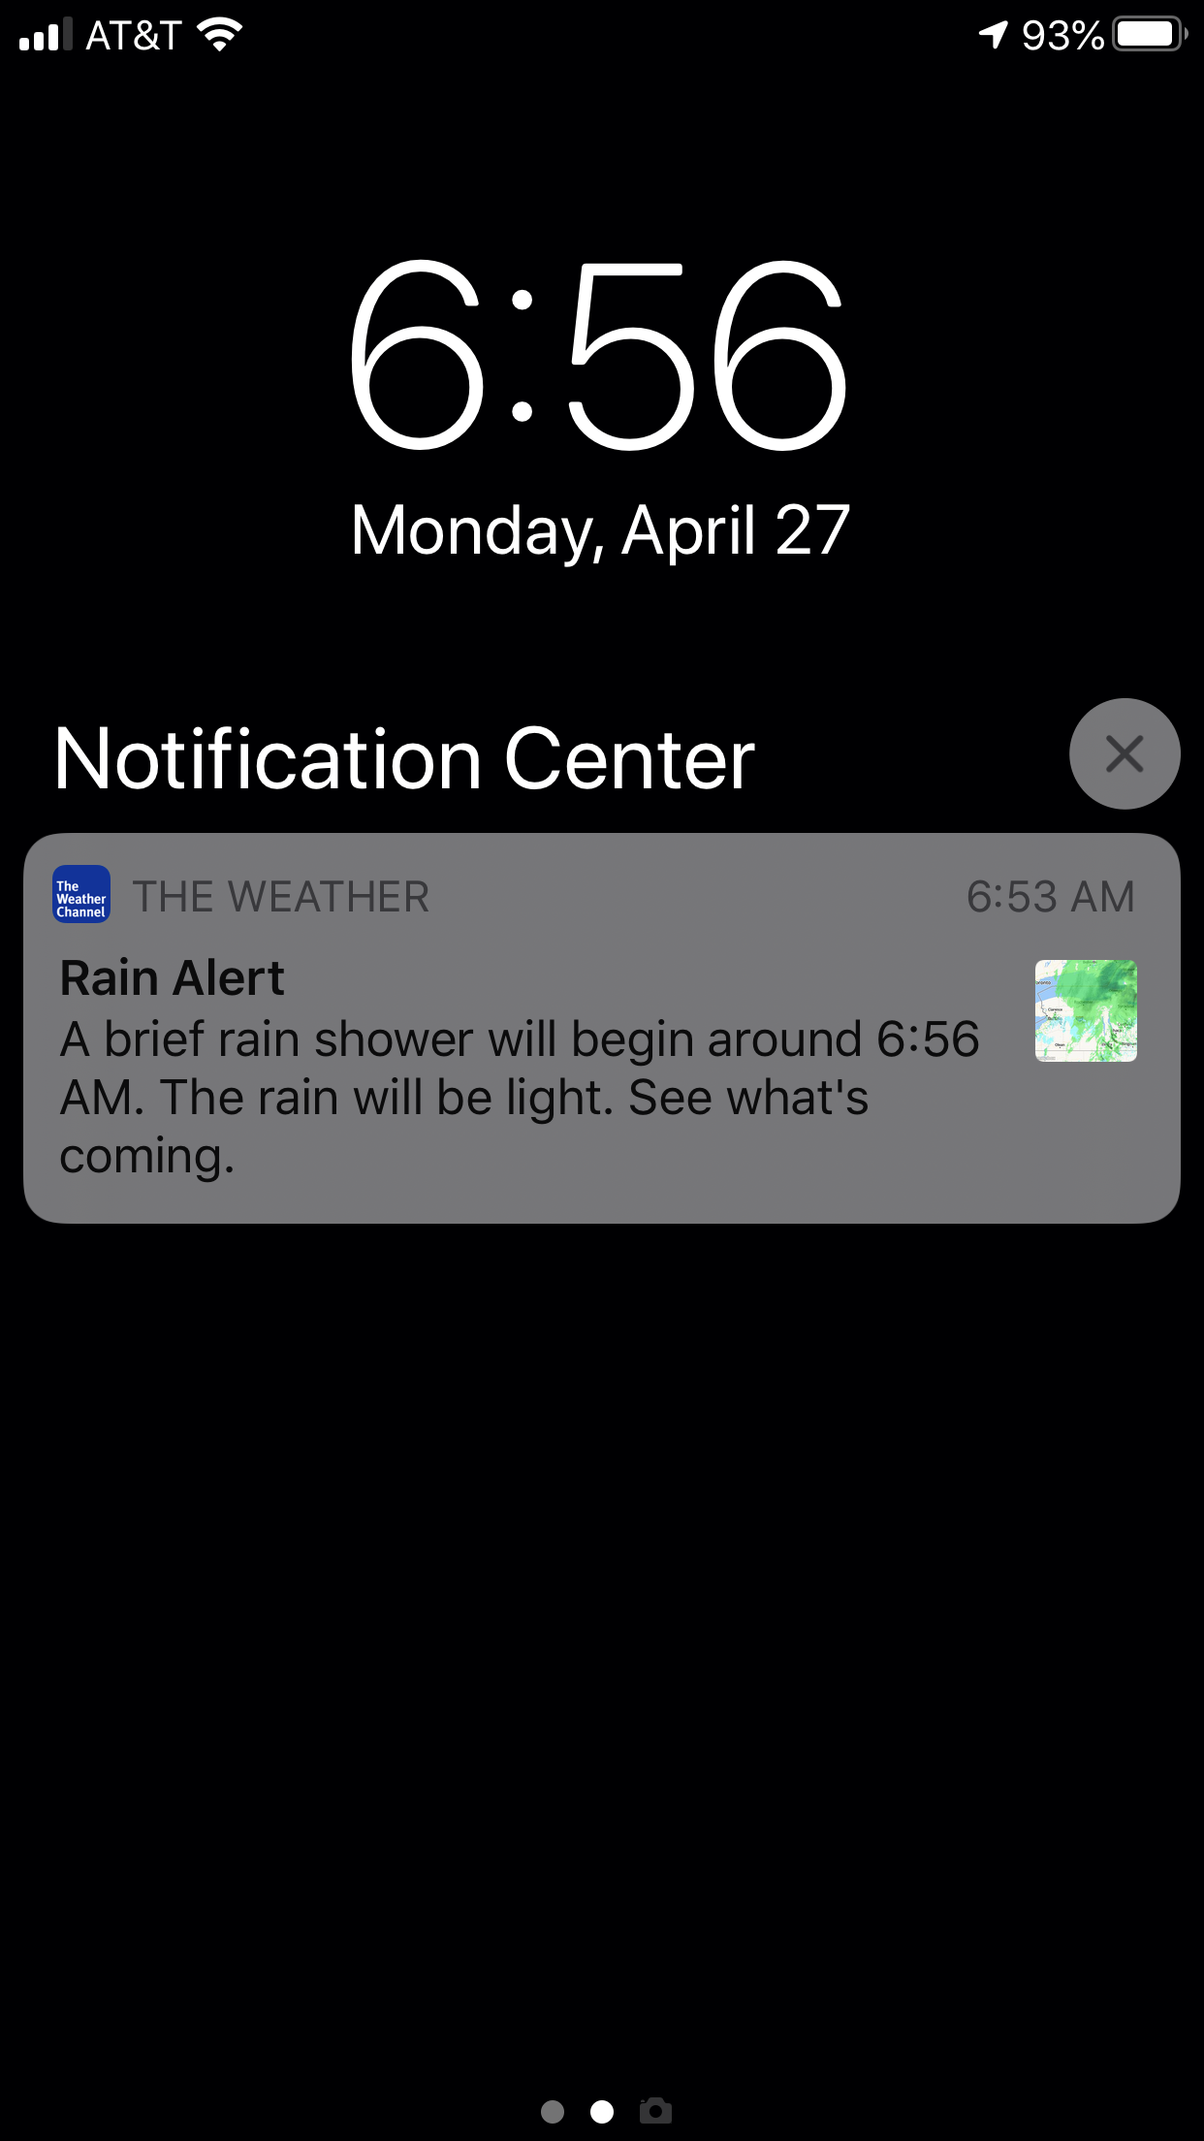
Push Notifications: Most effective communications method
Smartphone Push Notifications are used for Public Safety, Emergency, and AMBER alerts
Popular mobile apps employ Push Notification messages to instantly
deliver critical news or weather alerts
Why are Push Notifications highly effective?
Are instantly presented to the smartphone user, even if the device is locked or in use
Bypass the clutter of email, text, and other 3rd party messaging services
Are automatically delivered to the smartphone, even when the device is asleep
Can include an image to accompany the text
Can open a specified web page when tapped by the user
Can be targeted to specific users or to all users of a mobile app
Don’t require the phone number of a device for message delivery
Can be delivered to multiple devices for each recipient
No cost to the sender. Use tiny amount of data for recipient (≤256 bytes)
Rich Push
Notifications
Notes:
Push Notifications are the most effective communications method to reach a smartphone user.
Smartphone Push Notifications are used for Public Safety, Emergency, and AMBER alerts
Popular mobile apps employ Push Notification messages to instantly deliver critical news or weather alerts
Why are Push Notifications highly effective?
Because they are immediately presented to the smartphone user, even if the device is locked or in use
As a built-in feature of the device, they bypass the clutter of email, text, and other 3rd party messaging services
Push Notifications are automatically delivered to the smartphone, even when the device is asleep
A Push Notification can include an image to accompany the text
It can also open a specified web page or resource when tapped by the smartphone user
These two features make a Push Notification even more effective and distinguish it as a ‘Rich’ Push Notification
A Push Notification message can be targeted to specific users or to all users of a mobile app
Push Notifications don’t require the phone number of a device for message delivery, so the sender doesn’t have to collect and update phone numbers for each recipient.
Push Notifications can be delivered to multiple devices for each recipient including iPhones, iPads, and Android devices.
Unlike text messaging services, where the organization pays for each text message sent, there is no cost to the sender or recipient for Push Notification messages, and they use only tiny amount of data for recipient.

Slide 51









SnapEval Custom Rich Push Notification Messages
Feature | iOS | Android | Accompanying Email
Automatically target message recipient(s)
- Everyone in organization
- All members of a group (e.g. a Department, a Team, a Job Function)
✓
✓
✓
- All individuals in a SnapEval role (e.g. all Managers)
- A specific individual
Specify a Message Type Indicator¹
- Critical, urgent
- Important, reminder
✓
-
✓
- Acknowledgement, task completed
- Informational
Include Custom Text Message (up to 250 characters)
✓
✓
✓
Include Emojis in Text
✓
✓
✓
Include Direct Web Link (e.g. https://www.cdc.gov)¹
✓
✓
✓
Deliver message by email to all targeted recipients²
✓
✓
✓
Identify message sender
-
-
✓
¹Rich Push Notification Feature
²The email is delivered to all targeted recipients, including recipients who aren’t using the SnapEval mobile app
Notes:
SnapEval’s Custom Rich Push Notification Message service helps small and mid-size organizations to effectively deliver urgent and important messages to their employees.
Here are the key features of SnapEval’s Custom Rich Push Notification Messaging service:
SnapEval administrators in an organization can instantly target the specific recipients for a message. This includes everyone in the organization, all members of a specific group (such as a department, team, or job function), all individuals in a SnapEval role (such as all managers), or a specific individual.
The message creator can select an image to indicate the type of message being sent. For example, a red indicator for a critical, urgent message, or a green indicator for an organization-wide announcement about an important achievement.
The message can be up to 250 characters in length and can include Emojis. Because they’re remote, work from home employees may not have the context for a message, so Emojis can help to set the message’s tone.
The message can also include a web link. When tapped by the recipient, this web link will automatically be opened on the user’s smartphone so they can take action as necessary.
All targeted recipients of a message receive an email with the full message contents, including the identity of the message sender. The email serves two purposes:
It is the only way to deliver the message to recipients that don’t have the SnapEval mobile app installed on their smartphone.
When a smartphone user taps a Push Notification message, the Push Notification is cleared on the device. The accompanying email enables the smartphone recipient to review the message at any time.

Slide 52
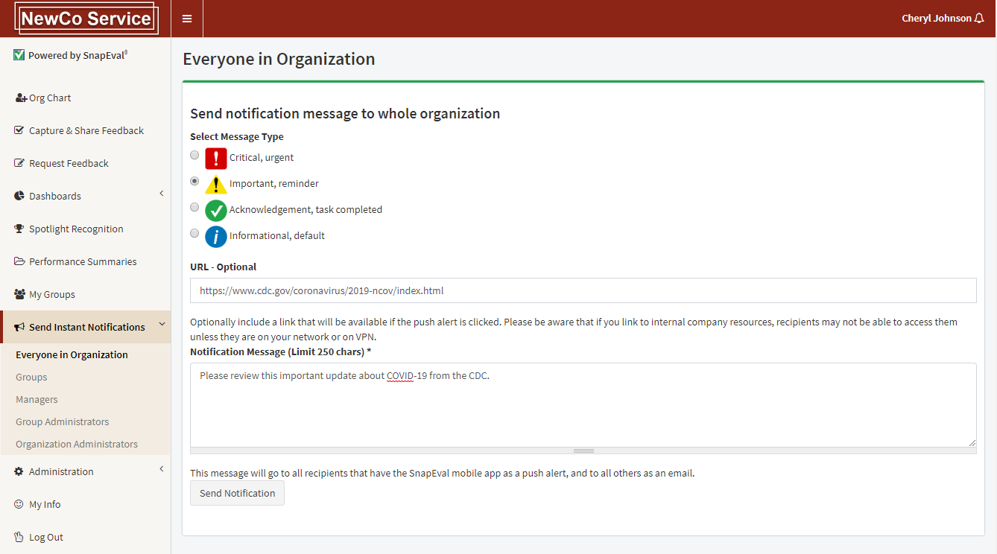
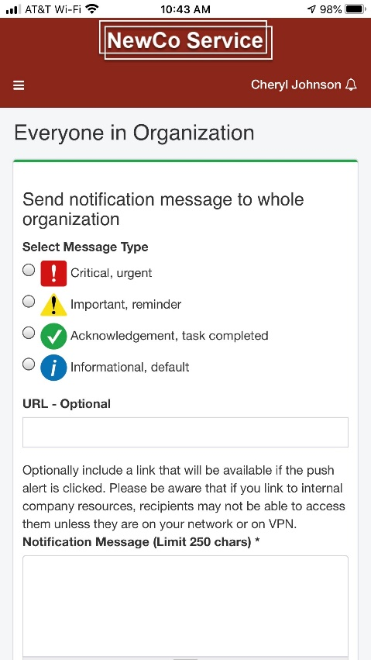
Create and send a Custom Rich Push Notification
(SnapEval Administrators Only)
1. Select recipient(s)
2. Select optional message type
3. Add optional web link
4. Add message text (can include Emojis)
5. Send the notification
Create and send from SnapEval mobile app
Notes:
A custom rich push notification can be created and sent in seconds.
First select the target audience for the message.
Second, select an optional message type. This will determine the icon displayed in the notification.
Third, if desired, add an optional web link. This can be a link to a webpage internal or external to SnapEval.
Fourth, add a text message of up to 250 characters. It can include emojis.
Finally, click the 'Send Notification' button to send it to all recipients.
Custom rich push notifications can also be created and sent from the mobile app.

Slide 53
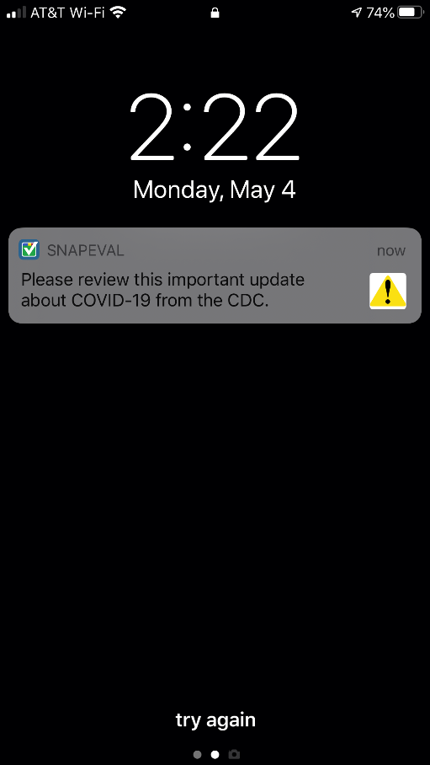
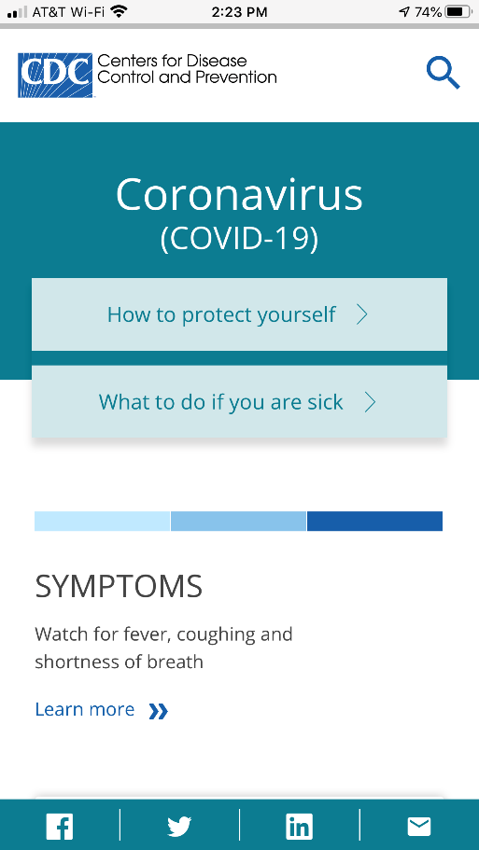
Your message is delivered to mobile app recipients
Message type you selected
Specified web link is opened when recipient taps the notification message
Your custom text
Notes:
The custom rich push notification message is delivered to the recipient's smartphone.
The custom text message is displayed along with the selected notification icon.
If the notification is tapped, the specified web link is opened in the SnapEval mobile app on the smartphone.

Slide 54
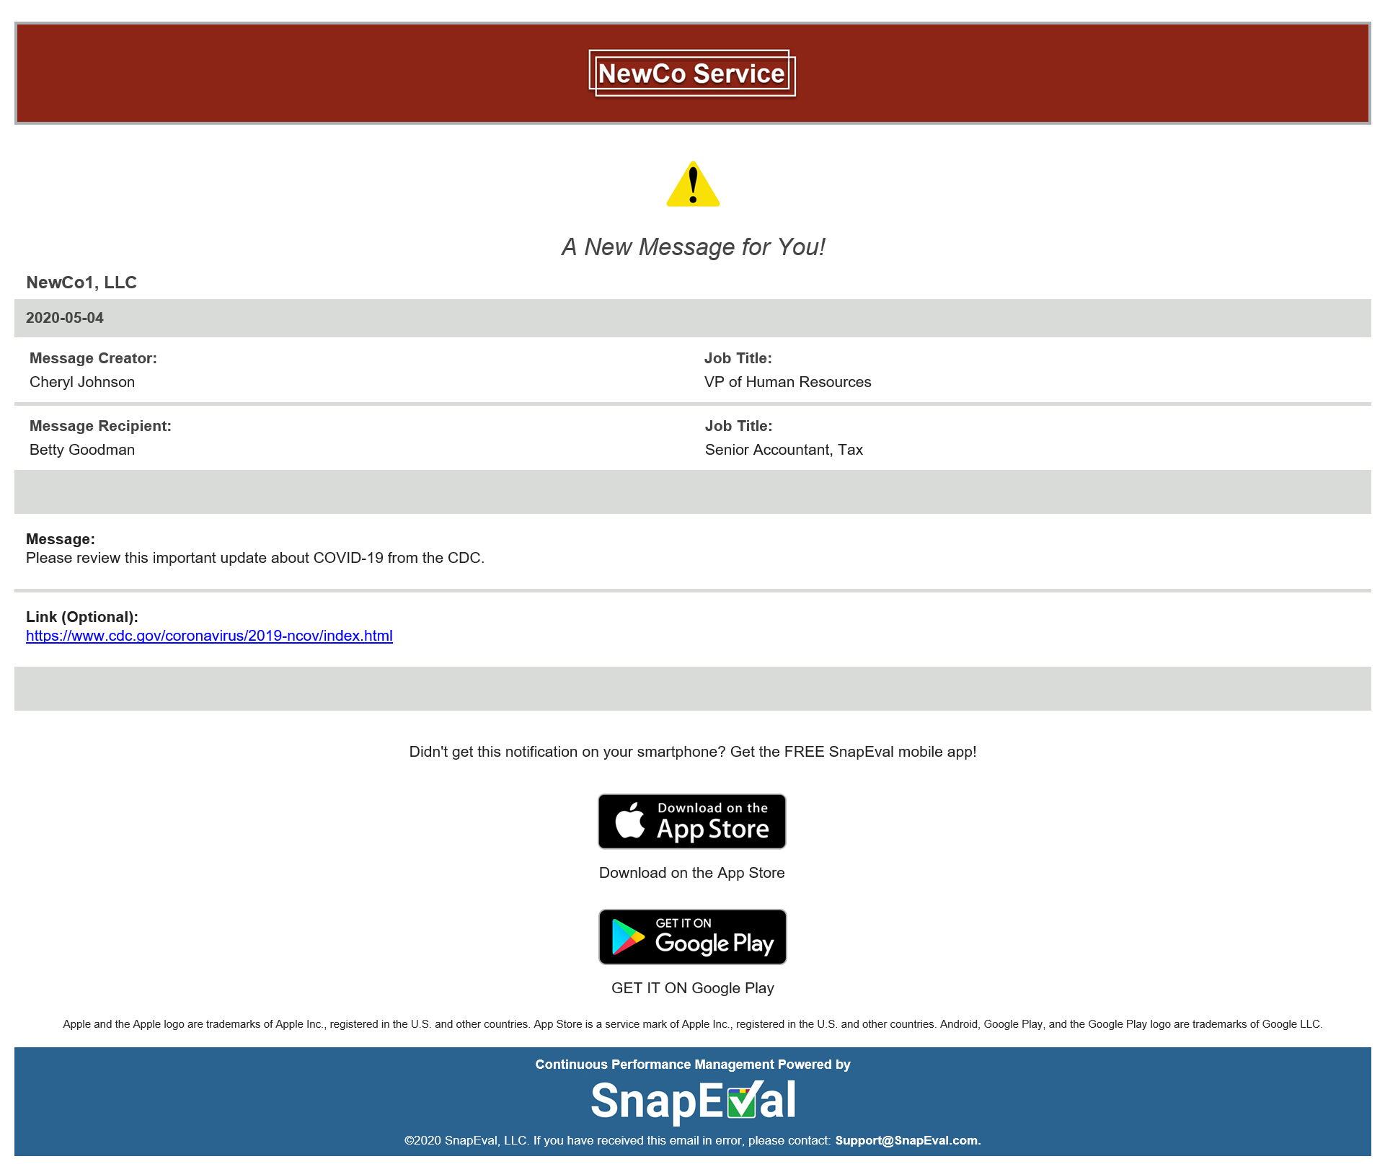
Your message is also delivered to all recipients by email
Custom branded with your organization’s logo and a complementary color theme
Message type you selected
Message Creator
Message Recipient
Your custom text
Specified web link
On their smartphone,
recipients can click on the appropriate button to instantly download the FREE SnapEval mobile app
Notes:
The message is also delivered as an email to all recipients.
The email includes the organization's logo and a complimentary color theme.
The selected notification icon is displayed at the top of the email.
The message creator and recipient are shown.
The custom text, including emojis is displayed.
The specified web link URL is also displayed.
To encourage all recipients to download and install the free SnapEval mobile app, links to the SnapEval mobile app in the Apple App Store and Google Play are included in the email.

Slide 55
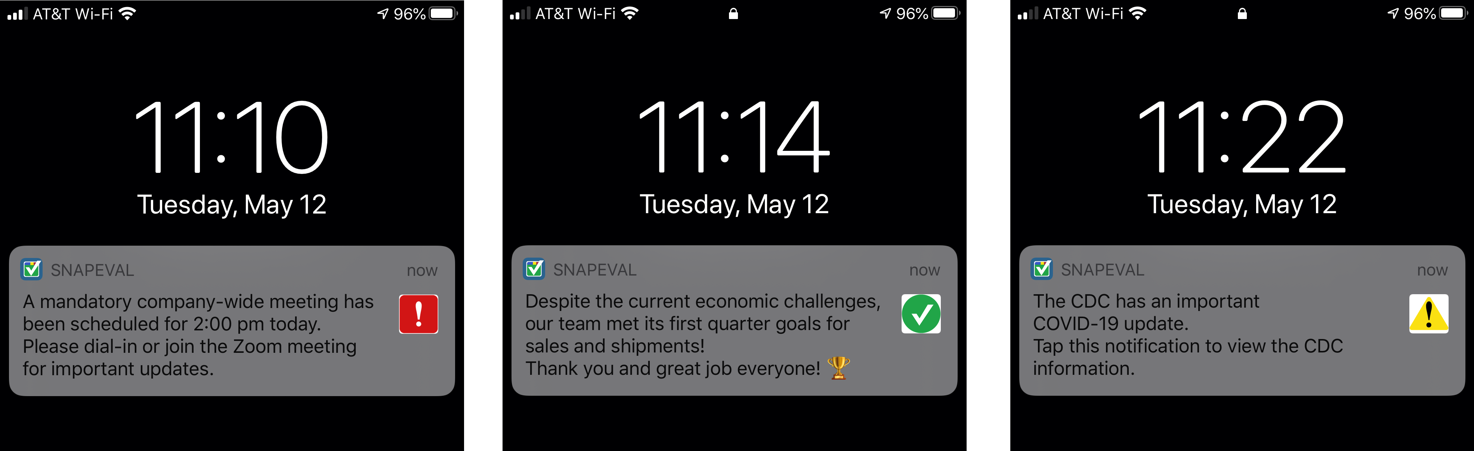
Custom Rich Push Notification Examples
Notes:
Here are some example messages delivered as rich custom push notifications.

Slide 56
Recognition of Performance Excellence (Spotlight)
Notes:
Recognizing the performance excellence of employees helps to increase their engagement with the organization and their job.

Slide 57
Performance Recognition
Performance Management and Performance Recognition are separate processes
Feature | Action
Feedback Creator
(Manager)
SnapEval Administrator
(HR Professional)
Feedback Recipient
(Employee)
Performance
Feedback Queuing Enabled
Feedback that meets predefined criteria is automatically queued for review by SnapEval Administrator before delivery to Feedback Recipient.
Performance
Feedback Queuing Disabled
All feedback is delivered directly to Feedback Recipient without review by SnapEval Administrator
Submit Snap Content
Inappropriate
Language¹?
Meets Queuing Criteria²?
No
No
Shared?
Yes
Feedback
Received*
Performance Management
No
Yes
*Feedback is visible only to employee, employee’s manager(s), and SnapEval Administrators
Email notification
Yes
Hold until Shared
Queued for Review
End
Feedback can be nominated for recognition of performance excellence.
Everyone in Organization
Spotlight Performance Recognition Enabled
Feedback cannot be nominated for recognition of performance excellence.
Spotlight Performance Recognition Disabled
Nominated for Spotlight recognition?
Nomination Reviewed
Yes
Accepted
Recognition
Published**
Performance Recognition
**Recognition is visible to everyone in organization through Spotlight Recognition Dashboard
No
Declined
End
End
¹Automatic, built-in dictionary of 400+ unacceptable words
²Administrator configurable organization-specific criteria
Notes:
Earlier, we introduced the workflow for Snaps in the Performance Management process, which is the top half of this diagram.
Now let’s focus on the ‘Spotlight Performance Recognition’ process, which is the bottom half of this diagram.
With the Spotlight Performance Recognition feature enabled, in the process of creating a Snap, a Feedback Creator has the option of nominating the Snap for public recognition of performance excellence within the organization.
To do this, the Feedback Creator checks the ‘Nominate this feedback for Spotlight Recognition’ checkbox before submitting the Snap.
After checking the checkbox, the Feedback Creator can also include optional comments that are only shared with the Organization Administrator(s) who will be reviewing the nomination. This provides the Feedback Creator with the opportunity to give more context as to why the Snap is being nominated for recognition of performance excellence. These optional comments aren’t shared with the recipient or anyone else.
Organization Administrator(s) are notified when a Snap has been submitted for recognition of performance excellence.
If the nomination is declined, the Performance Recognition process ends. However, it is important to note that the Feedback Recipient will still receive their Snap according to the Performance Management process we reviewed earlier. Of course, this feedback is private to the recipient as it is the Performance Management process.
If the nomination is accepted, then the Snap content is published to the Spotlight Recognition dashboard, which all the organization’s users have access to. The recipient also receives a Spotlight Recognition email from the SnapEval system.
If the organization periodically recognizes performance excellence in company-wide meetings, Organization Administrators can run reports that detail all of the Snaps that have been recognized for Spotlight Performance Excellence during a specified period and use this information for awards or other internal recognition activities.

Slide 58
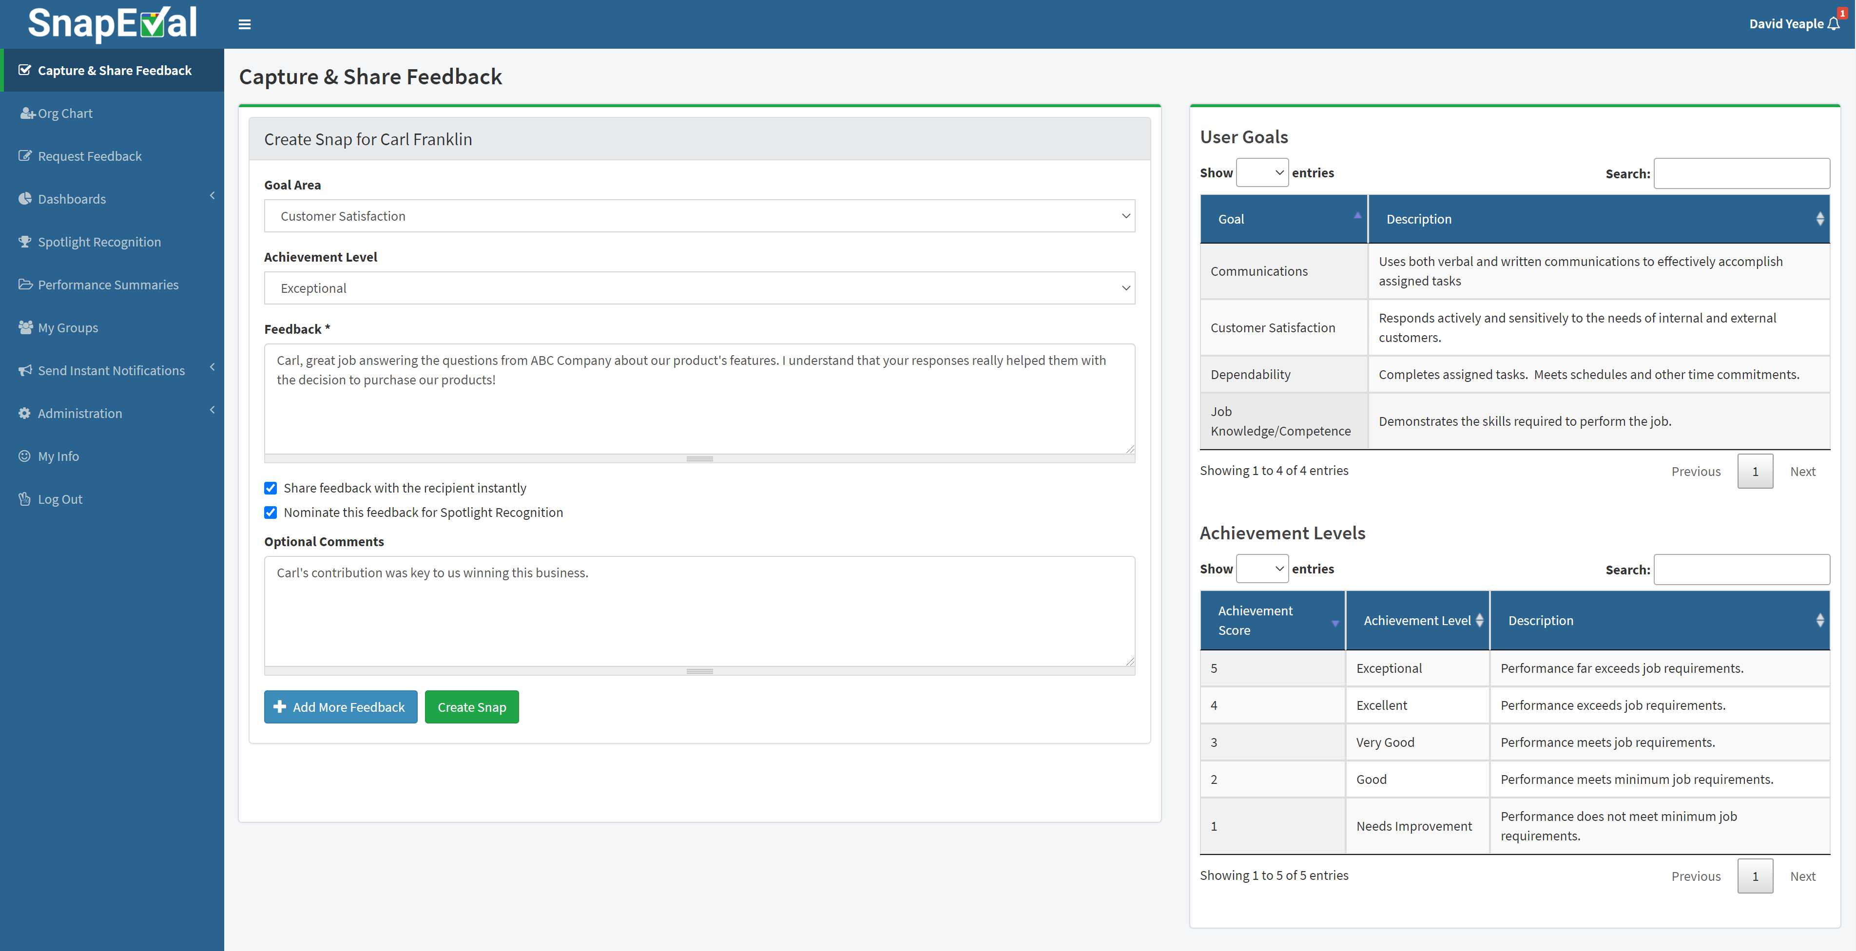
Spotlight Performance Recognition - Nomination
With Spotlight enabled, feedback can be nominated for recognition of performance excellence at the same time it’s captured!
Notes:
SnapEval's Spotlight Performance Recognition feature enables the creator of a Snap to nominate this employee feedback to be recognized for performance excellence within the organization.
A Snap can be nominated by checking the 'Nominate this feedback for Spotlight Recognition' check box at the time that a Snap is created.
When the check box is checked, a separate text box is displayed that can be used to include a private message to nomination reviewers with details about why the Snap is being nominated for Spotlight recognition.

Slide 59
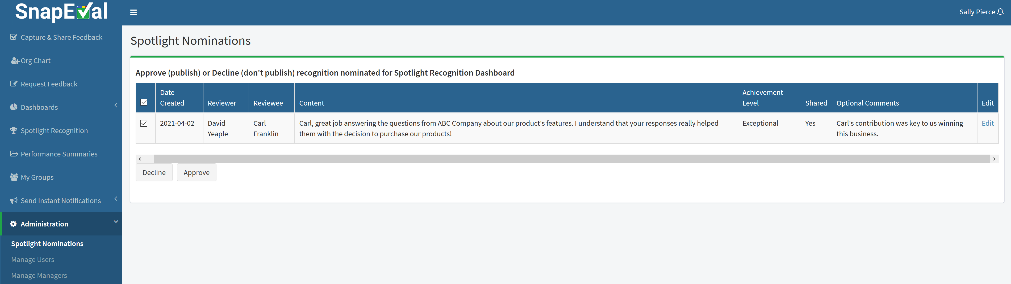
Spotlight Performance Recognition - Review
SnapEval Administrators approve or decline feedback nominated for recognition.
They can also edit the feedback.
Notes:
Organization Administrators review and approve or decline Snaps nominated for Spotlight recognition.
They can also edit the Snap content, which can be helpful in case of typos.
However, it's important to note that this also edits the Snap content for performance management purposes.
If a nomination is declined, the Snap recipient still receives their feedback in accordance with the performance management process in SnapEval.

Slide 60
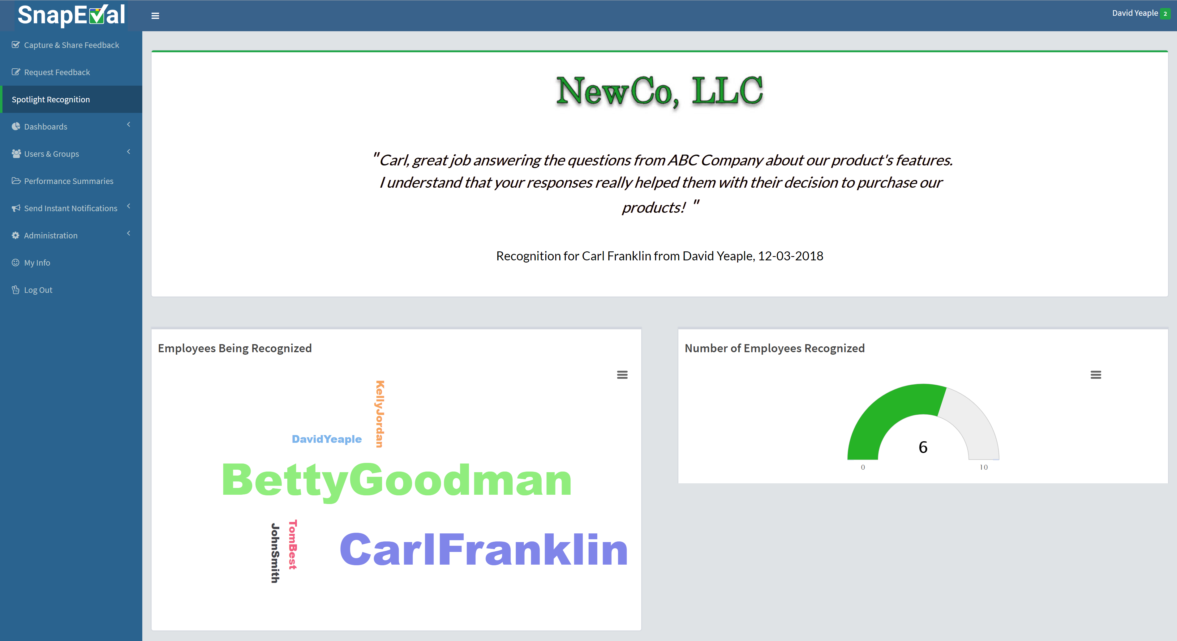
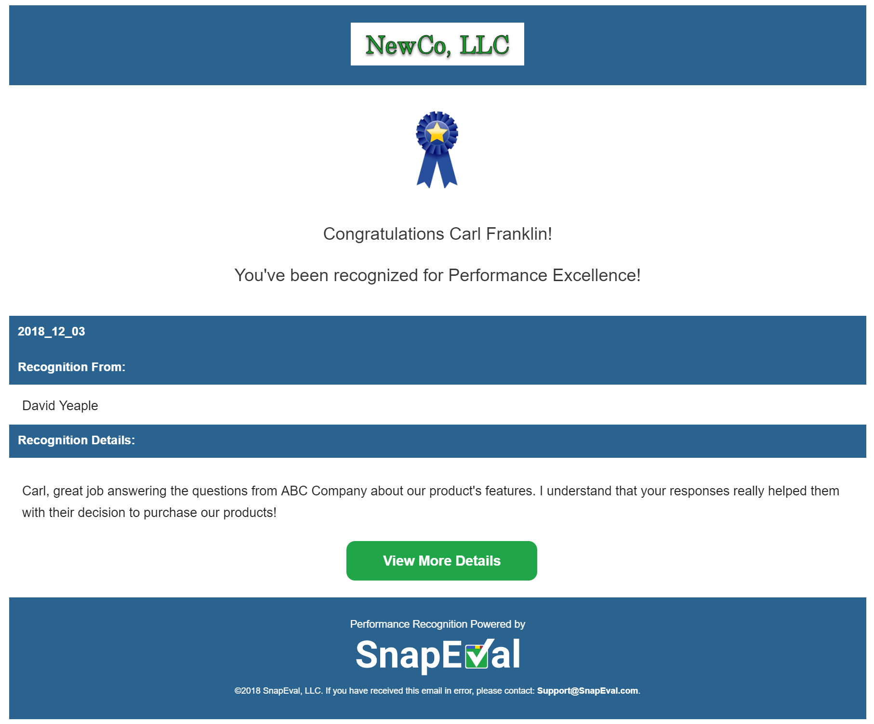
Spotlight Performance Recognition - Publishing
Approved recognition is published in the integrated Spotlight Recognition Dashboard for public display within the organization.
The recognition recipient is also notified by email and smartphone notification!
Notes:
Approved nominations are published to the Spotlight dashboard for public recognition within the organization.
All users in an organization with a SnapEval login can view the Spotlight dashboard.
The recognition recipient is also notified by email and a smartphone push notification.

Slide 61
Getting Started
Notes:
The process for getting started with SnapEval is quick and easy.
Depending on the complexity of an organization and its goals, deployments can be done in a matter of minutes to a few hours.

Slide 62
Getting started with SnapEval (non-ADP Customers)
Create a FREE
10-user SnapEval account at SnapEval.com
Provide org chart, values, goals, competencies, etc.
SnapEval
adds your firm’s Departments & Roles
SnapEval adds your firm’s values, competencies, goals, etc.
Your Time: ~2 min.
Your Time: ~2 min.
Your Time: 0 min.
Your Time: 0 min.
Your Cost: FREE
Your Cost: FREE
Your Cost: FREE
Your Cost: FREE
Assign up to 9 more users
Deploy to >10 users?
SnapEval bulk enrolls users
SnapEval helps with training managers and employees
Yes
Your Time: ~5 min.
No
Your Time: A few minutes
Your Time: ~30 min.
Your Cost: FREE
Your Cost: $2.25/user/mo.
Your Cost: FREE
- Billed monthly
Continue to use SnapEval
- No upfront costs
- No contract or commitment
Your Time: 0 min.
Your Cost: FREE
Notes:
The deployment process for organizations using SnapEval standalone starts by creating a free 10-user SnapEval instance at SnapEval.com. This step takes about two minutes and is free.
The organization could configure their own SnapEval instance, but it's a free service from SnapEval. So why not take advantage of the offer? To do this the organization provides SnapEval with basic information, such as an org chart, company goals, and job competencies. SnapEval then adds the organization's departments and job functions.
SnapEval also configures the organization's goals, job competencies, and other settings. Notice that there's still no cost to the organization in this process.
The organization can then add up to nine additional team members for a total of 10 users.
The organization is then ready to use the free 10 user account. All features are included and there's no time limitation. It's not trial software. The cost remains free indefinitely.
If the organization decides that it would like to deploy SnapEval to more than 10 users, then SnapEval can bulk enroll the additional team members.
This could be a team, a department, or the whole organization. At this point, SnapEval, we'll have the organization add its credit card, which will be billed $2.25 per user each month, based on actual enrollments. There's no upfront costs, contract, or commitment, and the organization can cancel anytime and take all of its data.
The last step is that SnapEval will also help with manager and employee training. This is also a free service.
This process is designed to minimize costs and risk to the organization and to empower the HR Professional to explore and utilize SnapEval without making any commitments for the organization.
The organization sets the pace for moving through these process steps, not SnapEval. In other words, the SnapEval team is there to assist the organization and won't push the organization to move through the process or deploy SnapEval to the whole organization.

Slide 63
Getting started with SnapEval (ADP Customers)
Create a FREE
10-user SnapEval account in the
ADP Marketplace
Log into SnapEval and accept ADP Consent Requests
SnapEval
imports Departments & Roles from ADP
SnapEval adds your firm’s values, competencies, goals, etc.
Your Time: ~2 min.
Your Time: ~1 min.
Your Time: 0 min.
Your Time: 0 min.
Your Cost: FREE
Your Cost: FREE
Your Cost: FREE
Your Cost: FREE
Assign up to 9 more users
Deploy to >10 users?
Assign >10 users to SnapEval
SnapEval helps with training managers and employees
Yes
Your Time: ~5 min.
No
Your Time: A few minutes
Your Time: ~30 min.
Your Cost: FREE
Your Cost: $2.25/user/mo.
Your Cost: FREE
- Billed monthly by ADP
Continue to use SnapEval
- No upfront costs
- No contract or commitment
Your Time: 0 min.
Your Cost: FREE
Notes:
The deployment process for organizations using SnapEval with ADP starts by creating a free 10-user SnapEval instance in the ADP Marketplace. This step takes about two minutes and is free.
The next step is for the organization's ADP Marketplace Administrator to log into their SnapEval account and accept the two ADP consent requests. This allows SnapEval to import core employee data, such as names, email addresses, and department assignments from ADP to configure the organization's SnapEval instance. Notice that there still no cost to the organization in this process.
The organization could configure its own goals, values, and job competencies, but account configuration is a free service from SnapEval, so why not take advantage of the offer and let SnapEval do the work?
The organization can then add up to nine additional team members for a total of 10 users. The organization is now ready to use its free 10-user account. All features are included and there's no time limitation. It's not trial software. The cost remains free indefinitely.
If the organization decides that it would like to deploy SnapEval to more than 10 users, SnapEval will have the organization change its subscription size in the ADP Marketplace. The organization will then be billed directly by ADP at $2.25 per user each month, based on the subscription size. There's no upfront costs, contract, or commitment and the organization can cancel anytime and take all of its data.
The last step is that SnapEval will also help with manager and employee training. This is also a free service.
This process is designed to minimize costs and risk to the organization, and to empower the HR Professional to explore and utilize SnapEval without making any commitments for the organization.
The organization sets the pace for moving through these process steps, not SnapEval. In other words, the SnapEval team is there to assist the organization and won't push the organization to move through the process or deploy SnapEval to the whole organization.

Slide 64
Get started now!
Instantly create your free 10-user SnapEval account
  SnapEval
  https://www.snapeval.com/
  SnapEval for ADP Workforce Now
  https://apps.adp.com/apps/209526
  SnapEval for RUN Powered by ADP
  https://apps.adp.com/apps/209522
Notes:
To instantly create your own free 10-user SnapEval account go to SnapEval.com or to the ADP Marketplace.

Slide 65
Have questions? Need help?
SnapEval Support
    Email: Support@SnapEval.com
    Phone: (585) 414-5000
Notes:
If you have questions or need help getting, please contact us at Support@SnapEval.com or 585-414-5000.
Thank you!

